Slide 1
Multicomponent FQHE
Tejas Deshpande
Journal club: 18 November, 2014

Slide 2
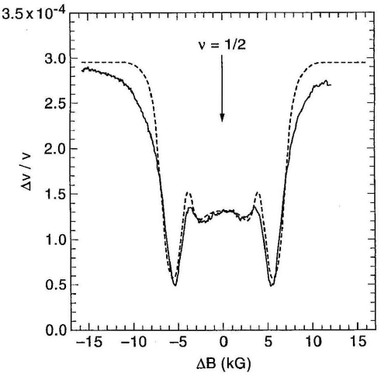
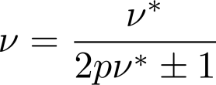
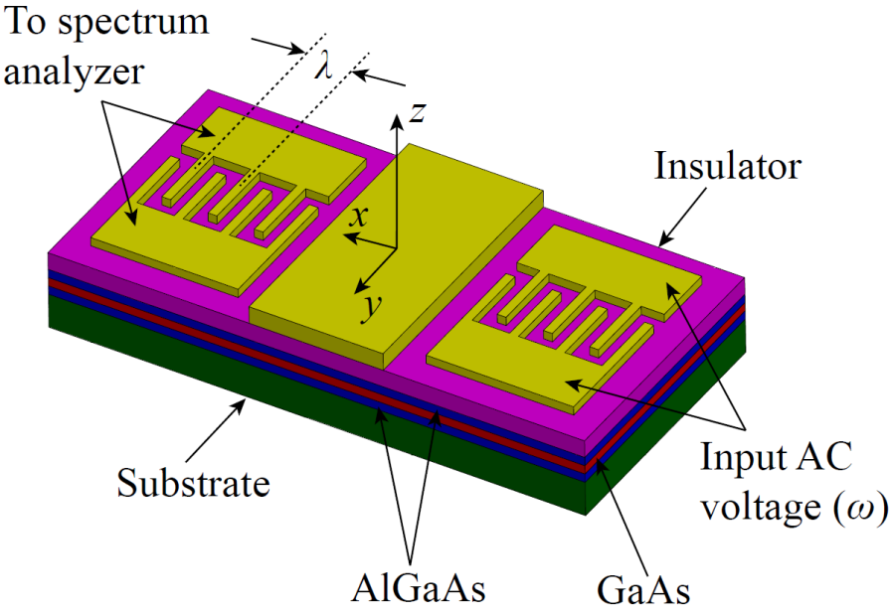
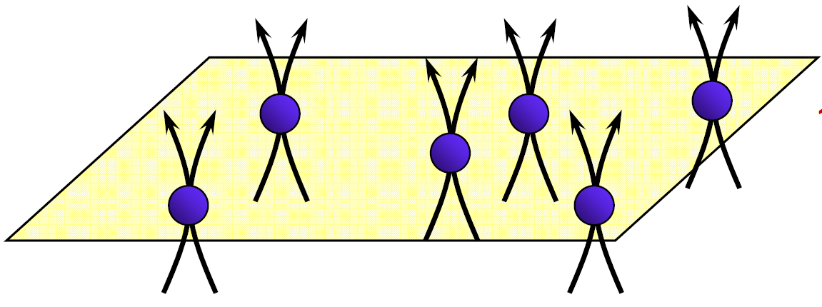
Last time: composite fermions
Review of FQHE
Laughlin states ν = 1/m
theory
Haldane’s hierarchical construction
Composite fermion “trick”
experiment
HLR: Composite fermion “theory”

Slide 3
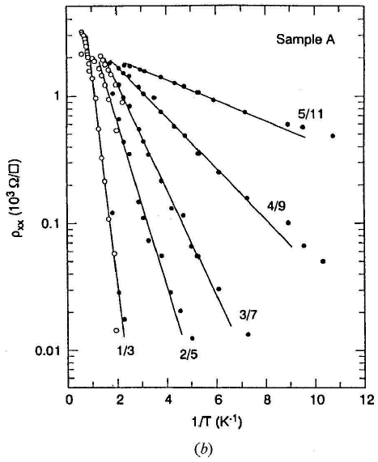
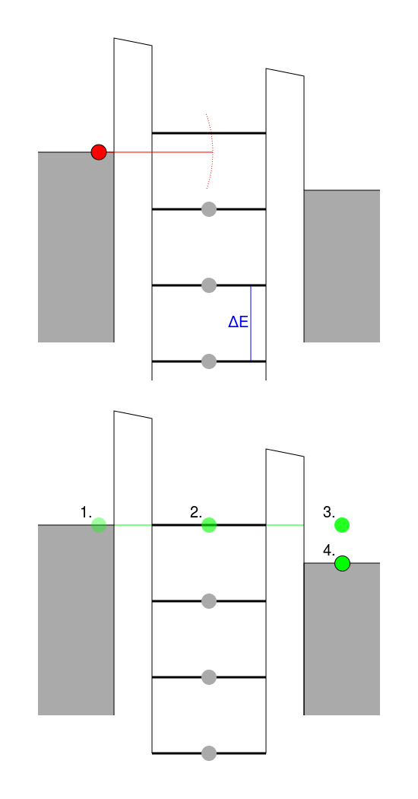
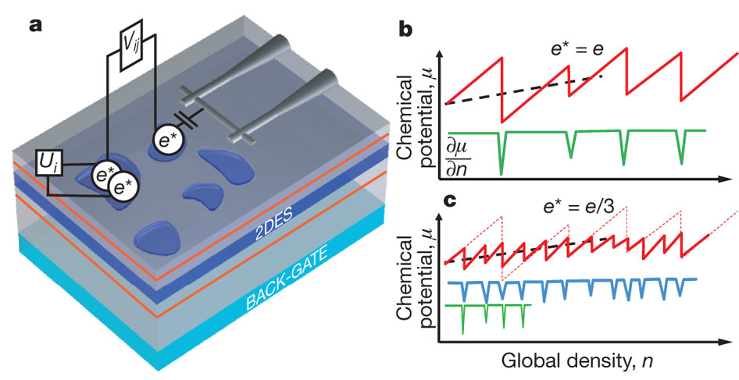
Review of FQHE experimental techniques
Measuring bulk energy gap
Arrhenius-type thermal activation energy
Orbital and spin components included in Δ_{total}
Local compressibility measurements

Slide 4
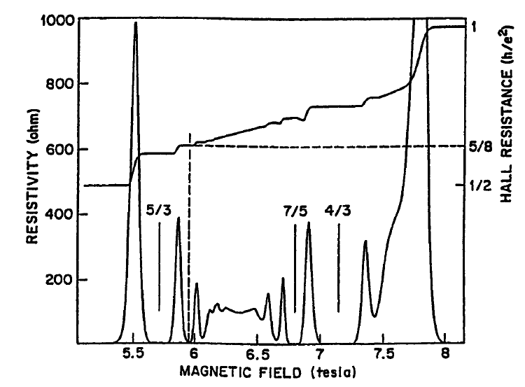
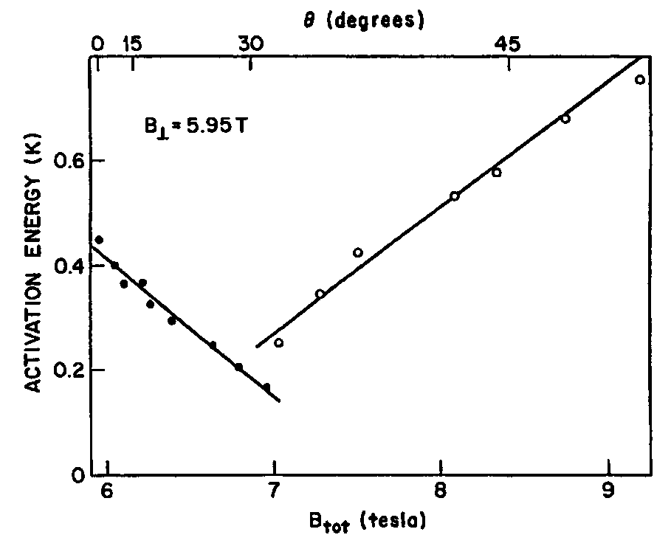
The case of ν = 2/5
Tilted Field Technique
“Daughter state” of ν = 1/3
Test effect of in-plane B-field in particle-hole conjugate state ν = 8/5 (2 – 2/5)

Slide 5
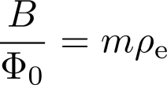
Accuracy of the spinless approximation
Spin DOF in FQHE in GaAs
Explicit Laughlin wavefunction
Halperin points out inconvenient detail
Example: ν = 1/3 Laughlin state
Compare energy scales for ν = 1/3 Laughlin state

Slide 6
Two-component FQHE
Spin DOF in FQHE in GaAs
Explicit Laughlin wavefunction
Halperin’s generalization of the Laughlin wavefunction
Flux-particle relation
Case {m, m, m} ⇒ Laughlin ν = 1/m state

Slide 7
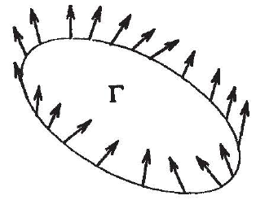
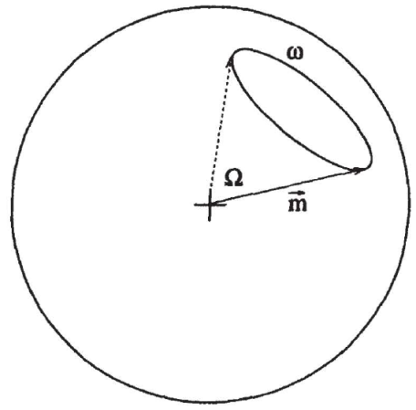
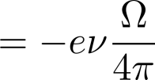
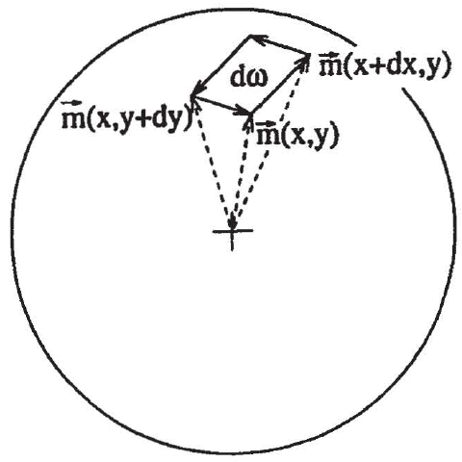
Topological defects in FQHE
Skyrmions: closer look at Laughlin quasiparticle
Real charge enclosed in region Γ
Overall phase across Γ = Berry + Aharonov-Bohm
Generalized Laughlin argument
Infinitesimal square loop

Slide 8
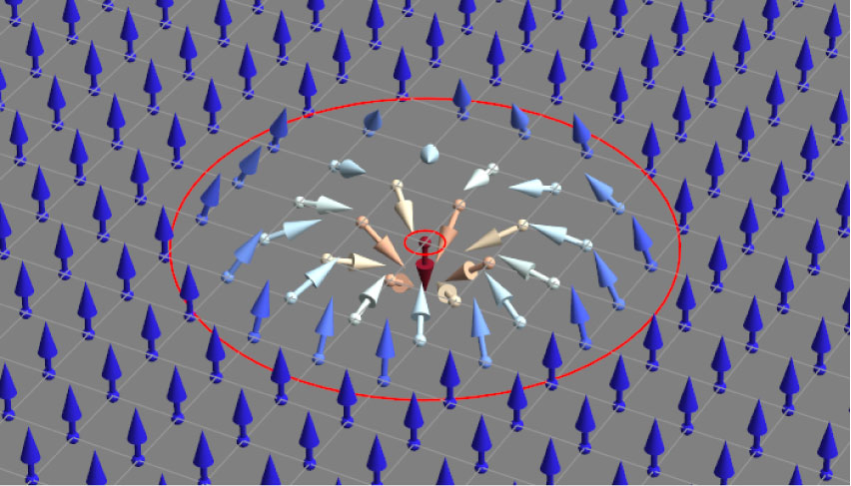
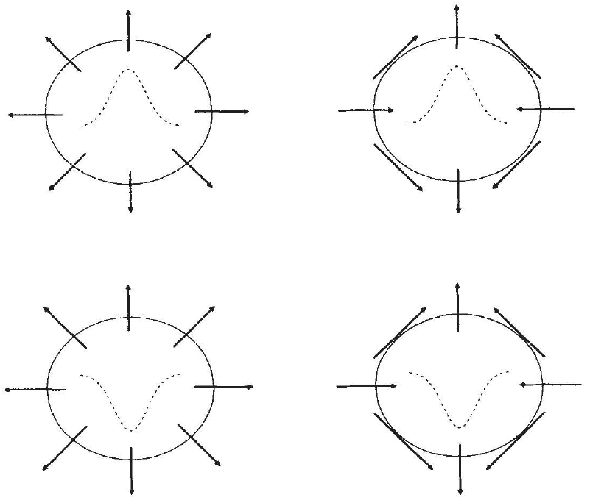
Topological defects in FQHE
Skyrmions and merons
Real charge enclosed in region Γ
Skyrmion with unit winding traps e/m charge
Break SU(2) ⇒ meron = half skyrmion ⇒ charge = e/2m
Four types of merons
Skyrmions as charged meron bound states (gapped)
Neutral bound states ⇒ spin waves (gapless)

Slide 9
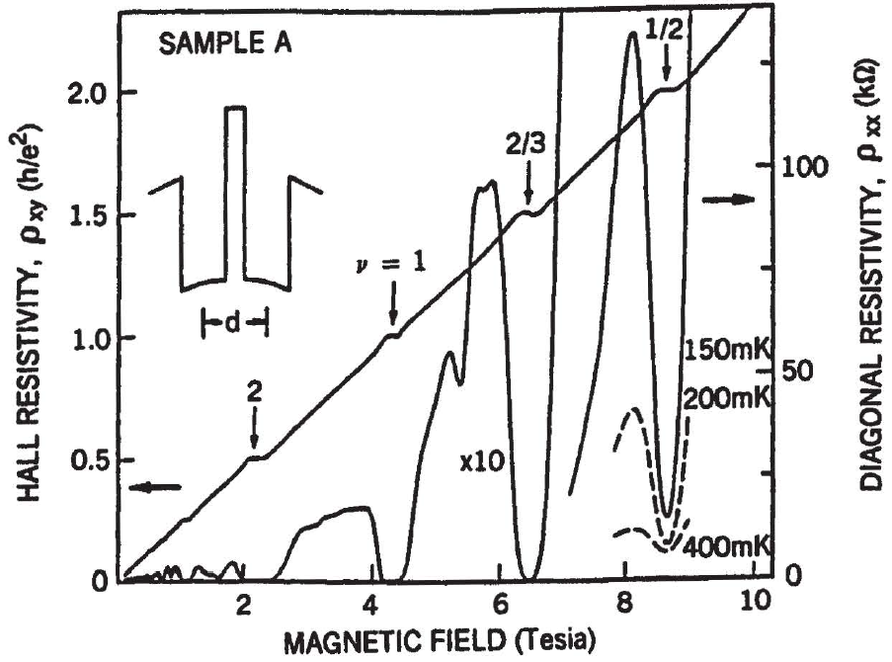
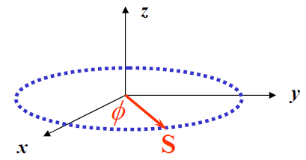
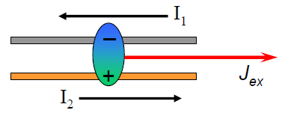
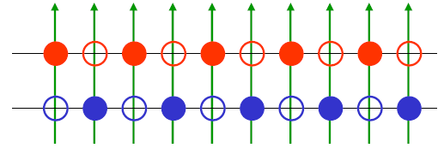
Bilayer FQHE
The ν = 1/2 “QHE”
Layer DOF ⇒ pseudospin
ν = 1/2 = 1/4 + 1/4
Halperin wave function
Superfluid at ν = 1 = 1/2 + 1/2
Halperin wave function

Slide 10
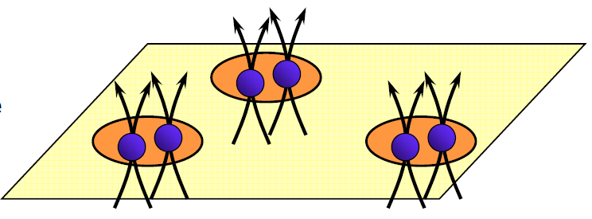
Moore-Read state
The Pfaffian wave function
Recall Halperin-Lee-Read (HLR) wave function
Wave function for the Moore-Read (MR) phase
 | B = 0 | B ≠ 0
Metal | Fermi liquid | HLR phase
Superconductor | BCS | MR phase
BCS wave function ansatz

Slide 11
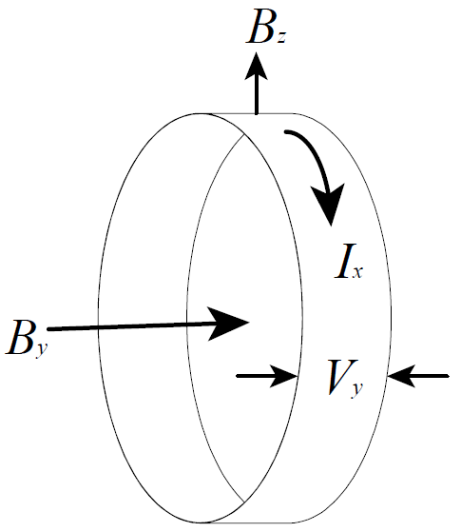
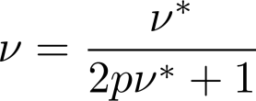
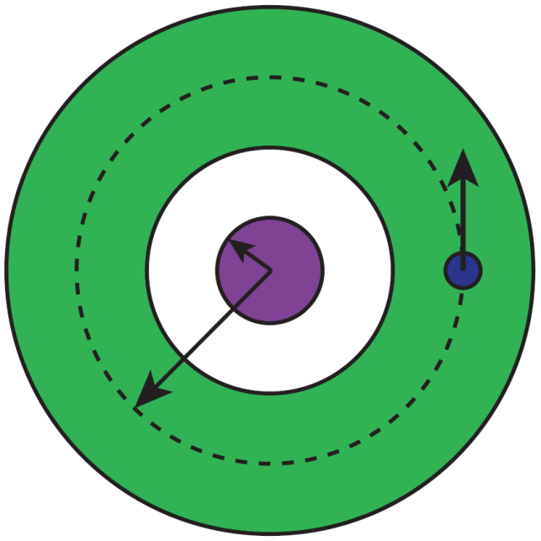
Back to gauge arguments
QHE vs. Superconductivity
QHE: Laughlin gauge argument
Bottom-line: no excitations smaller than ϕ₀
Superconductor: complex order parameter
With cooper pair charge q = 2e and single-valued Δ
Moore-Read state: only 2 quasihole excitations possible
Each quasihole carries “e/4” quasiparticle

Slide 12
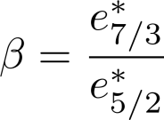
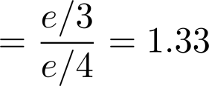
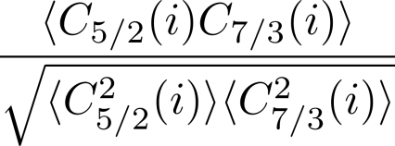
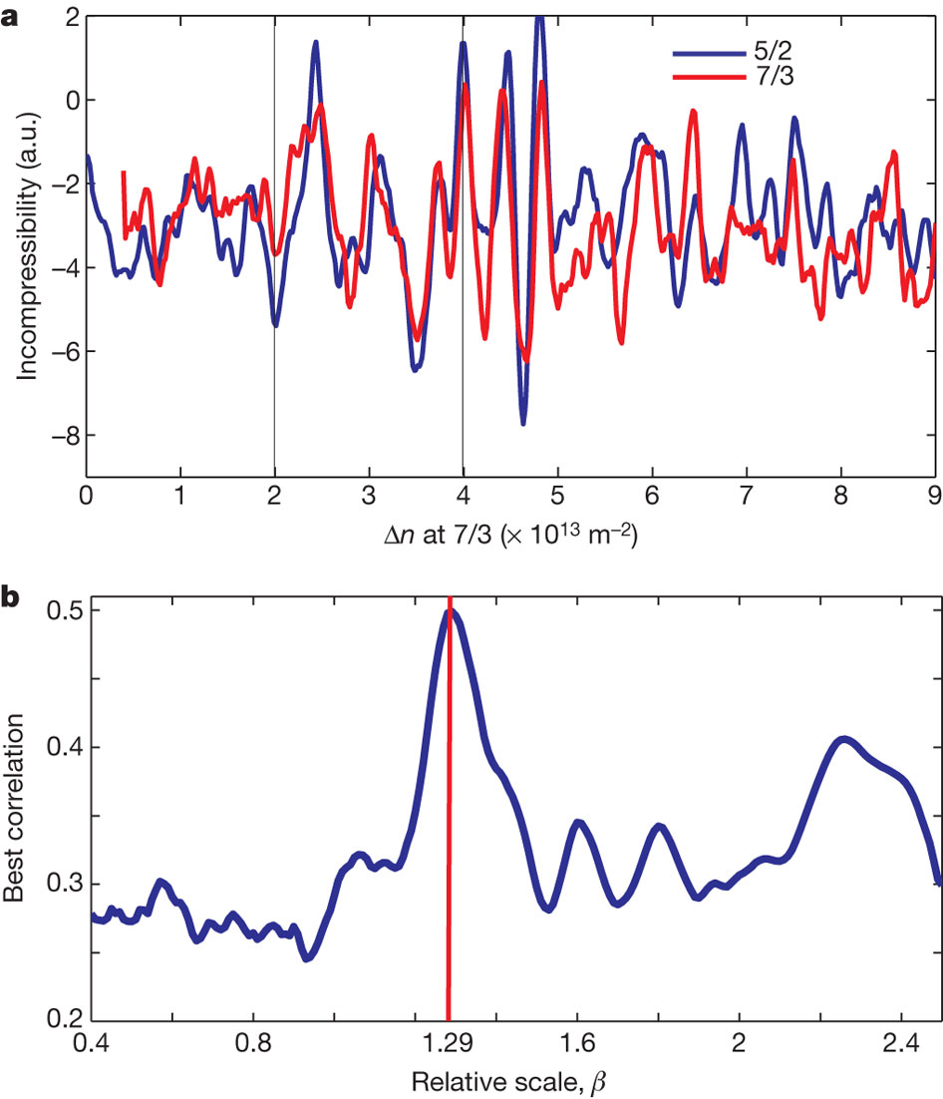
Detecting Moore-Read quasiparticle
Local compressibility measurements
Ratio of charge quasiparticles
Measure correlation function

Slide 13
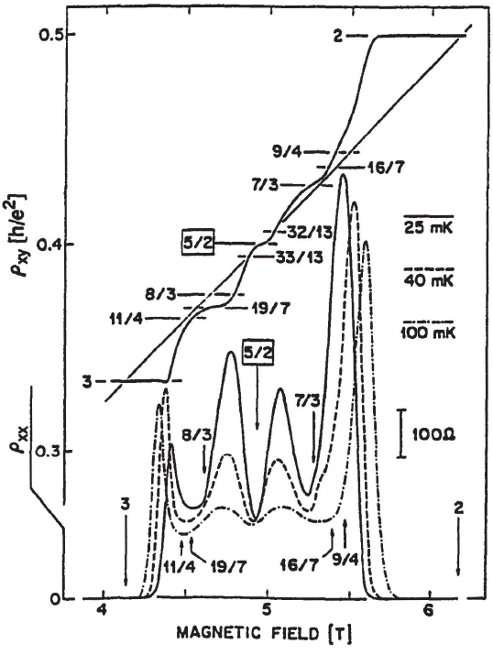
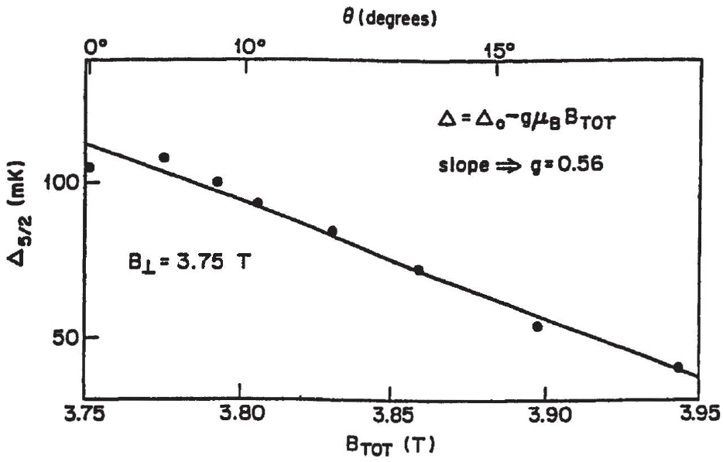
ν = 5/2: polarized or unpolarized?
Instability in tilted field measurements

Slide 14
Summary and Conclusions
Part 1: Composite fermions
Convenient FQHE to IQHE mapping
Halperin-Lee-Read (HLR): metallic state at single layer ν = 1/2
Part 2: Multicomponent FQHE
Quantum Hall Ferromagnetism
Topological spin excitations
Excitonic superfluidity in bilayer system

Slide 15
Thanks for listening
Questions?

