Slide 1
Introduction to even-denominator FQHE: composite fermions
Tejas Deshpande
Journal club: 11 November, 2014

Slide 2
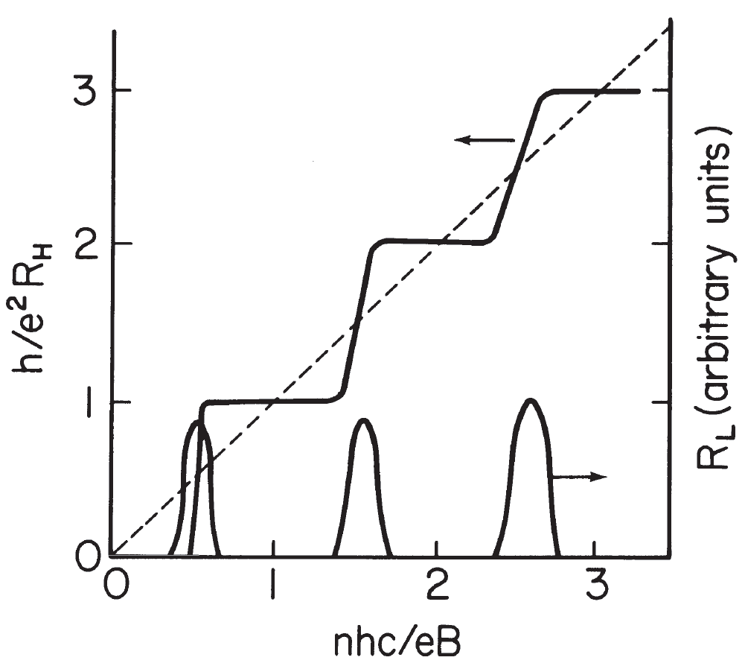
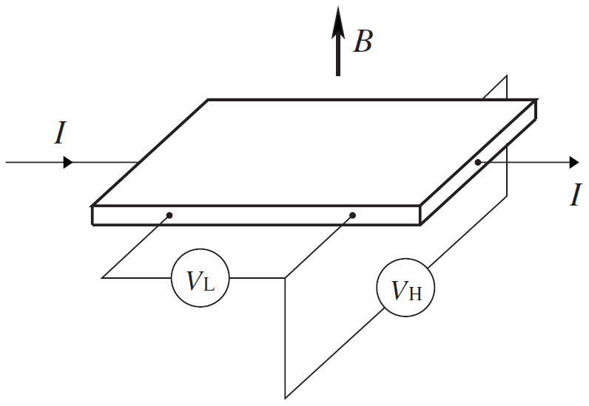
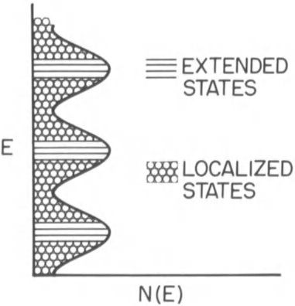
Integer Quantum Hall Effect
Phenomenology
von Klitzing sees IQHE in silicon MOSFET in 1980
Landau level Filling fraction or Hall conductivity:
Landau level degeneracy = total number of flux quanta (N_{ϕ})

Slide 3
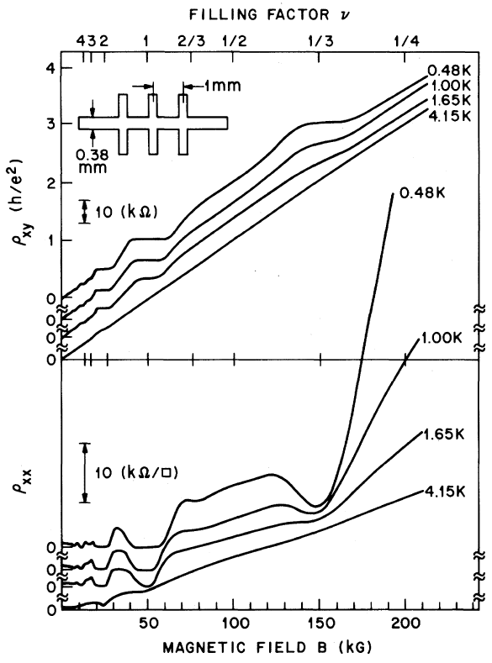
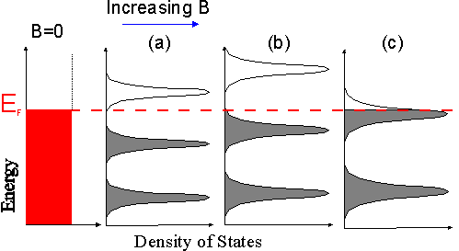
Fractional Quantum Hall Effect
Phenomenology
Tsui & Stormer see ν = 1/3 in GaAs quantum well in 1982
Landau level Filling fraction or Hall conductivity:
Partially filled non-interacting Landau level (n + p/q ≡ p/q)

Slide 4
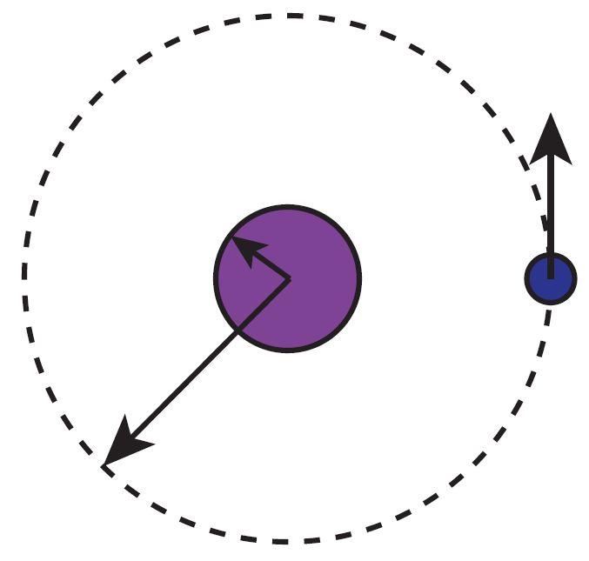
Aharonov-Bohm Effect
Quantum effect that lacks gauge invariance
Phase picked up by a quantum particle of charge q:
Gauge choice and parameterization
Phase picked up for arc subtending angle θ in the circle
Quantum of flux is defined as:
For q = e and θ = π we have:

Slide 5
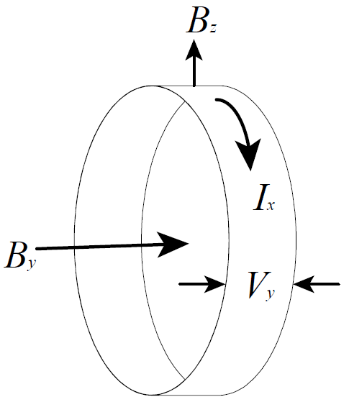
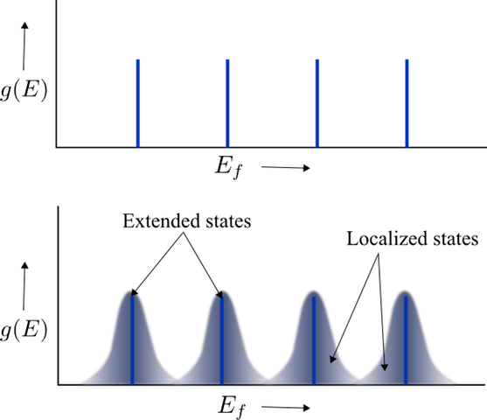
“Gauge invariance” in many disguises
Laughlin’s gauge argument
Quantization of Hall resistance from thought experiment
Gauge choices
Hamiltonian
Periodicity in x:

Slide 6
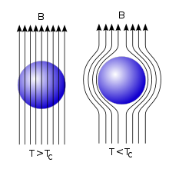
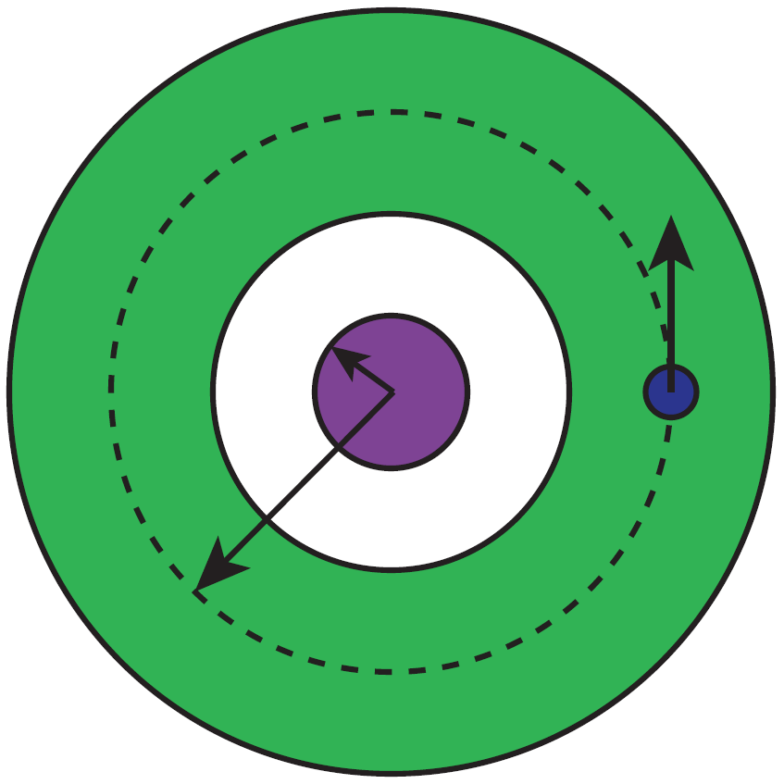
“Gauge invariance” in many disguises
Superconductivity
Also a macroscopic quantum effect like QHE
Complex order parameter
Flux quantization (Aharonov-Bohm effect)
With cooper pair charge q = 2e and single-valued Δ
Fundamental principle behind SQUIDs (Josephson effect)

Slide 7
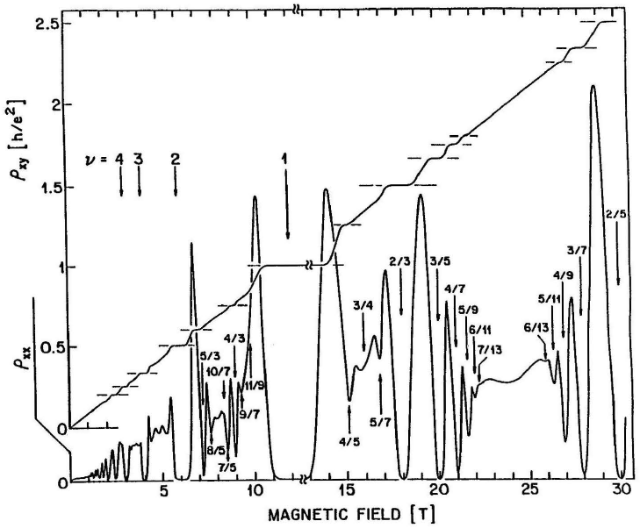
FQHE: Review of Laughlin states
Experimental Background
Wide range of fractions discovered after the 1982 discovery

Slide 8
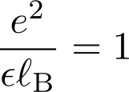
FQHE: Review of Laughlin states
Theoretical Background
Challenge: solve Schrodinger’s equation
Important energy/length scales
Units
Laughlin writes many-body wavefunction ansatz for a specific set of FQHE states with ν = 1/m

Slide 9
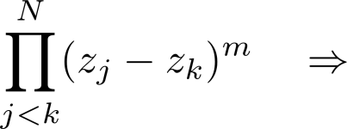
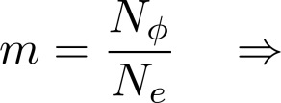
FQHE: Review of Laughlin states
Laughlin wavefunction
Laughlin wavefunction ν = 1/m FQHE states (with units)
What does it mean?
It vanishes as any two electrons approach each other due to:
repulsion between electrons
Larger m ⇒ electrons farther apart ⇒ larger angular momentum
larger m ⇒ lower electron density
Electrons within ℓ_{B} feel “attraction” to the origin; analogous to classical 2D plasma ⇒ Boltzmann probability distribution

Slide 10
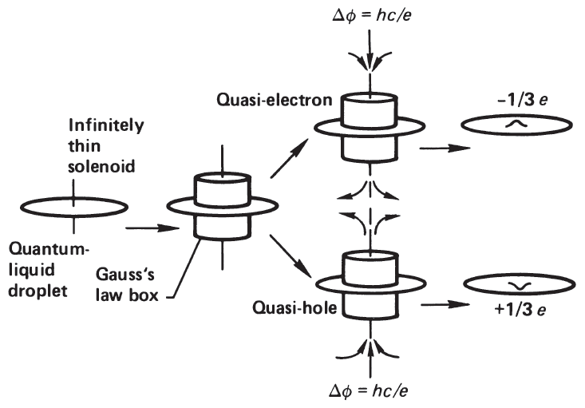
FQHE: Review of Laughlin states
Laughlin quasiparticle
Laughlin wave function describes ground state of charge e electrons
Where do charge e/m anyons come from?
Excitations create anyons. What causes excitations?

Slide 11
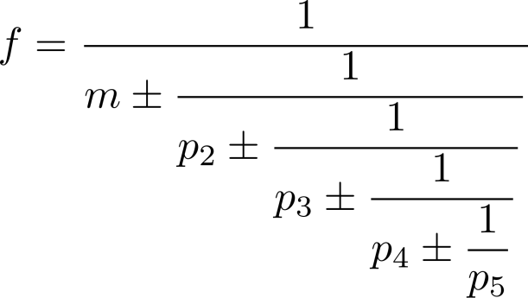
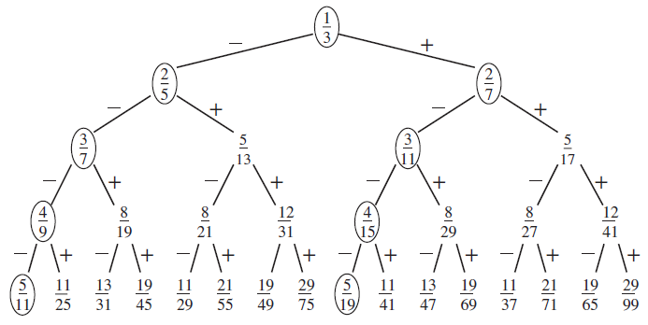
FQHE: Haldane’s hierarchical structure
“Daughter” states
Haldane proposed hierarchical construction for other fractions
FQHE of Laughlin quasiparticles of the 1/m state

Slide 12
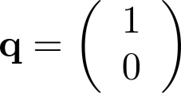
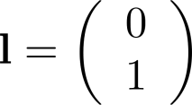
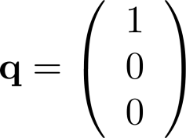
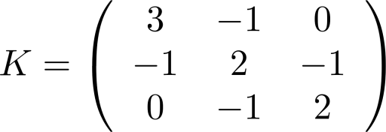
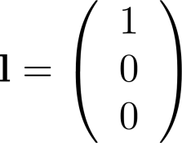
FQHE: Review of the K-matrix
Example of ν = 2/5 and 3/7: “Shut up and calculate!”
Chern-Simons effective theory
Formulas for ν and quasiparticle charge (Q)
ν = 2/5 from Laughlin state ν = 1/3
ν = 3/7 from daughter state ν = 2/5
K matrix dimension equal to the hierarchy level

Slide 13
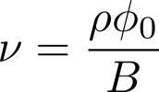
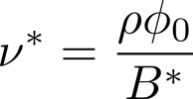
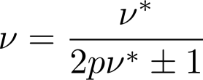
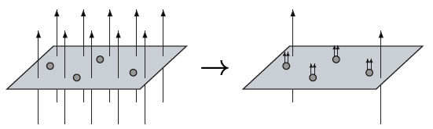
Composite fermion “trick” (or theory)?
Mapping to IQHE
Composite particle by “attaching” even (2p) flux quanta (h/e)
Real and effective filling factors
Physical picture of flux attachment: real electron + 2p fluxes ⇒ “composite fermion” (CF)
CF Landau level (Λ level) degeneracy = total effective flux quanta

Slide 14
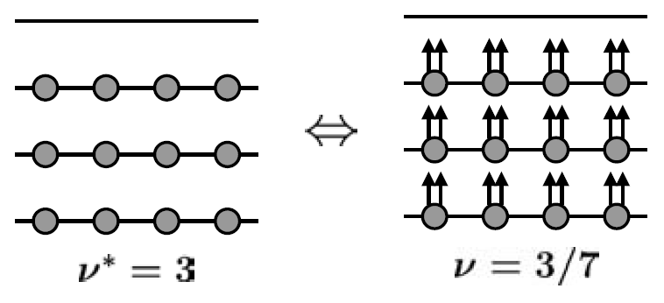
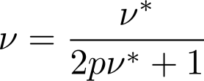
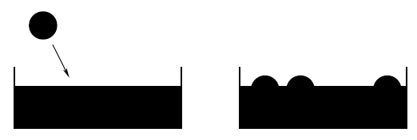
Composite fermion “trick” (or theory)?
What about Laughlin quasiparticles?
CFs carry charge -e and spin 1/2
Consider ground state at arbitrary ν (ν*)
Degeneracy of each Λ level:
Add a real electron to (ν* + 1)^{th} Λ level (local excitation)
Modified degeneracy of each Λ level:
Each Λ level contributes to 2p CF-quasiparticle excitations
Total (2pν* + 1) CF-quasiparticles = external electron
Charge on each CF quasiparticle
ν = 1/3

Slide 15
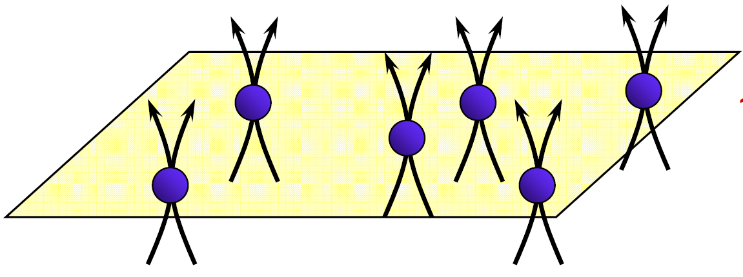
Halperin-Lee-Read (HLR) phase
Theory of the half-filled “Landau level”?
Does the composite fermion picture have any predictive power?
HLR make hypothesis if Fermi liquid state at ν = 1/2 in 1993
Dips at other even denominator fractions
No QHE at even denominators!
No plateaus at even denominators

Slide 16
HLR phase: Chern-Simons Theory
Mathematical flux attachment
Simplest Hamiltonian of FQHE
Attach flux via gauge transformation
Transformed Hamiltonian
Fictitious magnetic field:
Fictitious and external (real) B-field cancel on average at exactly ν = 1/2

Slide 17
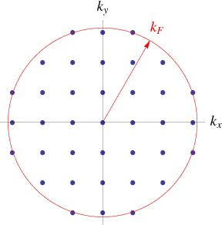
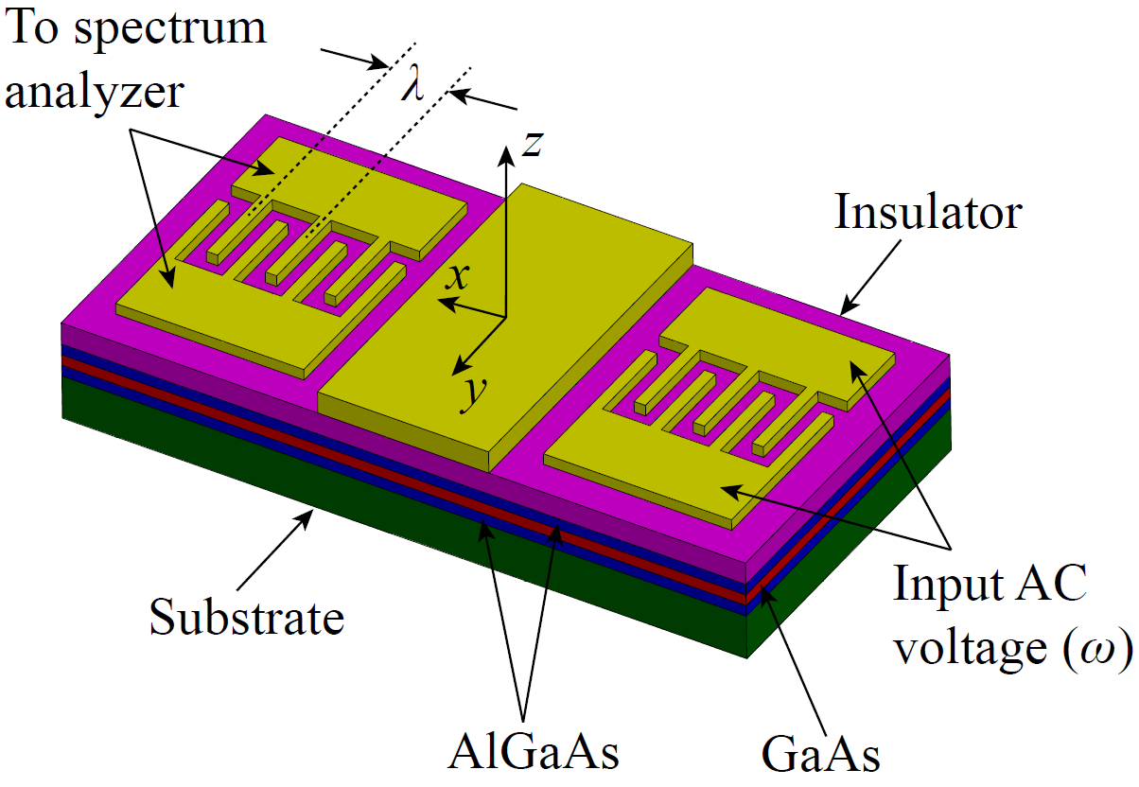
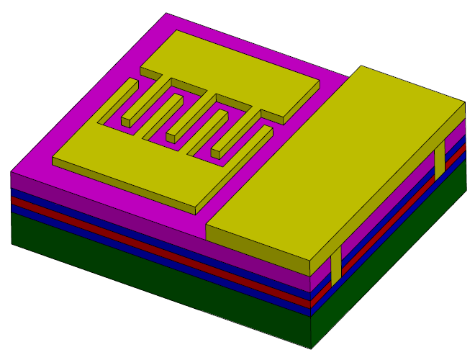
Composite fermion “theory”!
Experimental verification
Most important parameters of a Fermi liquid?
Testing biggest hypothesis: do quasiparticles really see B_{eff}?
Yes! Surface acoustic wave (SAW) experiment on ν = 1/2 prove composite Fermi liquid hypothesis

Slide 18
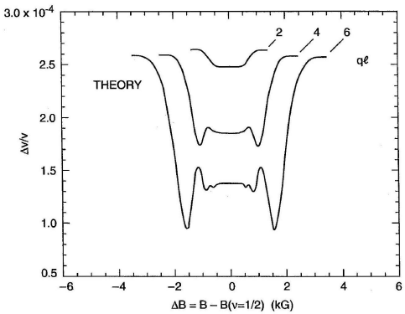
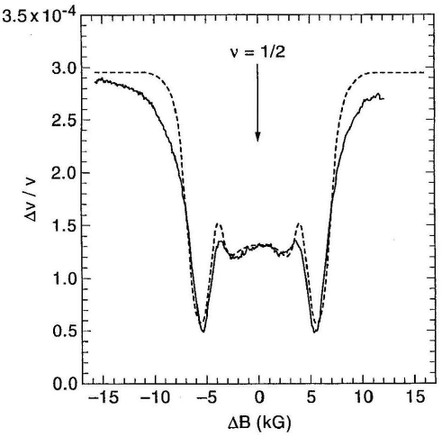
Composite fermion “theory”!
Surface acoustic wave (SAW) propagation experiment
HLR predicted SAW resonance for probe wavelength less than CF mean free path (ℓ)
theory
experiment

Slide 19
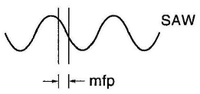
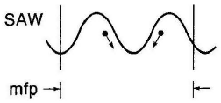
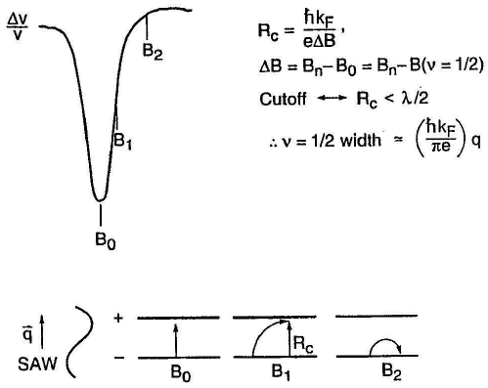
Composite fermion “theory”!
SAW interpretation

Slide 20
Composite fermion “theory”!
Mass of a composite fermion
Cyclotron gap between Λ levels?

Slide 21
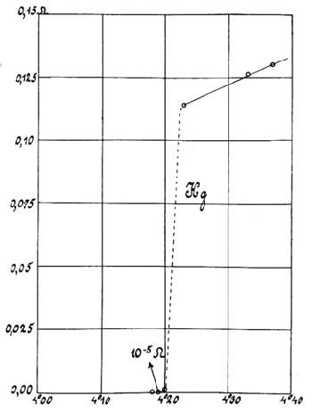
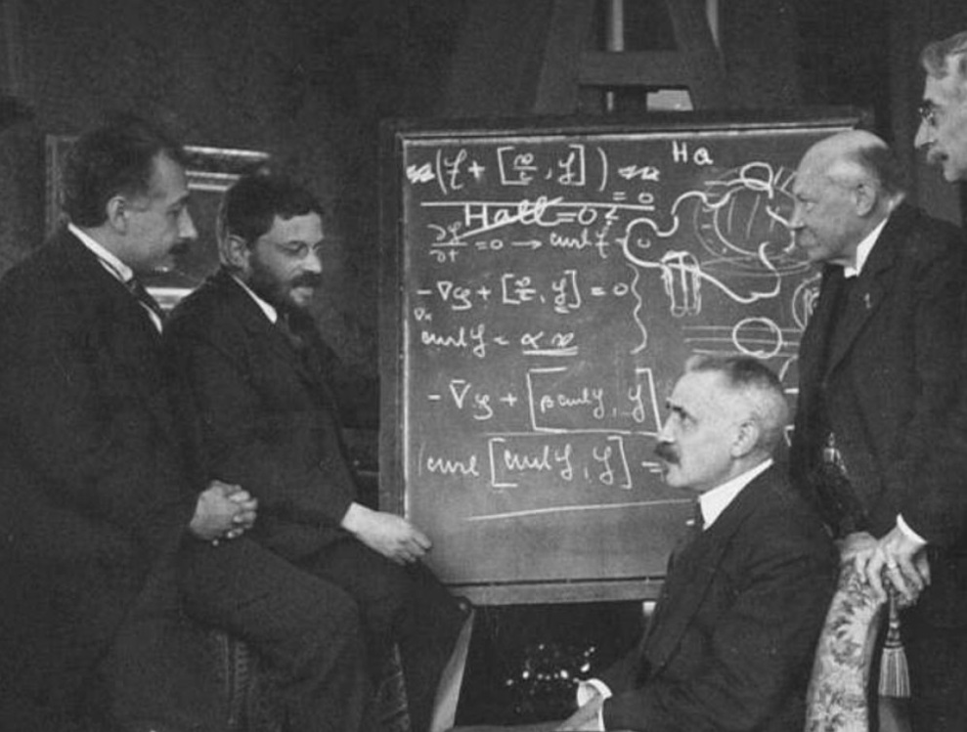
Odd-denominator states as “composite bosons”
Non-composite fermion flux attachment schemes
Heike Kamerlingh Onnes produces liquid ⁴He on 10 July, 1908
On 8 April, 1911 he discovered superconduct-ivity in a solid Hg wire at 4.2 K
Quantum origins of superconductivity a mystery until 1957
Einstein, Ehrenfest, Langevin, Kamerlingh Onnes, and Weiss at a workshop in Leiden October 1920. The blackboard discussion, on the Hall effect in superconductors

Slide 22
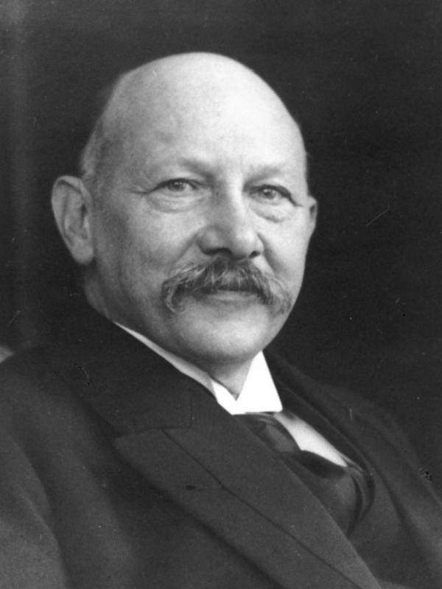
Closing remarks: spin DOF?
QHE in GaAs
Heike Kamerlingh Onnes produces liquid ⁴He on 10 July, 1908
On 8 April, 1911 he discovered superconduct-ivity in a solid Hg wire at 4.2 K
Quantum origins of superconductivity a mystery until 1957
Einstein, Ehrenfest, Langevin, Kamerlingh Onnes, and Weiss at a workshop in Leiden October 1920. The blackboard discussion, on the Hall effect in superconductors

Slide 23
Closing remarks: edge states?
Composite Fermi liquid or Luttinger liquid?
Heike Kamerlingh Onnes produces liquid ⁴He on 10 July, 1908
On 8 April, 1911 he discovered superconduct-ivity in a solid Hg wire at 4.2 K
Quantum origins of superconductivity a mystery until 1957

Slide 24
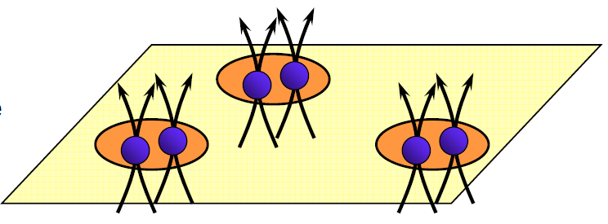
Next time: even-denominator “plateaus”
Moore-Read state (ν = 5/2 = 2 + 1/2)
Effects of composite fermion formation
Absorb flux ⇒ metal in zero B-field at even denominators
Absorb interactions ⇒ mass of composite fermions
Residual B-field ⇒ IQHE of composite fermions ⇒ odd denominators
Residual interactions ⇒ back to intractable interacting problem?
Attractive interactions? ⇒ BCS instability?

Slide 25
Thanks for listening
Questions?

