Slide 1
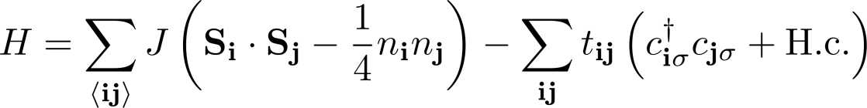

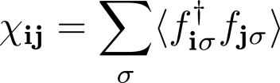


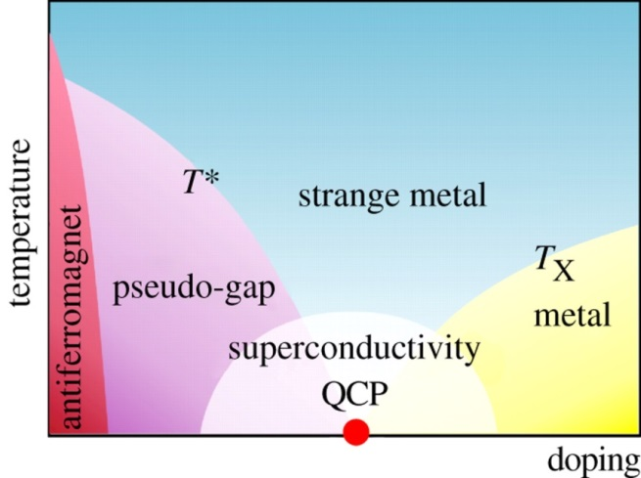
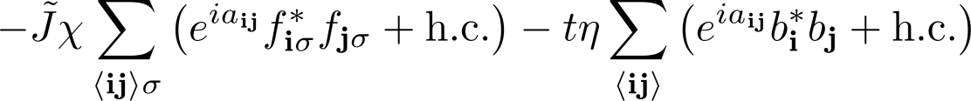
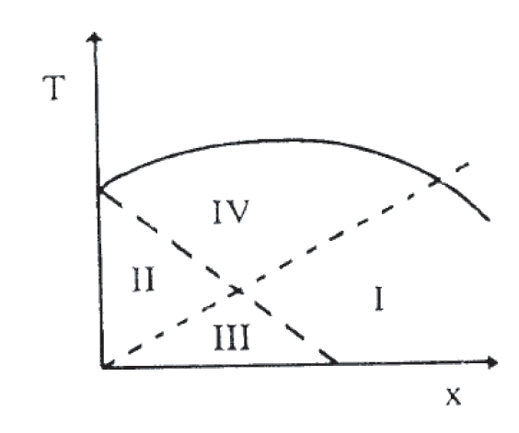
Recap: U(1) slave-boson formulation of t-J model and mean field theory
Mean field phase diagram
Label | State | χ | Δ | b
I | Fermi liquid | ≠ 0 | = 0 | ≠ 0
II | Spin gap | ≠ 0 | ≠ 0 | = 0
III | d-wave superconducting | ≠ 0 | ≠ 0 | ≠ 0
IV | uRVB | ≠ 0 | = 0 | = 0
Notes:
http://ko.com.ua/files/u15/3811522056_cb7fa96980.jpg

Slide 2
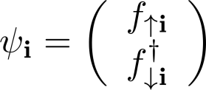
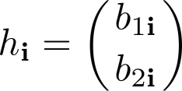
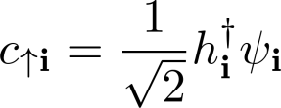
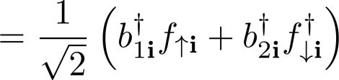
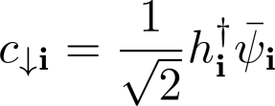
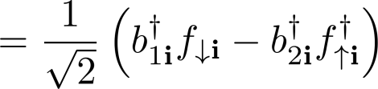

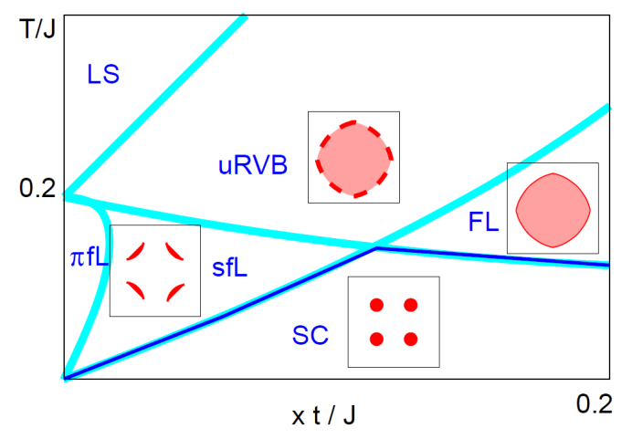
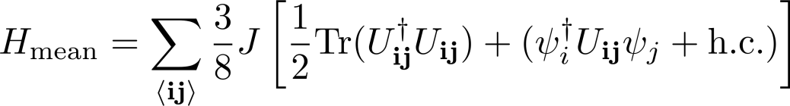
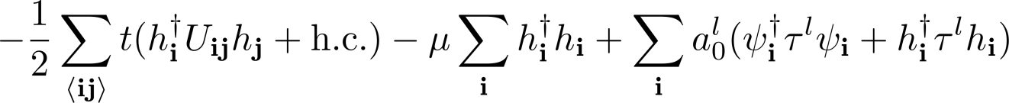
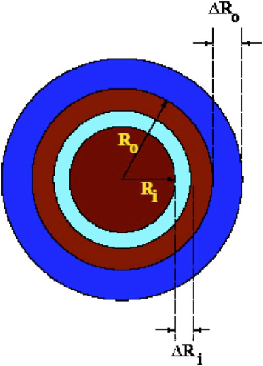
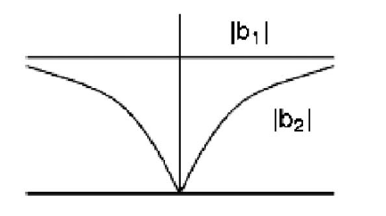
SU(2) slave-boson formulation of t-J model and mean field theory
U(1)
Mean field phase diagram
Notes:
http://ko.com.ua/files/u15/3811522056_cb7fa96980.jpg

Slide 3

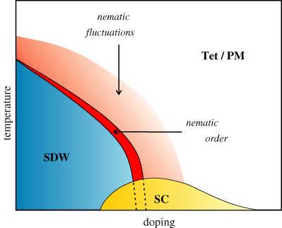
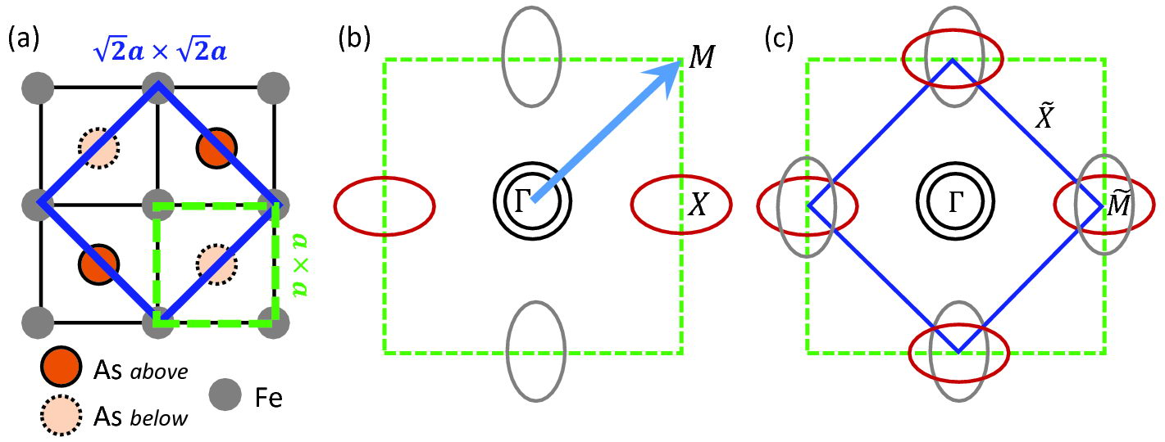
I. Introduction
A. Aim and scope
Discovery
  Discovered in 2008 by Kamihara et al. in LaFeAsO with T_{c} = 26 K
  Similarities with the cuprates
    High-T_{c}
    quasi-2D
    Almost universal phase diagram
Notes:
Before diving into the details of this paper, some disclaimers are in order:
The contents of this review article are extremely focused: the gap structure of the pnictides.
This article is far from comprehensive. Having only been discovered 5 years ago, the field of pnictides it still in its infancy and the literature is too “disorganized” or structureless for an elementary introduction.
Throughout this section of the talk, I will be making comparisons to the cuprates. Since we’re discussing the gap structure, we will primarily focus on the superconducting portion of this phase diagram.
Recall from our discussion of the cuprates that we kept focusing on the pseudogap portion rather than the superconductivity portion. That was understandable considering the fact that the pseudogap is the key to unlocking the mysteries of the cuprates. As a result, we never really focused on the superconducting dome itself! Fortunately, we do not have the pseudogap in the pnictides and we can focus entirely on the superconducting dome. Yes, the nematic phase is somewhat exotic. However, this portion of the phase diagram is still the subject of an intense debate. It’s best that any elementary discussions of pnictides stay away from the nematic phase.
Anyways, the superconducting phase of the pnictides is more complex than the cuprates because of the existence of up to 5 Fermi sheets in the first Brillouin zone.

Slide 4
I. Introduction
B. Fe-based superconductors
Comparison with cuprates
  Gap structure unclear after following experiments:
    Penetration depth
    ARPES
    NMR
    Phase sensitive Josephson tunneling
Important questions
  What is the gap structure?
  What is pairing mechanism?
  What is the role of disorder in experiments?

Slide 5
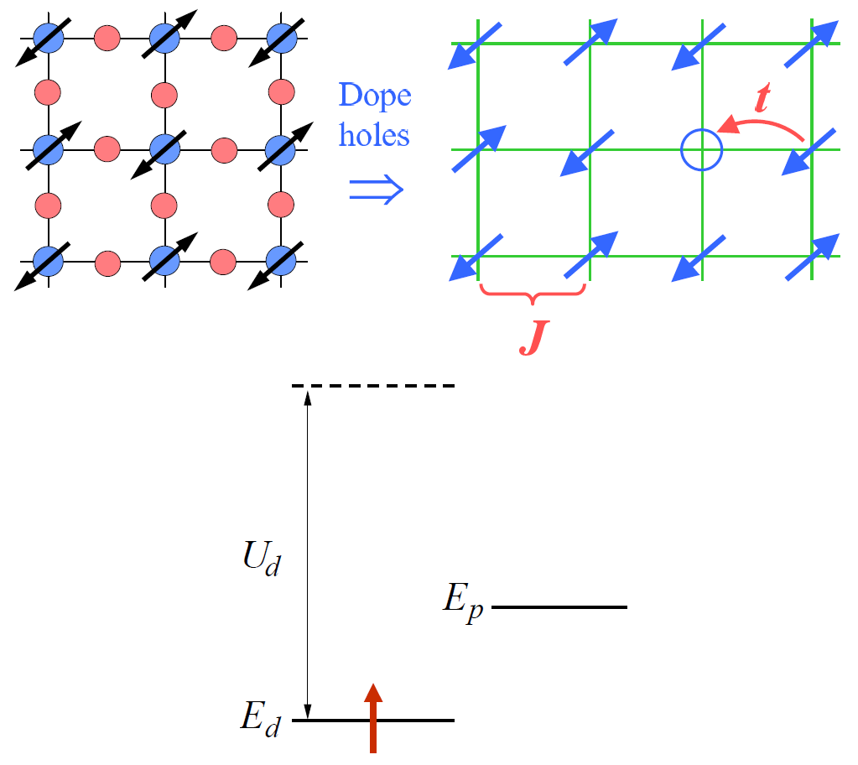
I. Introduction
B. Fe-based superconductors
Comparison with cuprates
  Fe has weaker interactions
  2p-ligands (e.g. As) lie out of Fe plane
  Multiple bands near the Fermi energy
  Undoped or parent compounds are poor metals with SDW order
  Coexistence of superconductivity and magnetism
  No robust pseudogap region
  Doping involves in-plane and out-of-plane substitution, e.g. Sr_{1-x}K_{x}Fe₂As₂, Ba(Fe_{1-x}Co_{x})₂As₂, etc.

Slide 6
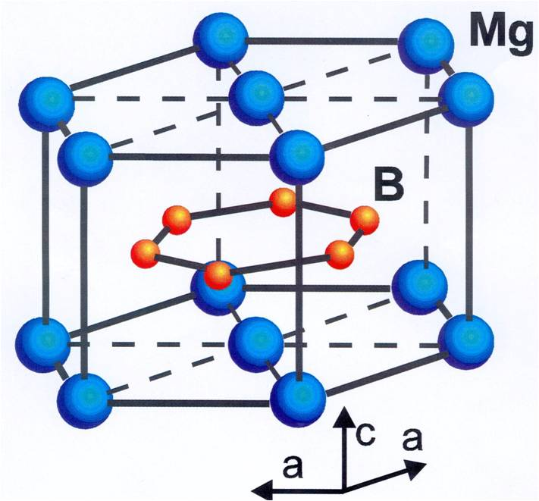
I. Introduction
B. Fe-based superconductors
Comparison with MgB₂
  First example of multigap superconductivity
  T_{c} = 40 K ➔ higher than first cuprate!
  Type-II multiband BCS superconductor
Conceptual importance
  Not an improvement from pratical standpoint
    T_{c} lower than cuprates (maximum 55 K)
    Expensive to fabricate and difficult to work with
  Pnictides demonstrated cuprate properties are not unique to high-T_{c}
  Differences in cuprates and pnictides highlight critical ingredients of high-T_{c}
Notes:
A once popular joke asked how a physicist would interpret experimental data on odd numbers. As the first experiments reveal that 1, 3, 5 and 7 are all prime numbers, the physicist becomes convinced that all odd numbers are prime and that a correct theory of 'primeness' should be able to explain this experimental fact. Further studies, however, show that 9 is not a prime number. The community initially disregards this as an experimental error; however, after more experiments, the researchers are forced to admit that 9 is indeed not prime, making it a unique case. This view is reinforced when further experiments show that the next odd numbers in the series, 11 and 13, are both prime. Only after it is found that, in violation of 'conventional wisdom', 15 is not a prime number, does the idea that there are infinitely many odd numbers, but not prime numbers, take root in researchers' minds.

Slide 7
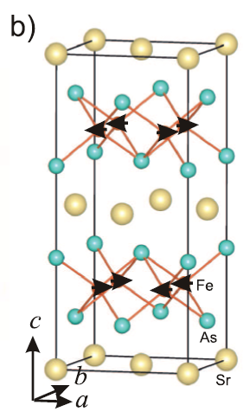
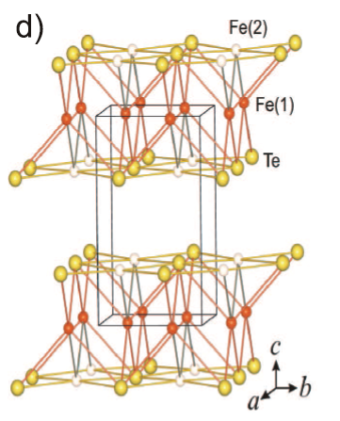
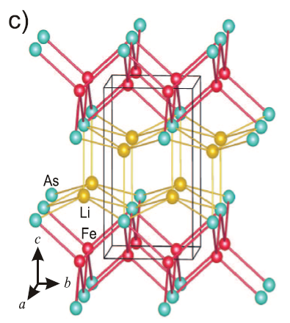
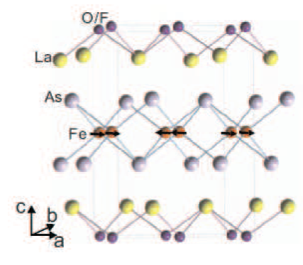
I. Introduction
B. Fe-based superconductors
Families of pnictides/chalcogenides
  1111 family ➔ LaFeAsO ➔ LaFeAsO_{1-x}F_{x}
  122 family ➔ SrFe₂As₂
  111 family ➔ LiFeAs
  11 family ➔ FeTe
Notes:
A once popular joke asked how a physicist would interpret experimental data on odd numbers. As the first experiments reveal that 1, 3, 5 and 7 are all prime numbers, the physicist becomes convinced that all odd numbers are prime and that a correct theory of 'primeness' should be able to explain this experimental fact. Further studies, however, show that 9 is not a prime number. The community initially disregards this as an experimental error; however, after more experiments, the researchers are forced to admit that 9 is indeed not prime, making it a unique case. This view is reinforced when further experiments show that the next odd numbers in the series, 11 and 13, are both prime. Only after it is found that, in violation of 'conventional wisdom', 15 is not a prime number, does the idea that there are infinitely many odd numbers, but not prime numbers, take root in researchers' minds.

Slide 8
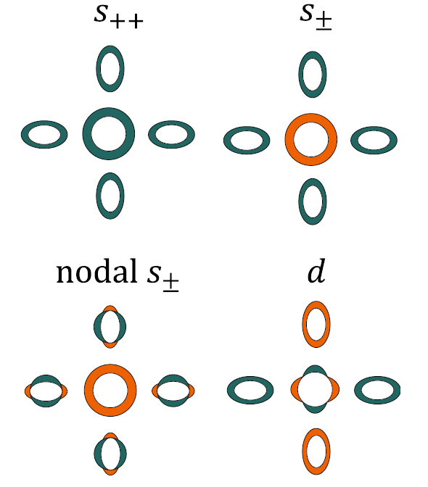
I. Introduction
B. Fe-based superconductors
Gap symmetry and structure
  Experiments ruled out triplet pairing
  s-wave and d-wave have different symmetry
  s₊₊ and fully gapped s± make sense in multiband picture
  Gap symmetry ➔ phase change in k-space
  Singlet vs. triplet ➔ phase change in spin-space (no spin-orbit coupling)
  Gap “structure” ➔ everything else! e.g. phase change across Fermi sheets

Slide 9
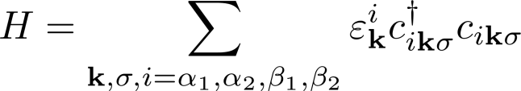
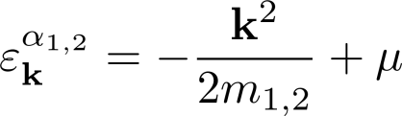
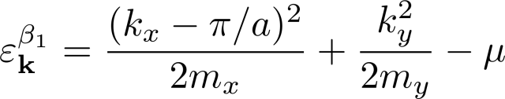
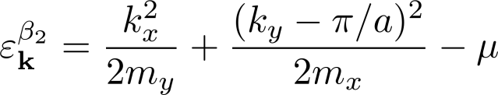
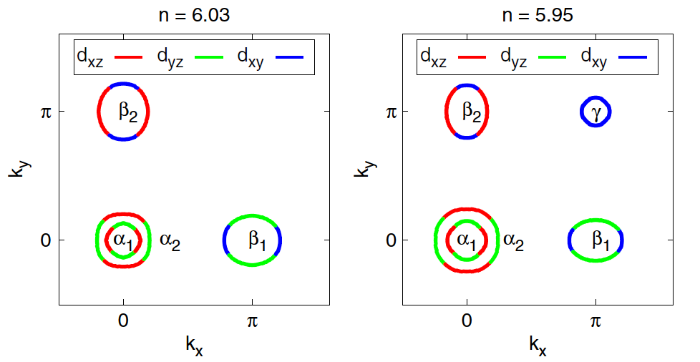
II. Electronic structure
B. Minimal band models
Multiband nature
  Unit cells ➔ “folded” (blue) and “unfolded” (green)
  Treat height of Arsenic as a perturbation
  Simplest model in “unfolded” zone
  Fermi sheets for electron-hole doped case (Fe²⁺ ➔ 3d⁶)
Notes:
Let us first write down the simplest possible non-interacting portion of the tight-binding Hamiltonian which can reproduce the general features of experiments and is consistent with ab-initio calculations.
As you saw in the last couple of slides, here is the crystal structure for FeAs layers. The arsenic atoms color coded in a different fashion differentiate the atoms lying above and below the Fe-plane. At first glance this 2 × 2 checkerboard-like patterned square appears to be the unit cell. However, upon careful observation, it can be noted that the unit cell can be defined more cleverly as this blue box. Consequently we have cut down the number of iron atoms per unit cell from 3 to 2. As we’ll see shortly, we need to consider up to five orbitals per iron atom. While writing down the tight-binding Hamiltonian, it would be even more convenient if we only had one iron atom per unit cell. As it turns out, this can be done by tweaking the tight-binding parameters slightly. Just as the oxygen does not play any role in the low-energy electronic properties of the cuprates, the out-of-plane displacement of arsenic atoms does not influence the low-energy dynamics of the pnictides. To that end, we further shrink down the unit cell to this dotted green box and treat the displacement of the arsenic atom as a perturbation. This theoretical transformation is also referred to as “zone folding.” These bottom two pictures show the respective Brillouin zones in the two folding schemes.
After performing be simplifications we can write down the noninteracting are hopping term of the Hamiltonian in an already diagonalized form. Be careful of the index “i”. It labels two electron and two hole bands and not lattice site. The dispersion of the hole bands, denoted by α, can be written in the usual quadratic form. Note that the minus sign denotes dispersion below the chemical potential; hence it’s a hole band. These two hole bands are centered at the Γ point shown here. The two electron bands, denoted by β, are centered at the edges of the BZ and disperse upward compared to the Fermi energy; hence the positive sign.
Note that Fe is in the 2+ oxidation state which corresponds to six electrons in the 3d orbital. Therefore the deviation of n from 6 represents doping. It’s worth noting that for whole doping a fifth Fermi sheet, denoted by γ, also appears at the edge of the BZ.

Slide 10
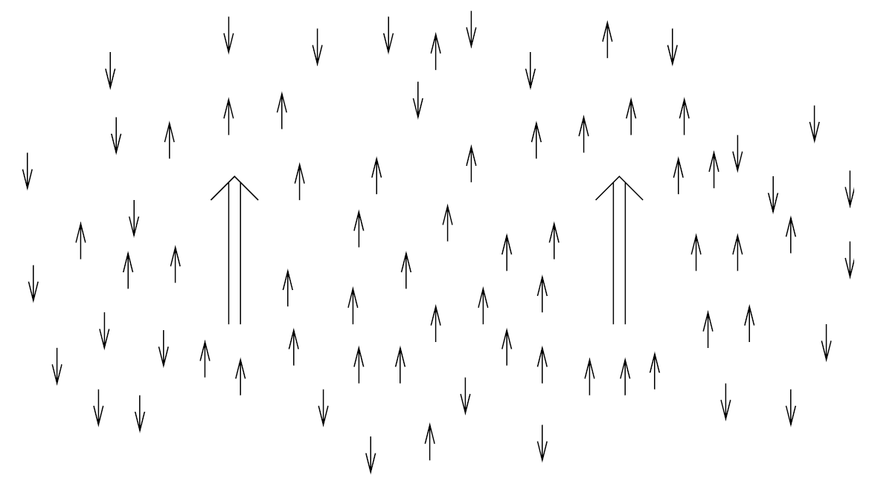
III. Theoretical background
A. Spin fluctuation pairing
Historical: ferromagnetic spin fluctuations
  Transition metals near ferromagnetism
  Exchange of “paramagnons”

Slide 11
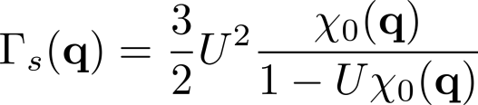
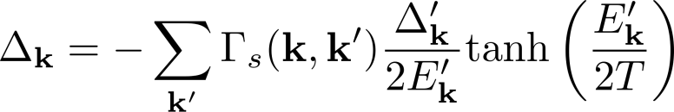
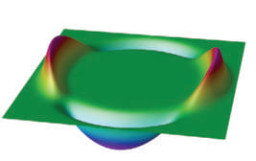

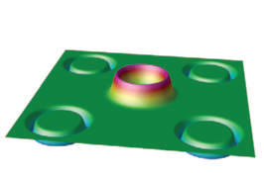
III. Theoretical background
A. Spin fluctuation pairing
Antiferromagnetic spin fluctuations
  Susceptibility strongly peaked near Q
  Singlet interaction (always repulsive)
  Self-consistent BCS gap equation
  Solution possible for
  In cuprates, χ is peaked at Q = (π, π)
  In pnictides, χ is peaked at Q = (π, 0) ➔ s± pairing

Slide 12
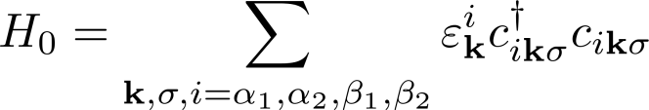

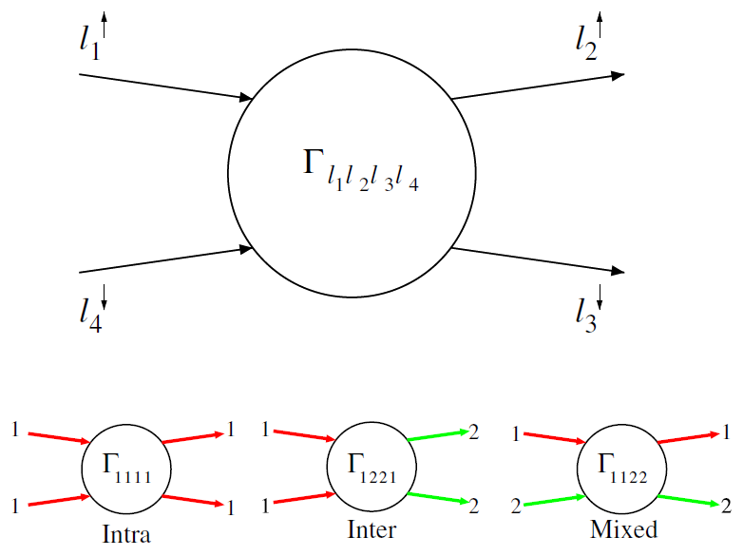



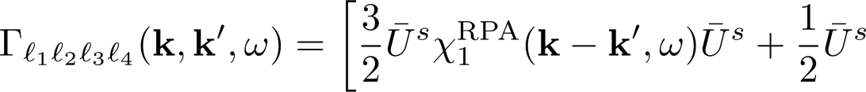
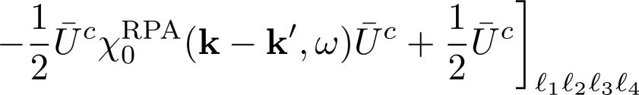
III. Theoretical background
A. Spin fluctuation pairing
Spin fluctuation pairing in multi-orbital systems
Hund’s coupling
  Effective pair scattering vertex between bands i and j in the singlet channel
  Orbital vertex functions
Spin fluctuations
Charge/orbital fluctuations
Notes:
Now, let’s develop a microscopic theory for this so-called “spin fluctuation pairing.” The case of pnictides we have multi-orbital system. It should be relatively straightforward to repeat this analysis for single-orbital systems like cuprates. It is important to stress that “multi-orbital” models don’t always mean multi-band systems. Explicitly stating that this is a multi-orbital model means we are considering different orbitals on the same atom (i.e. Fe).
Just as a reminder, here is the Fermiology of the pnictides. Recall the non-interacting Hamiltonian discussed a few slides ago. To induce pairing we naturally need to include Hubbard-like interaction terms. Looking at the Fermiology it should be obvious that pairing can occur in multiple ways. The states participating in pairing interactions can be labeled by spin, orbital, and Fermi sheet.
The first interaction term represents intra-orbital Coulomb interaction. This term can potentially give rise to on-site, intra-orbital, spin-singlet pairing.

Slide 13
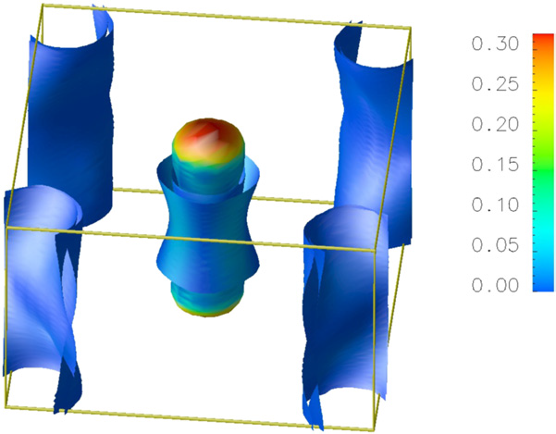

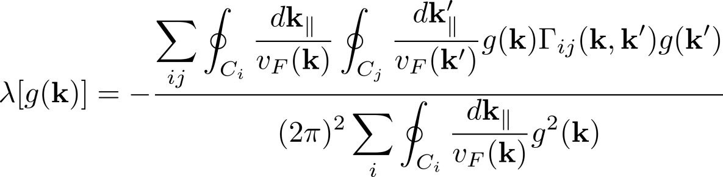

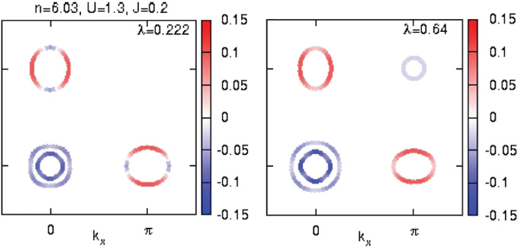
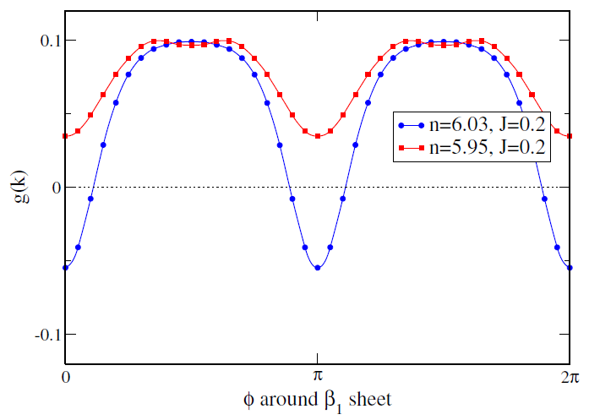
III. Theoretical background
A. Spin fluctuation pairing
Results of microscopic theory
  Gap symmetry and structure
  Orbital vertex functions

Slide 14
III. Theoretical background
A. Spin fluctuation pairing
Physical origins of anisotropy of pair state and node formation
  Intra-orbital pairing between α and β Fermi sheets ➔ favors s±
  Sub-leading inter-orbital between β₁ and β₂ Fermi sheets ➔ favors nodes ➔ frustrates s±
  Hole doping (n < 6) ➔ appearance of γ pocket
  Appearance of γ pocket ➔ β₁-β₂ scattering causes weaker s± frustration
  Height of Arsenic above Fe-plane ➔ appearance of γ pocket and isotropy of s± state in 1111 family

Slide 15
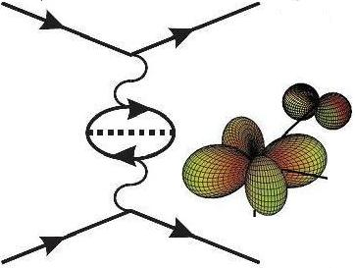
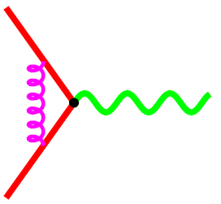

III. Theoretical background
B. Alternative approaches
Excitonic Superconductivity
  Proposed by Little and Ginzburg
  Exciton + phonon ➔ CDW ➔ suppress super-conductivity
Orbital fluctuations
  Ordering of Fe 3d orbitals possible
  Recall Hamiltonian
phonon
  Cannot have for purely electronic interactions
Orbital fluctuation
electron

Slide 16
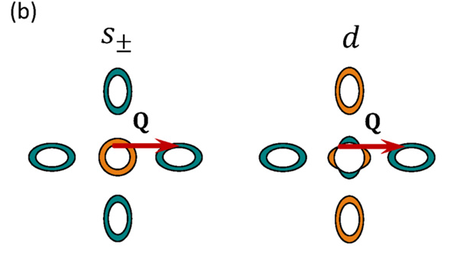
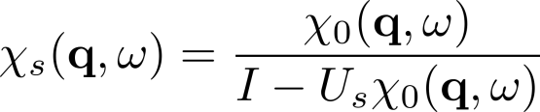
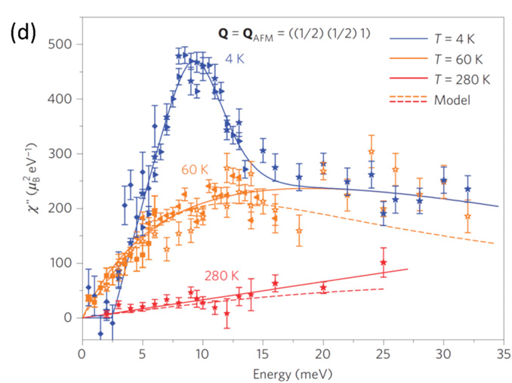
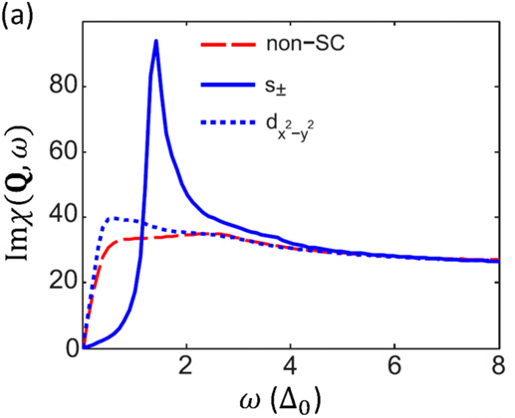
V. Gap structure
A. Does the gap in FeBS change sign?
Spin-resonance peak
  Neutron scattering ➔ dynamical spin susceptibility

Slide 17
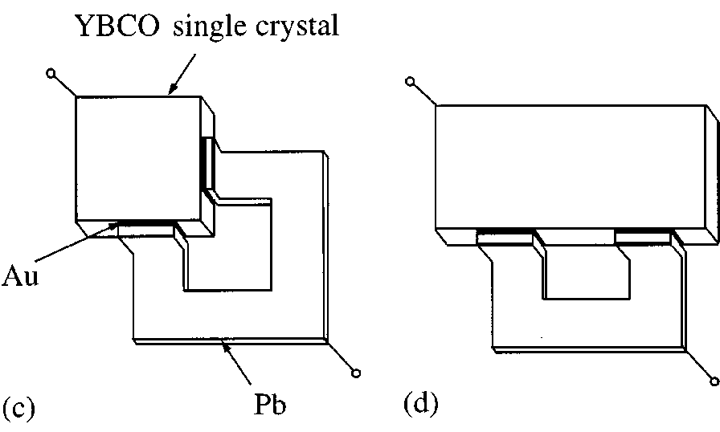


V. Gap structure
A. Does the gap in FeBS change sign?
Josephson junctions
  d-wave symmetry of cuprates confirmed by Josephson effect
  Phase shift of π between orthogonal planes
  Unfortunately pnictides don’t have spatial anisotropy
  Phase difference across electron and hole Fermi sheets for s± pairing
  Solution ➔ Measure Josephson effect across epitaxially grown interface between electron- and hole-doped pnictide

Slide 18





V. Gap structure
A. Does the gap in FeBS change sign?
Quasiparticle interference ∝
  QPI in the Cuprates
  QPI in the Pnictides ➔ no “hot spots”
  Bragg vs. QPI?

Slide 19

V. Gap structure
A. Does the gap in FeBS change sign?
Coexistence of magnetism and superconductivity
  Co-doped BaFe₂As₂ ➔ Microscopic coexistence of weak antiferromagnetism and superconductivity
  s± or s₊₊ states coexists with SDW
  In-plane thermal conductivity experiment ➔ no c-axis nodal lines
  s₊₊ pairing ➔ SDW-induced BZ band folding ➔ c-axis line nodes ➔ s₊₊ pairing cannot coexist with SDW

Slide 20

V. Gap structure
B. Evidence for low-energy subgap excitations
  Evidence for very low energy excitations consistent with gap nodes
  Bulk probes provide consistent picture of the evolution of the low-energy quasiparticle density across the phase diagram

Slide 21



V. Gap structure
B. Evidence for low-energy subgap excitations
Penetration depth
  Δλ ∝ exp(-Δ_{min}/T) ➔ fully gapped (optimally doped Ba_{1-x}K_{x}Fe₂As₂)
  Δλ ∝ T ➔ line nodes (1111 family)
  Δλ ∝ T² ➔ disorder (122 family)

Slide 22

V. Gap structure
B. Evidence for low-energy subgap excitations
Specific heat
  Nodes ➔ Volovik effect ➔ C/T ∝ H^{1/2}
  Fully gapped ➔ vortex cores states ➔ C/T ∝ H
  Fe(Te,Se) specific heat oscillations

Slide 23
V. Gap structure
B. Evidence for low-energy subgap excitations
The ARPES “paradox”
  The most direct probe of gap structure ➔ proved d-wave pairing in cuprates
  No ARPES study has seen nodes in the gap
Possible explanations of the paradox
  Surface electronic reconstruction
    Surface DFT on BaFe₂As₂ ➔ additional d_{xy} pocket
    d_{xy} pocket stabilizes isotropic pair state
  Surface depairing
    Surface roughness ➔ in-plane intraband scattering ➔ destroys gap anisotropy
  Resolution issues
Notes:
Given the common assumption that the ground state of many (but probably not all) Fe-based superconductors display anisotropic A_{1g} order, it is easy to see that the anisotropic component of the gap (whether on hole or electron sheet) will be destroyed by in-plane intraband scattering by the rough surface, since it does not conserve the parallel (to the surface) quasiparticle momentum. Thus, as one approaches the surface, the superconducting gap associated with a pair of momentum k,-k should become isotropic and the nodes lifted. The phenomenon is similar to that observed for the same type of superconducting order in the presence of intraband scattering by impurities [Mishra_09]. Surface scattering and electronic reconstruction should be smaller for non-polar surfaces which occur, e.g. in the LiFeAs material. In this case, however, spin fluctuation theory [theory_LiFeAs], thermal conductivity [tanatar_2011], penetration depth [LiFeAspendepth], ARPES [borisenko_2010] and STM [STMLiFeAs] are all in agreement that the gap is fully developed.

Slide 24

Summary
Bardeen-Cooper Schrieffer (conventional) superconductors
  Discovered in 1911 by Kamerlingh-Onnes
  Fully gapped Bogoliubov quasiparticle spectrum
  Important effects
    Vanishing resistivity
    Meissner effect (London penetration depth)
    Coherence effects (coherence length)
Heavy-fermion superconductors
  Discovered by Steglich et al. in 1979
  Key ingredients
    Lattice of f-electrons
    Conduction electrons
  Multiple superconducting phases
Notes:
Last time we covered BCS
This was followed by a brief discussion of heavy fermion superconductors
In this talk are going to cover the physics behind the very first high-temperature superconductors: the cuprates. It’s worth mentioning that this talk, despite its gigantic volume, does not even come close to being comprehensive. The field of the cuprates has a lot of controversies. There are several contending theories. This talk naturally reflects the biases of the authors the paper as well as people who think alike.

Slide 25




Summary
Electronic structure
  Relevant physics confined to 2D
  The “t-J” model
  Universal phase diagram
Phenomenology of the cuprates
  Experimental signatures of the pseudogap phase
  Nodal quasiparticles
Slave bosons
  Slave fermions and bosons
  U(1) & SU(2) gauge theory

Slide 26
Summary
Iron-based (pnictide) superconductors
  Discovered in 2008 by Kamihara
  Physics confined to 2D like cuprates
  Pseudogap replaced by “nematic phase”
Gap structure
  Theory and some experiments ➔ s±
  Contradictory experimental evidence
    ARPES
    Specific heat
    Penetration depth

Slide 27
Thanks for listening!
Questions?

Slide 28

Future Topics
Heavy fermion materials
  Not limited to superconductivity
  e.g. Kondo topological insulators
Exotic topics motivated by the cuprates
  Gauge theories and confinement physics
  Quantum critical point (QCP)
Competing interpretations of cuprate high-Tc?
  Stripe or no stripe?
  Is slave boson picture nonsense?

