Slide 1
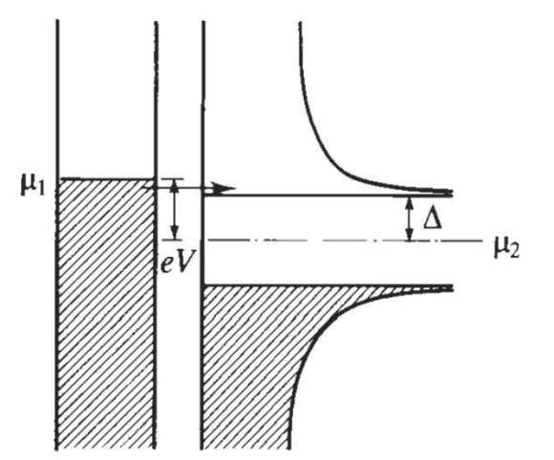
Last time: BCS and heavy-fermion superconductors
Bardeen-Cooper Schrieffer (conventional) superconductors
  Discovered in 1911 by Kamerlingh-Onnes
  Fully gapped Bogoliubov quasiparticle spectrum
  Important effects
    Vanishing resistivity
    Meissner effect (London penetration depth)
    Coherence effects (coherence length)
Heavy-fermion superconductors
  Discovered by Steglich et al. in 1979
  Key ingredients
    Lattice of f-electrons
    Conduction electrons
  Multiple superconducting phases
Notes:
Last time we covered BCS
This was followed by a brief discussion of heavy fermion superconductors
In this talk are going to cover the physics behind the very first high-temperature superconductors: the cuprates. It’s worth mentioning that this talk, despite its gigantic volume, does not even come close to being comprehensive. The field of the cuprates has a lot of controversies. There are several contending theories. This talk naturally reflects the biases of the authors the paper as well as people who think alike.

Slide 2
Cuprates overview
Introduction and Phenomenology
Experiments
  Pseudogap
  Stripes
  Nodal quasiparticles
Introduction to Resonating Valence Bond (RVB)
Phase fluctuations vs. competing order
Numerical techniques
Single hole problem
Slave particles and gauge fields
  Mean field theory
  U(1) gauge theory
  Confinement physics
Notes:
The first part, i.e. introduction of phenomenology, is obviously the basics: lattice structure, electronic structure, etc. In other words, what do the cuprates look like?
The next section, I will very quickly skim over the experiments just to give you a feel for the basic properties of the cuprates. It’s worth noting that we don’t yet have a universal theory of the cuprates. Theories come and go, but experiments are forever. Theories might get outdated; but experimental facts don’t.
The phase diagram of the cuprates contain some strange labels. One such strange people is the so-called “pseudogap.” I’m sure that by now most of you are aware of the fact that the pseudogap region is the hardest to understand. Many experts now believe that an understanding of the pseudogap might contain the key to understanding the cuprates. One interesting observation you can make is that the outline of this talk has no explicit mention of the superconducting state anywhere. Some of you might even walk out of this talk wondering “when did we talk about superconductivity?” To quote Phil Anderson, “the superconducting state of the cuprates is more “normal” than the normal state.”

Slide 3
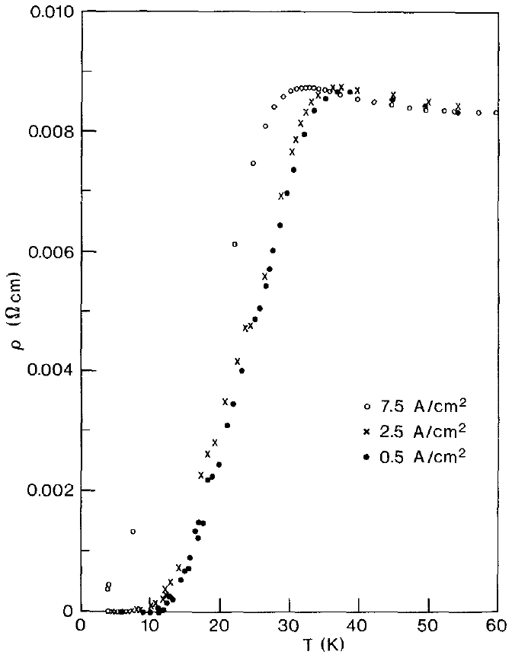
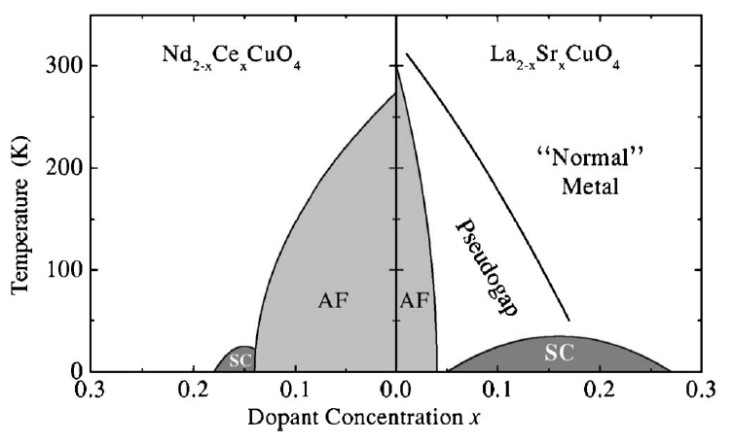
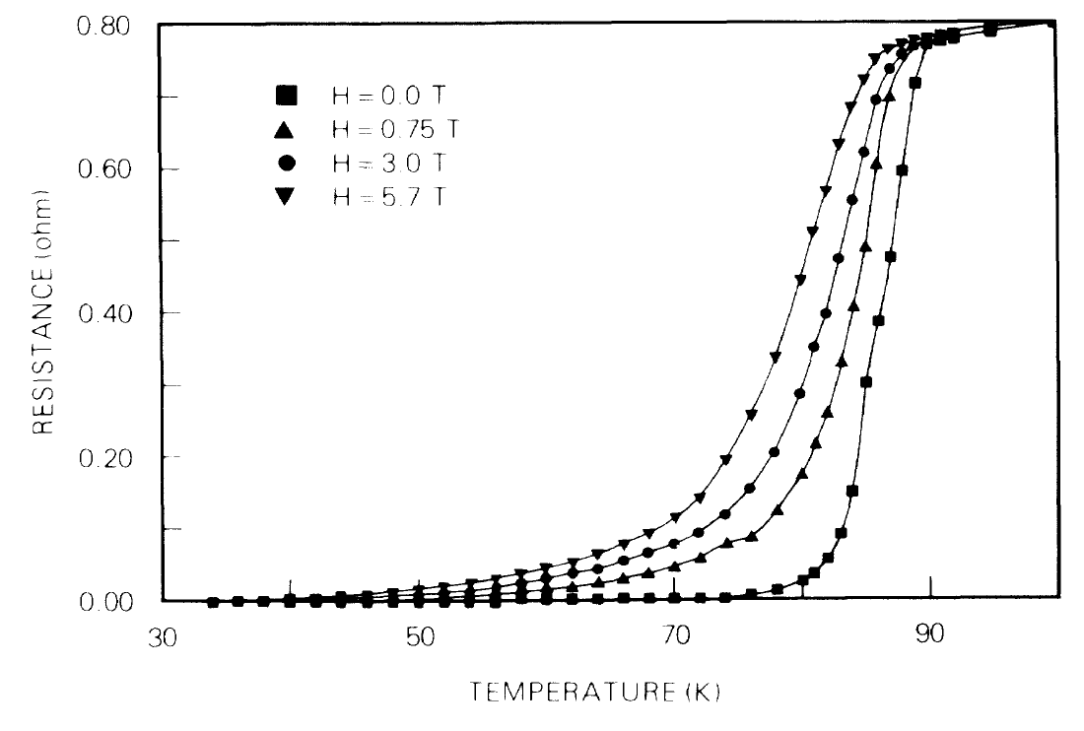
I. Introduction (cuprates)
Discovery
  Bednorz and Müller reported T_{c} ≈ 30 K in Ba-doped La₂CuO₄ in 1986
  Highest BCS superconductor was Nb₃Ge with T_{c} = 23.2 K
  N₂ barrier ➔ T_{c} > 77 K in YBCO
  “Universal” phase diagram
Notes:
http://ko.com.ua/files/u15/3811522056_cb7fa96980.jpg

Slide 4
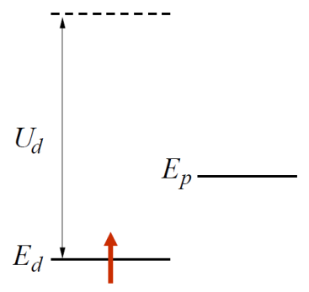
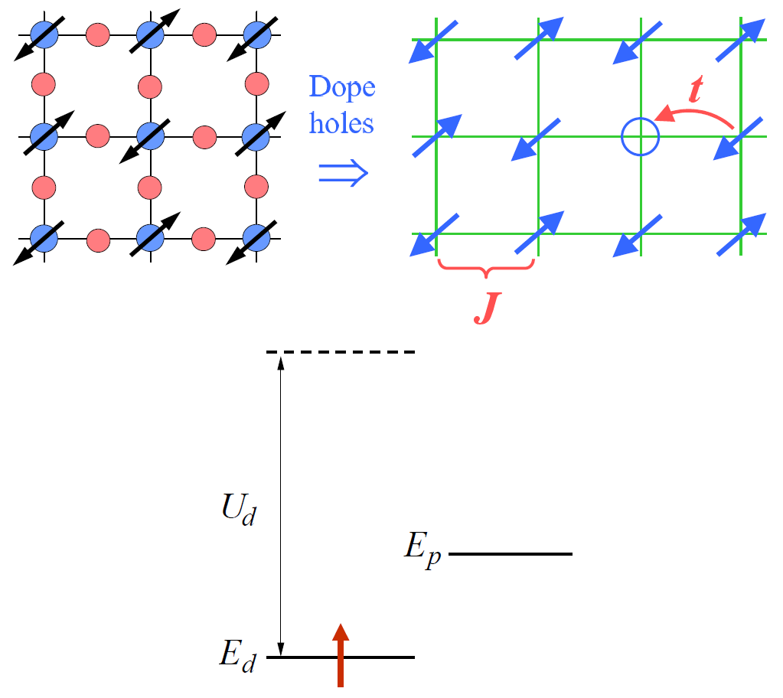
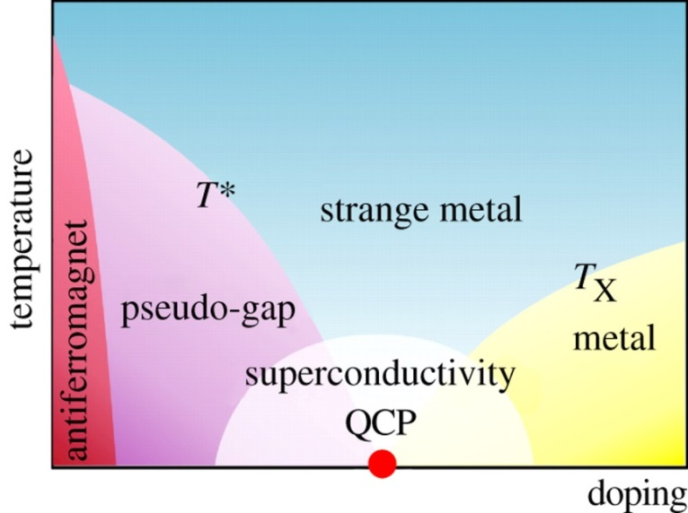
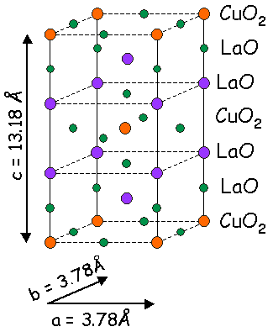
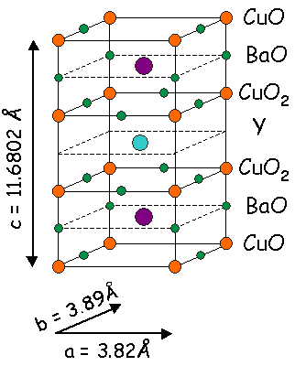
II. Basic electronic structure of the cuprates
Lattice, bonding, and doping
  Relevant energy scales:
    t ➔ hopping energy
    U_{d} ➔ double-occupancy penalty
  La₂CuO₄: La³⁺, Cu²⁺, O^{4–}; 1 hole doped by La³⁺ → Sr²⁺
  La_{1.85}Sr_{0.15}CuO₄ (LSCO) ➔ T_{c} ≈ 40 K
  YBa₂Cu₃O₇: Y³⁺, Ba²⁺, Cu²⁺, O^{4–}; already hole doped!
  YBa₂Cu₃O_{7–ε} (YBCO) ➔ T_{c} ≈ 93 K
Notes:
http://hoffman.physics.harvard.edu/materials/images/SCimages/LSCOstructure.gif

Slide 5
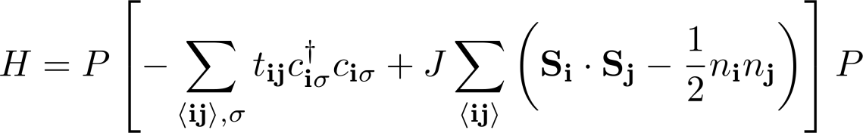
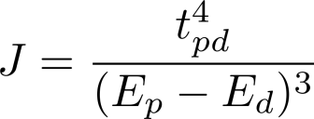
II. Basic electronic structure of the cuprates
Theoretical modeling
  The “t-J model” Hamiltonian
  Projection operator P restricts the Hilbert space to one which excludes double occupation of any site
  Next-nearest (t′) and next-next-nearest (t′′) hopping gives better fits to data
  A non-zero t′ accounts for asymmetry in electron and hole doped systems
  Weak coupling between CuO₂ layers gives non-zero T_{c}
  Cuprates are “quasi-2D” ➔ 2D layer describes the entire phase diagram
Notes:
http://ko.com.ua/files/u15/3811522056_cb7fa96980.jpg

Slide 6
Cuprates overview
Introduction and Phenomenology
Experiments
  Pseudogap
  Stripes
  Nodal quasiparticles
Introduction to Resonating Valence Bond (RVB)
Phase fluctuations vs. competing order
Numerical techniques
Single hole problem
Slave particles and gauge fields
  Mean field theory
  U(1) gauge theory
  Confinement physics

Slide 7
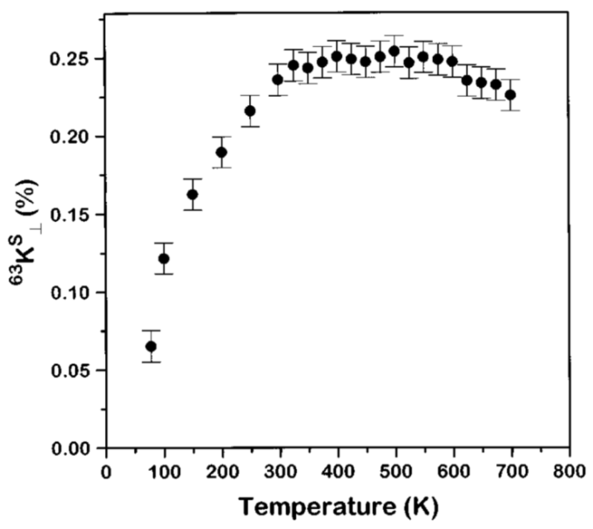
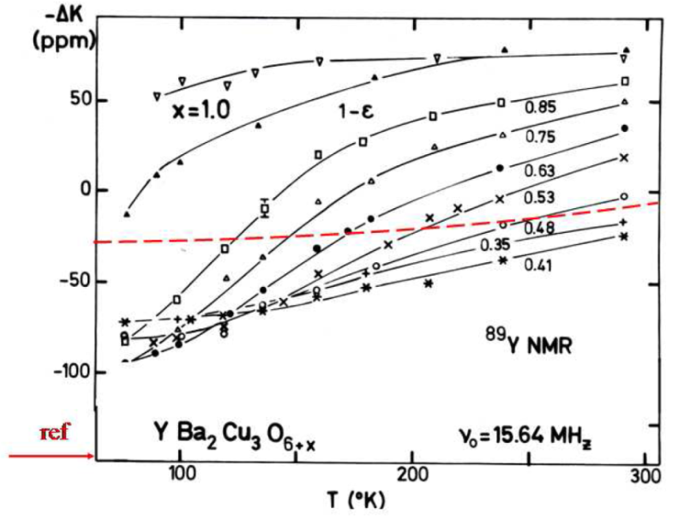
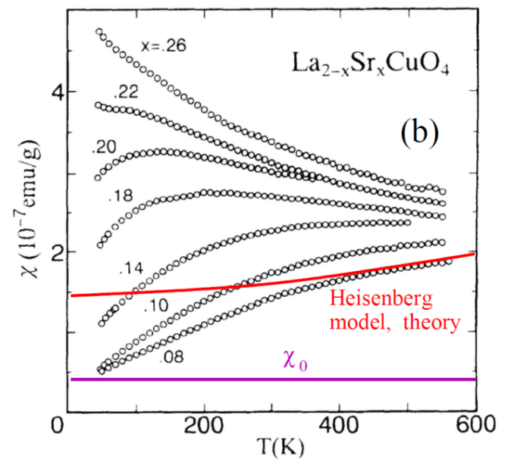

III. Phenomenology of the underdoped cuprates
A. The pseudogap phenomenon in the normal state
Magnetic properties
  NMR/Knight shift on YBCO (T_{c} = 79 K)
  χ_{s} is T-independent from 300 K to 700 K
  χ_{s} drops below Heisenberg model expectation before T_{c}
  Strongly points to singlet formation as origin of pseudogap

Slide 8
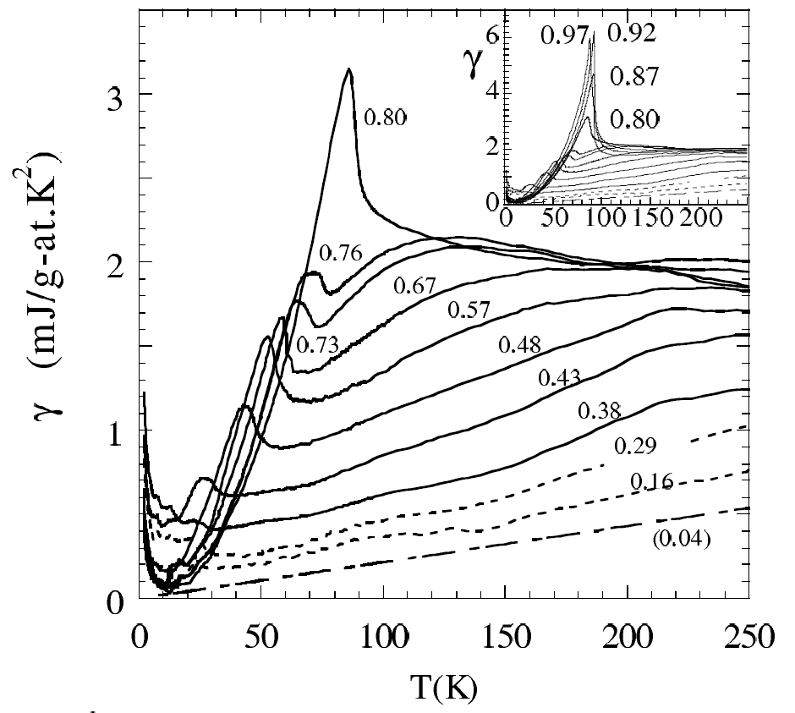
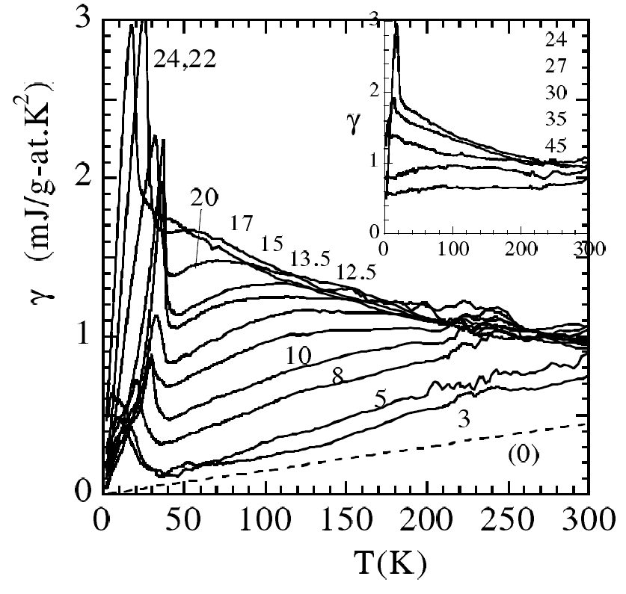

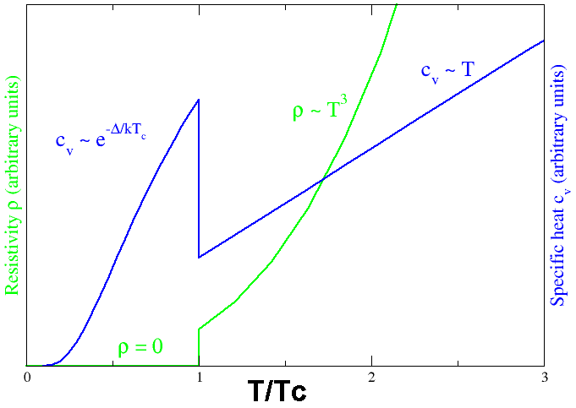
III. Phenomenology of the underdoped cuprates
A. The pseudogap phenomenon in the normal state
Specific heat
  Linear T-dependence of specific heat coefficient γ above T_{c}
  γ for YBa₂Cu₃O_{6+y} for different y; optimally doped curves in the inset
  γ for La_{2-x}Sr_{x}CuO₄ for different x; overdoped curves in the inset
  γ at T_{c} reduces with decreasing doping

Slide 9
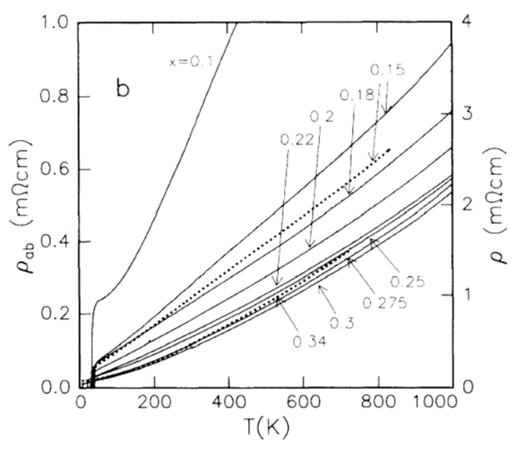
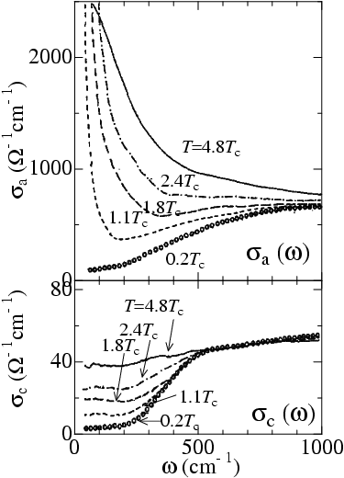
III. Phenomenology of the underdoped cuprates
A. The pseudogap phenomenon in the normal state
DC Conductivity
  Anomalous linear-T “normal” state resistivity
AC Conductivity
  In-plane (CuO₂ plane) conductivity (σ_{a}) only gapped below T_{c}
  Perpendicular conductivity (σ_{c}) gapped in the pseudogap phase

Slide 10
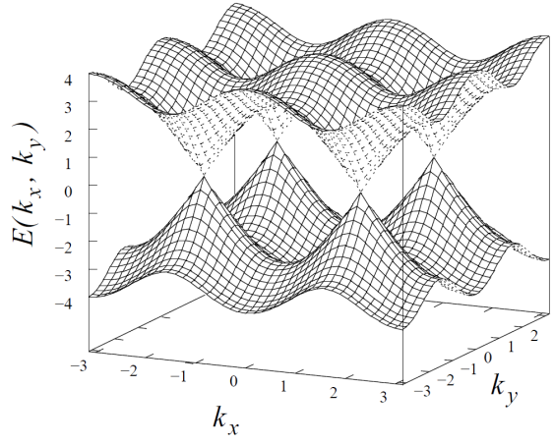
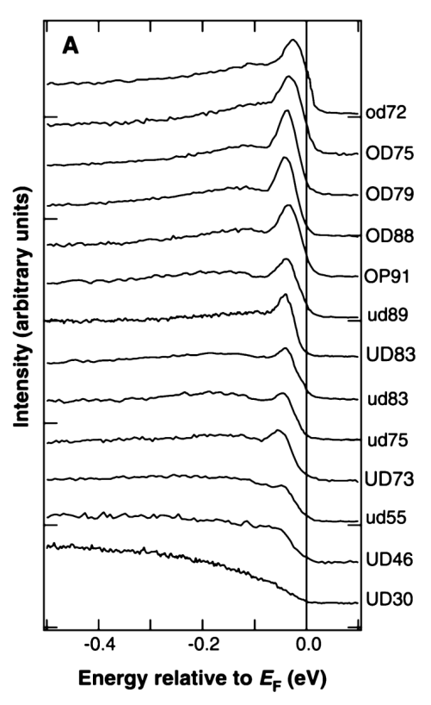
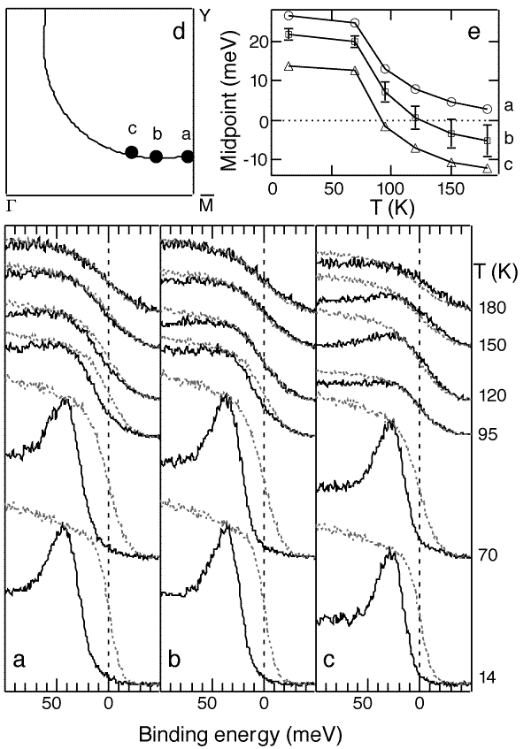
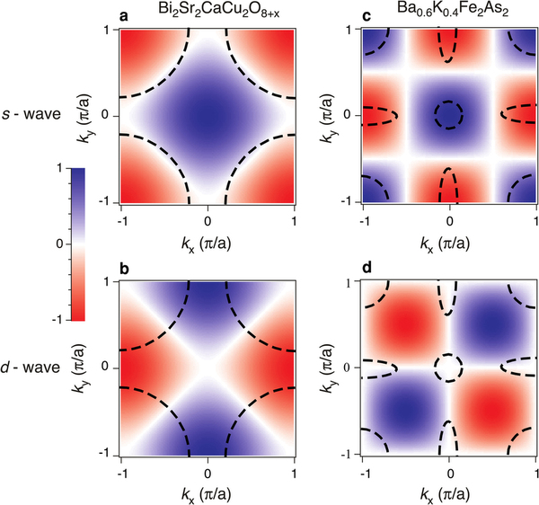
III. Phenomenology of the underdoped cuprates
A. The pseudogap phenomenon in the normal state
ARPES
  Superconducting gap exhibits nodes
  Pseudogap opens at (π/a, 0)
  Luttinger’s theorem ➔ Fermi surface volume = 1 – x
  Spectral weight in coherence peak vanishes with decreasing hole doping

Slide 11

III. Phenomenology of the underdoped cuprates
A. The pseudogap phenomenon in the normal state
STM
  Surface inhomogeneity in the gap function
  STM sees two dips ➔ first dip is indication of pseudogap state
(a)-(d) ➔ decreasing hole doping

Slide 12
Cuprates overview
Introduction and Phenomenology
Experiments
  Pseudogap
  Stripes
  Nodal quasiparticles
Introduction to Resonating Valence Bond (RVB)
Phase fluctuations vs. competing order
Numerical techniques
Single hole problem
Slave particles and gauge fields
  Mean field theory
  U(1) gauge theory
  Confinement physics

Slide 13
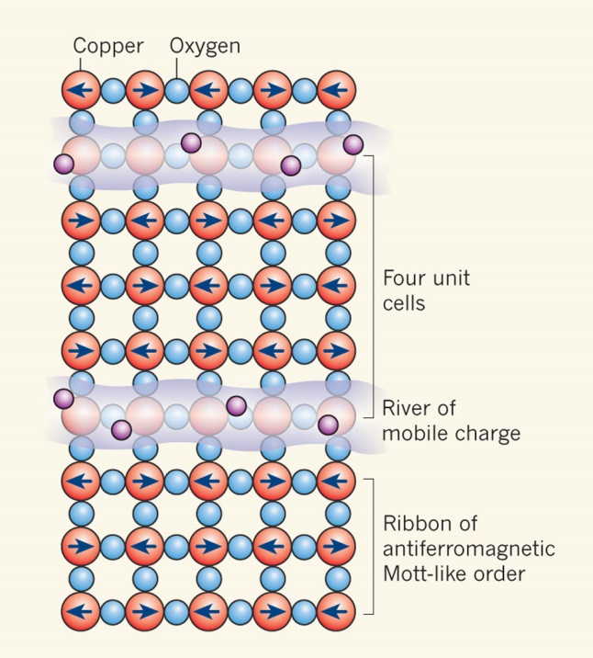
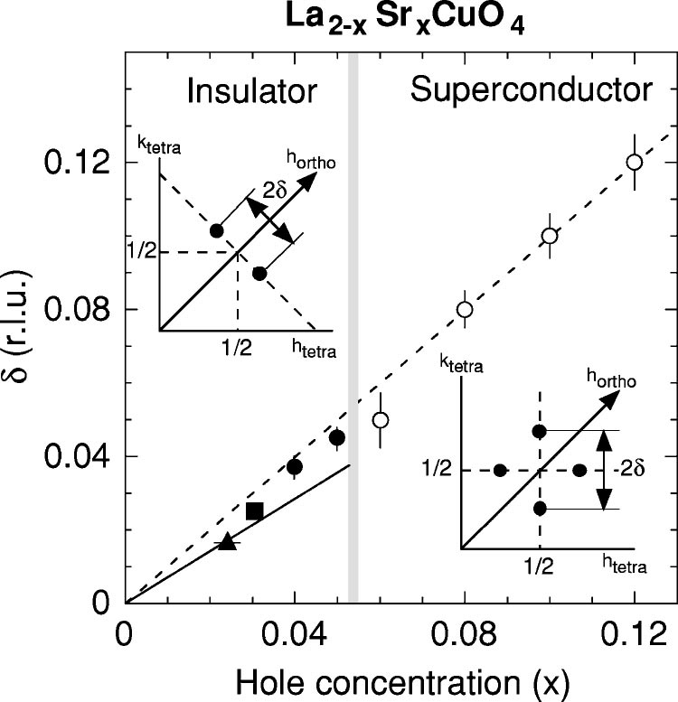
III. Phenomenology of the underdoped cuprates
B. Neutron scattering, resonance and stripes
Stripe order
  Observed in LSCO at doping of x = 1/8
  Charge density wave (CDW) periodicity = 4
  Spin density wave (SDW) periodicity = 8
Neutron scattering
  Scattering peak at q = (π/2, π/2)
  Incommensurability (δ) scales with doping (x)
  “Fluctuating stripes” apparently invisible to experimental probes
  Fluctuating stripes “may” explain pseudogap and superconductivity
Notes:
Now, this slide needs to go a little faster than the rest. That’s mainly because the authors of this paper think that stripes are bullshit. By “bullshit” don’t mean that they don’t exist. In fact, the whole reason people cling to the idea of stripes is because they have been experimentally observed. Therefore, nobody questions their existence. When you hear people say that they don’t believe in stripes, the really mean is that they do not believe that stripes play any relevant role in the physics of the cuprates. They believe that it’s more of a parasitic effect that “comes along for the ride.”

Slide 14
Cuprates overview
Introduction and Phenomenology
Experiments
  Pseudogap
  Stripes
  Nodal quasiparticles
Introduction to Resonating Valence Bond (RVB)
Phase fluctuations vs. competing order
Numerical techniques
Single hole problem
Slave particles and gauge fields
  Mean field theory
  U(1) gauge theory
  Confinement physics
Notes:
A couple of slides ago we discussed the dispersion of the cuprates. Unlike conventional superconductors the cuprates are not fully gapped.
It was predicted and experimentally observed that the energy spectrum of the Bogoliubov quasiparticles is gapless at 4 points in the Brillouin zone.
Recall that, in the early days of superconductors, it was not known that superconductors have a gap. This fact was only figured out after numerous experiments hinted at the existence of an energy gap. It is natural to expect that the existence of a gapless spectrum would have qualitatively different signatures and experiments. This is basically what this section is about

Slide 15
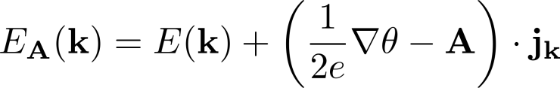
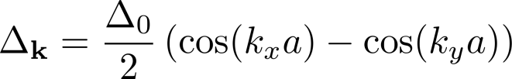
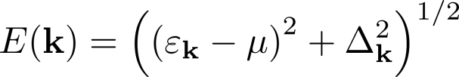
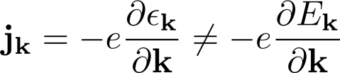
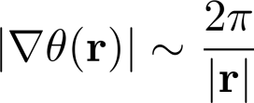

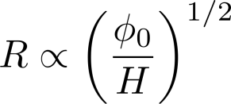
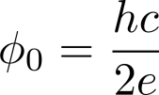

III. Phenomenology of the underdoped cuprates
C. Quasiparticles in the superconducting state
Volovik effect
  Shift in quasiparticle energies
  Original quasiparticle spectrum
  Nodal quasiparticle disperses like “normal” current
  Phase winding around a vortex
  Field-dependent quasiparticle shift

Slide 16
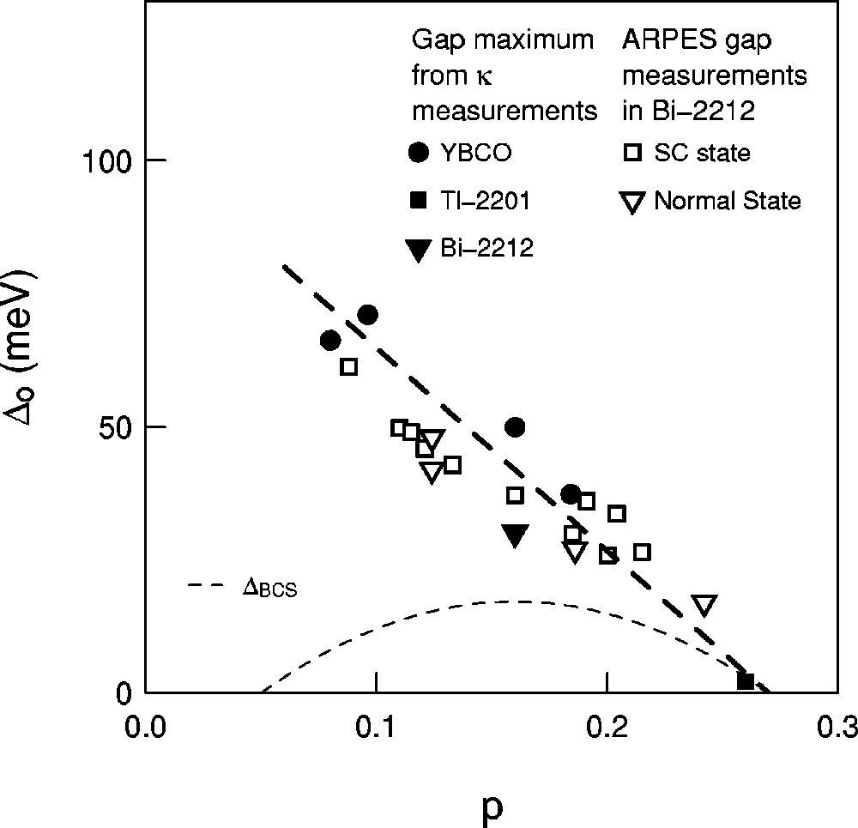
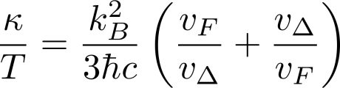

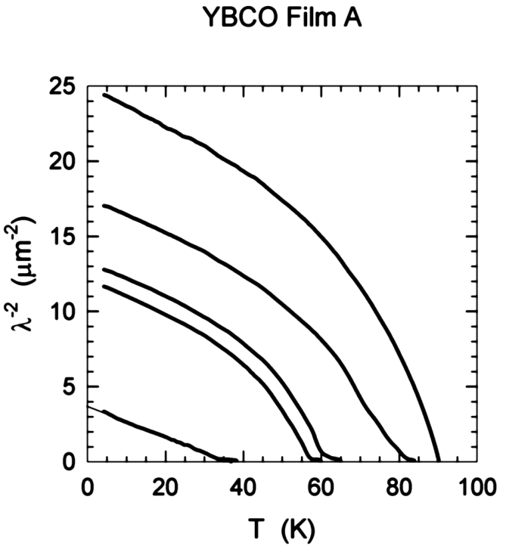
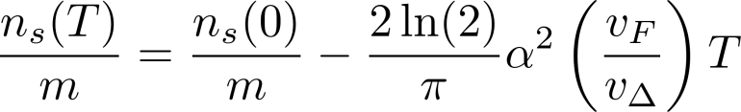
III. Phenomenology of the underdoped cuprates
C. Quasiparticles in the superconducting state
Nodal quasiparticles
  Universal conductivity per layer
  Antinodal gap obtained from extrapolation
  Phenomenological expression for linear-T superfluid density
  London penetration depth shows α = constant
  Slave boson theory predicts α ∝ x

Slide 17
Cuprates overview
Introduction and Phenomenology
Experiments
  Pseudogap
  Stripes
  Nodal quasiparticles
Introduction to Resonating Valence Bond (RVB)
Phase fluctuations vs. competing order
Numerical techniques
Single hole problem
Slave particles and gauge fields
  Mean field theory
  U(1) gauge theory
  Confinement physics

Slide 18
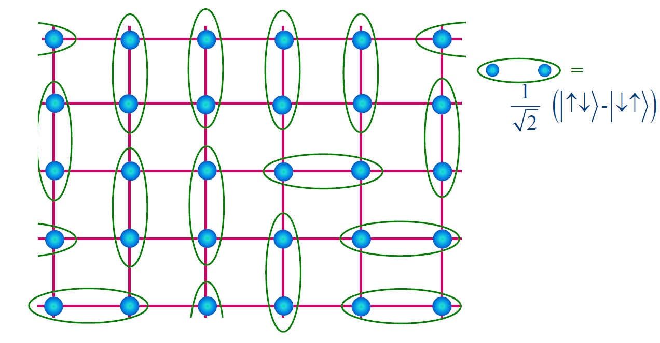

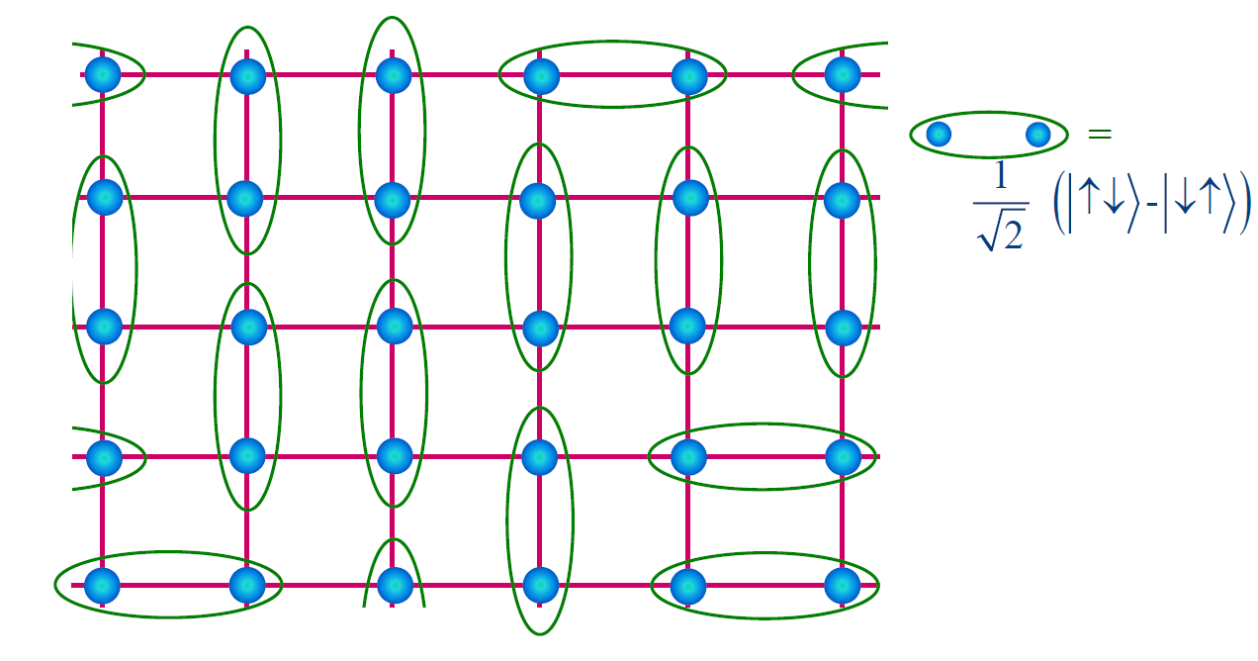

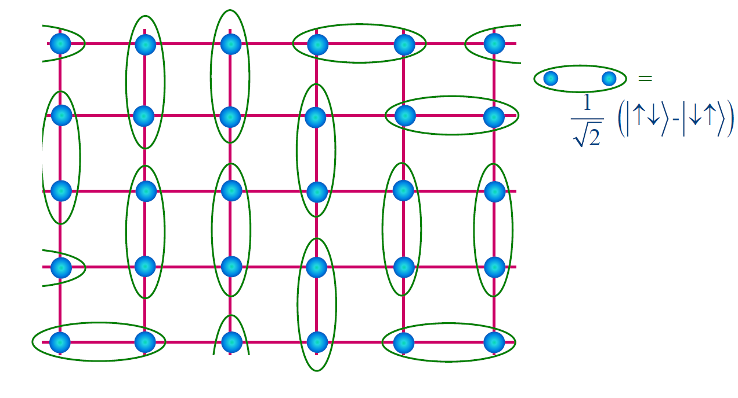
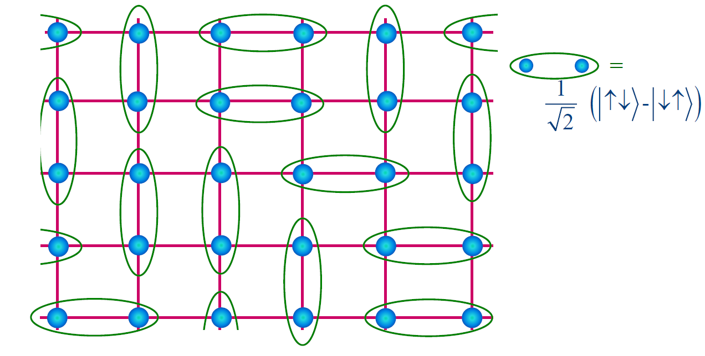
IV. Introduction to RVB and a simple explanation of the pseudogap
Resonating Valence Bond (RVB)
  Anderson revived RVB for the high-T_{c} problem
  RVB state “soup” of fluctuating spin singlets
Notes:
http://ko.com.ua/files/u15/3811522056_cb7fa96980.jpg

Slide 19
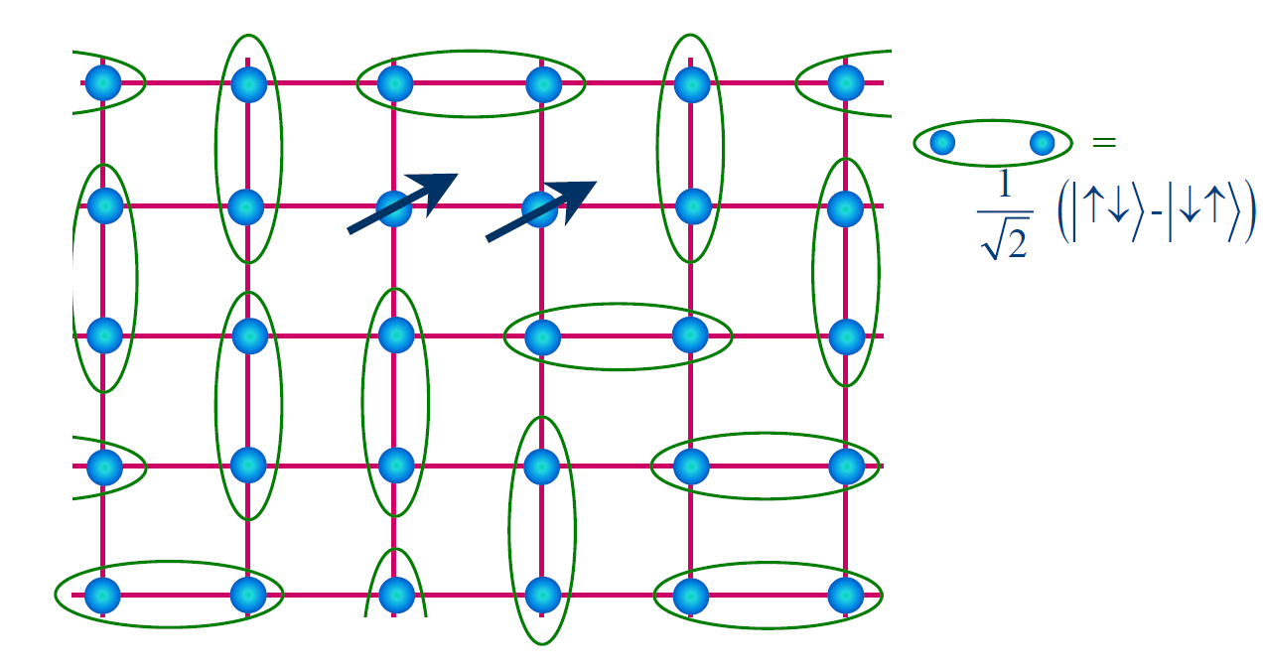
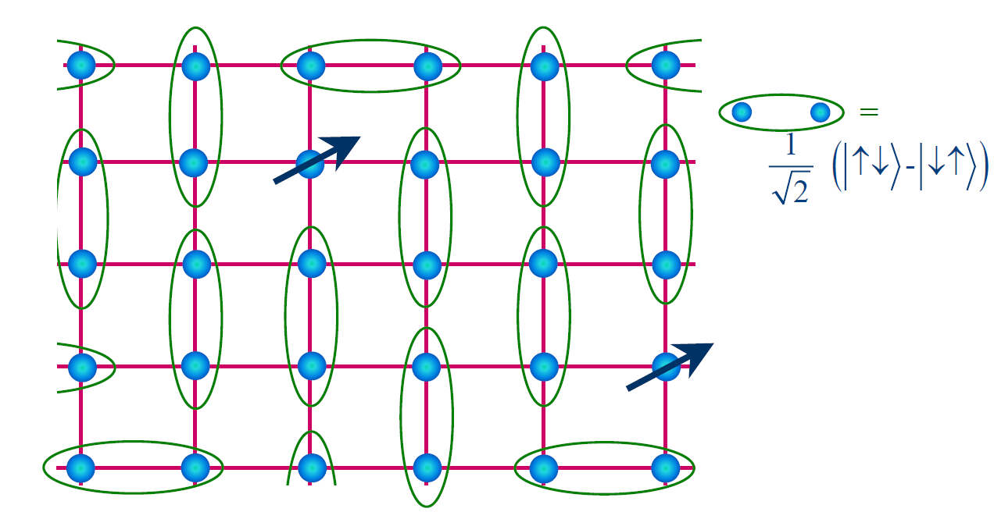
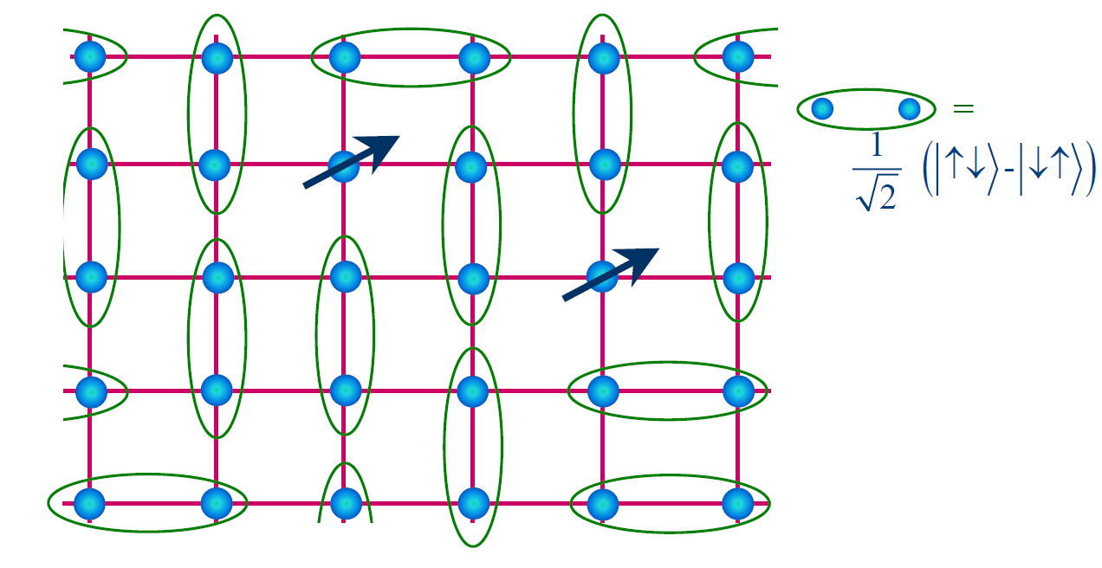
IV. Introduction to RVB and a simple explanation of the pseudogap
Deconfinement of “slave particle”
  We can “split” an electron into charge and spin degrees of freedom
  Purely spin degrees of freedom ➔ “spinons”
Notes:
http://ko.com.ua/files/u15/3811522056_cb7fa96980.jpg

Slide 20

IV. Introduction to RVB and a simple explanation of the pseudogap
Resonating Valence Bond
  Anderson revived RVB for the high-T_{c} problem
  Potential explanation of the pseudogap phase
  Holes confined to 2D layers
  Vertical motion of electrons needs breaking a singlet ➔ a gapped excitation
Notes:
http://ko.com.ua/files/u15/3811522056_cb7fa96980.jpg

Slide 21
Cuprates overview
Introduction and Phenomenology
Experiments
  Pseudogap
  Stripes
  Nodal quasiparticles
Introduction to Resonating Valence Bond (RVB)
Phase fluctuations vs. competing order
Numerical techniques
Single hole problem
Slave particles and gauge fields
  Mean field theory
  U(1) gauge theory
  Confinement physics

Slide 22

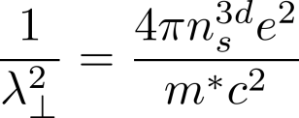

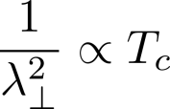
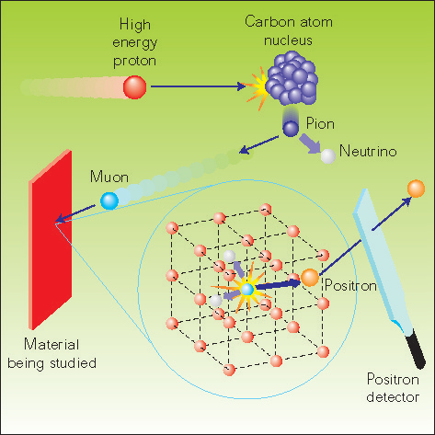

V. Phase fluctuation vs. competing order
Factors influencing T_{c}
  London penetration depth for field penetration perpendicular to the ab plane
  London penetration depth inferred from μSR rate
  Indication of intralayer bose condensation of holes from μSR
Notes:
http://ko.com.ua/files/u15/3811522056_cb7fa96980.jpg

Slide 23


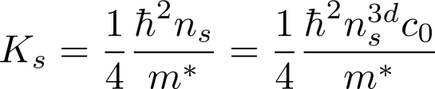
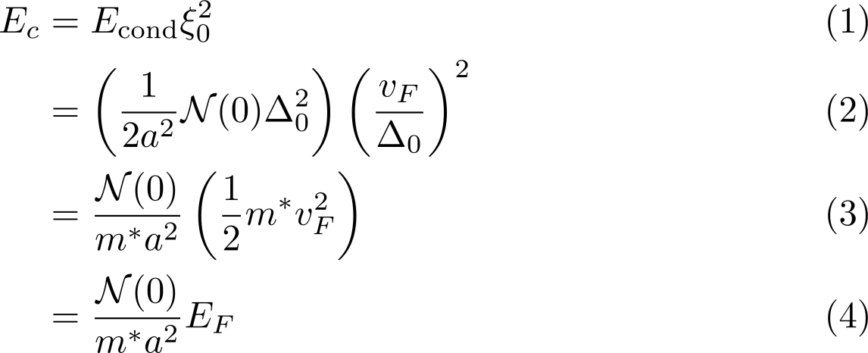
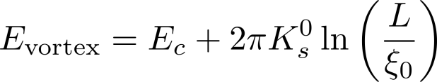
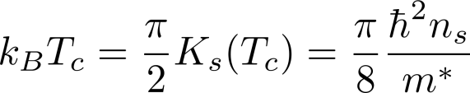

V. Phase fluctuation vs. competing order
A. Theory of T_{c}
T_{c} as a function of phase stiffness
  Phase stiffness of the order parameter
  The BKT transition; energy of a single vortex
  Relation between phase stiffness and T_{c}
Cheap vortices
  Suppose T_{MF} is described by the standard BCS theory
  E_{F} ≈ E_{c} ≫ k_{B}T_{c} ➔ Pseudogap mostly superconducting ➔ E_{c} is clearly not of order E_{F}
  E_{c} ≈ T_{c} ≈ K_{s} ➔ notion of strong phase fluctuations is applicable only on a temperature scale of 2T_{c}

Slide 24

V. Phase fluctuation vs. competing order
B. Cheap vortices and the Nernst effect
Nernst effect
  Transverse voltage due to longitudinal thermal gradient in the presence of a magnetic field
  Nernst region as second type of pseudogap ➔ explained by phase fluctuations
  The first type of pseudogap explained by singlet formation

Slide 25
Cuprates overview
Introduction and Phenomenology
Experiments
  Pseudogap
  Stripes
  Nodal quasiparticles
Introduction to Resonating Valence Bond (RVB)
Phase fluctuations vs. competing order
Numerical techniques
Single hole problem
Slave particles and gauge fields
  Mean field theory
  U(1) gauge theory
  Confinement physics

Slide 26


VI. Projected trial wavefunctions and other numerical results
Anderson’s original RVB proposal
The Gutzwiller projection operator
Projection operator too complicated to treat analytically
Properties of the trial wave function evaluated using Monte Carlo sampling
Wave function ansatz
SC: superconducting without antiferromagnetism
SC+AF: superconducting with antiferromagnetism
SF: staggered-flux without antiferromagnetism
SF+AF: staggered-flux with antiferromagnetism
ZF: zero-flux

Slide 27



VI. Projected trial wavefunctions and other numerical results
A. The half-filled case
d-wave BCS trial wavefunction
Staggered flux state
SU(2) symmetry

Slide 28
Cuprates overview
Introduction and Phenomenology
Experiments
  Pseudogap
  Stripes
  Nodal quasiparticles
Introduction to Resonating Valence Bond (RVB)
Phase fluctuations vs. competing order
Numerical techniques
Single hole problem
Slave particles and gauge fields
  Mean field theory
  U(1) gauge theory
  Confinement physics

Slide 29








VII. The single hole problem
Vacancy in an “antiferromagnetic sea”
  Dynamics of a single hole
  Using self-consistent Born approximation, and ignoring crossing magnon propagators, self-consistent equation for the hole propagator is
  ARPES sees two peaks in A(k, ω) in addition to hole quasiparticle peaks centered at
  These can be understood as the “string” excitation of the hole moving in the linear confining potential due to the AF background
Notes:
http://ko.com.ua/files/u15/3811522056_cb7fa96980.jpg

Slide 30


VII. The single hole problem
Vacancy in an “antiferromagnetic sea”
  ARPES sees two peaks in A(k, ω) in addition to hole quasiparticle peaks centered at
  These can be understood as the “string” excitation of the hole moving in the linear confining potential due to the AF background
  The hole must retrace its path to “kill” the string ➔ holes are localized
  Do holes really conduct?
  Yes! A hole does not necessarily need to retrace its path without raising energy
Notes:
http://ko.com.ua/files/u15/3811522056_cb7fa96980.jpg

Slide 31
Cuprates overview
Introduction and Phenomenology
Experiments
  Pseudogap
  Stripes
  Nodal quasiparticles
Introduction to Resonating Valence Bond (RVB)
Phase fluctuations vs. competing order
Numerical techniques
Single hole problem
Slave particles and gauge fields
  Mean field theory
  U(1) gauge theory
  Confinement physics

Slide 32







VIII. Slave boson formulation of t-J model and mean field theory
Splitting the electron
  Low energy physics in terms of the t-J model
  No-double-occupancy condition
  Most general “electron splitting” using slave boson operators
  Enforcing no-double-occupancy condition in terms of slave particles
  Heisenberg exchange term in terms of slave particles
Notes:
http://ko.com.ua/files/u15/3811522056_cb7fa96980.jpg

Slide 33







VIII. Slave boson formulation of t-J model and mean field theory
Splitting the electron
  Heisenberg exchange term in terms of slave particles
  Decoupling exchange term in particle-hole and particle-particle channels
evaluated using constraint and ignoring
  Hubbard-Stratonovich transformation
Notes:
http://ko.com.ua/files/u15/3811522056_cb7fa96980.jpg

Slide 34







VIII. Slave boson formulation of t-J model and mean field theory
“Local” U(1) gauge symmetry
  Effective Lagrangian
  Local U(1) transformation
  Phase fluctuations of χ_{ij} and λ_{i} have dynamics of U(1) gauge field
  We have various choices satisfying mean field conditions
Notes:
http://ko.com.ua/files/u15/3811522056_cb7fa96980.jpg

Slide 35


VIII. Slave boson formulation of t-J model and mean field theory
Mean field ansatz
  Effective Lagrangian
  The uniform RVB (uRVB) state ➔ purely fermionic theory
  Lower energy states than uRVB state
    d-wave state
    Staggered flux state
  d-wave and staggered flux state have identical dispersion due to local SU(2) symmetry
Notes:
http://ko.com.ua/files/u15/3811522056_cb7fa96980.jpg

Slide 36


VIII. Slave boson formulation of t-J model and mean field theory
Mean field ansatz
  Effective Lagrangian
  Use of SU(2) doublets
  Compact Effective Lagrangian
Notes:
http://ko.com.ua/files/u15/3811522056_cb7fa96980.jpg

Slide 37






VIII. Slave boson formulation of t-J model and mean field theory
Mean field ansatz
  Compact Effective Lagrangian
  Lagrangian invariant under
  Connecting mean field ansatz
  Ground state of ➔ antiferromagnetic long range ordering (AFLRO)
  Hence we can naively decouple the exchange interaction
Notes:
http://ko.com.ua/files/u15/3811522056_cb7fa96980.jpg

Slide 38


VIII. Slave boson formulation of t-J model and mean field theory
The doped case
  Undoped (x = 0) only has spin dynamics
  Bosons are crucial for charge dynamics
  No Bose-Einstein condensation (BEC) in 2D!
  Weak interlayer hole-hopping ➔ T_{BE} ≠ 0
  Slave boson model ➔ 5 phases classified by χ, Δ, and b = 〈b_{i}〉
Label | State | χ | Δ | b
I | Fermi liquid | ≠ 0 | = 0 | ≠ 0
II | Spin gap | ≠ 0 | ≠ 0 | = 0
III | d-wave superconducting | ≠ 0 | ≠ 0 | ≠ 0
IV | uRVB | ≠ 0 | = 0 | = 0
Notes:
http://ko.com.ua/files/u15/3811522056_cb7fa96980.jpg

Slide 39
Cuprates overview
Introduction and Phenomenology
Experiments
  Pseudogap
  Stripes
  Nodal quasiparticles
Introduction to Resonating Valence Bond (RVB)
Phase fluctuations vs. competing order
Numerical techniques
Single hole problem
Slave particles and gauge fields
  Mean field theory
  U(1) gauge theory
  Confinement physics

Slide 40
IX. U(1) gauge theory of the RVB state
Motivation
  Mean field theory enforces no-double-occupany on average
  Treat fluctuations about mean field on a Gaussian level
  Redundancy of U(1) phase in defining fermion and boson
U(1) gauge theory
  Ioffe-Larkin composition rule
  Describes high temperature limit of the optimally doped cuprate
Limitations
  Fails in the underdoped region
  Gaussian theory also misses the confinement physics
Notes:
http://vector.nsbp.org/wp-content/uploads/2011/04/phasediagcupratesbook.jpg

Slide 41





IX. U(1) gauge theory of the RVB state
A. Effective gauge action and non-Fermi-liquid behavior
Slave-boson formalism
  “Fractionalizing” the electron
  Local gauge degree of freedom
  Fermion/boson strongly coupled to the gauge field ➔ conservation of the gauge charge
  Green’s functions transform as
  Definition of gauge fields
Notes:
The a_{ij} is simply the phase of χ_{ij} and a₀(i) is nothing but the time-dependent Lagrange multiplier

Slide 42





IX. U(1) gauge theory of the RVB state
A. Effective gauge action and non-Fermi-liquid behavior
Gaussian approximation
  Relevant Lagrangian
  a_{ij} → a_{ij} + 2π ➔ Lattice gauge theory coupled fermions/bosons
  Gauge field has no dynamics ➔ coupling constant of the gauge field is infinity
  Integrate out the matter fields:
  Gaussian approximation or RPA (continuum limit)

Slide 43



IX. U(1) gauge theory of the RVB state
A. Effective gauge action and non-Fermi-liquid behavior
Effective gauge field action
  Gaussian Lagrangian
  Coupling between the matter fields and gauge field
  Constraints after integrating over temporal and spatial components of a_{μ}
  Physical meaning of the gauge field? Consider electron moving in a loop

Slide 44














IX. U(1) gauge theory of the RVB state
B. Ioffe-Larkin composition rule
Physical quantities in terms of fermions/bosons
  The fermion/boson current
  External E field ➔ gauge field a induces “internal” electric field e
  Recall constraint
  “Scattering” from the gauge field
  Temperature-dependent superfluid density

Slide 45

IX. U(1) gauge theory of the RVB state
B. Ioffe-Larkin composition rule
Physical effects of gauge field
  Physical conductivity
  External E field ➔ gauge field a induces “internal” electric field e

Slide 46




IX. U(1) gauge theory of the RVB state
C. Ginzburg-Landau theory and vortex structure
The Berezinskii-Kosterlitz-Thouless (BKT) Transition
  Free energy of a single CuO₂ layer
Notes:
In this section we are going to mainly discuss the vortex structure inside the superconducting state. And as most of you may know, vortices in superconductors are best discussed in the context of Ginzburg-Landau theory.
According to the Ginzburg-Landau theory we can write down the free energies of the bosonic and fermionic fields in the following way. For now ignore the gradient terms the fermionic and bosonic free energies. Here alpha represents the coefficient of the quadratic term. This is explicitly written out the above free energy expressions. It is easy to see that above the critical temperature, T_{D} for the fermions and T_{BE} for the bosons, the ground state only permits the order parameter to be zero. However, below the transition temperature, the order parameter develops a finite value. In other words, the physics of the phase transition is covered by the quadratic and quartic terms.
However, our goal is not to discuss the phase transition. We are interested in energy of the vortex. But let us first remind ourselves what it means to have a vortex in a superconductor. This is where the gradient terms play a role. It is worth noting that this is one of the distinguishing features Ginzburg-Landau theory. The power of BCS is in the fact that it explains microscopics as well as the phase transition. However, inhomogeneities is the superconductor is best discussed in the Ginzburg-Landau theory. And based on this schematic, a vortex does indeed represent a type of inhomogeneity in the superconductor. As discussed in the previous sections, the superconducting condensate has a so-called “phase stiffness.” In other words, fluctuations of the phase costs energy. In a vortex inside a conventional superconductor, in addition to the magnitude of the order parameter going to zero, its phase also winds by 2*pi. The physical origin of this winding can be associated with the fact that current flow around the vortex.

Slide 47






IX. U(1) gauge theory of the RVB state
C. Ginzburg-Landau theory and vortex structure
Vortex structure
  Type A: Vortex core state is the Fermi liquid (I)
  Type B: Vortex core state is the spin gap state (II)
  Energy contribution from region far away from the core (> ξ_{B}, ξ_{F}) for type A
  Condensation energy for types A and B:
  Total vortex energies

Slide 48
Cuprates overview
Introduction and Phenomenology
Experiments
  Pseudogap
  Stripes
  Nodal quasiparticles
Introduction to Resonating Valence Bond (RVB)
Phase fluctuations vs. competing order
Numerical techniques
Single hole problem
Slave particles and gauge fields
  Mean field theory
  U(1) gauge theory
  Confinement physics

Slide 49








IX. U(1) gauge theory of the RVB state
D. Confinement-deconfinement problem
Pure lattice gauge theory
  Compact lattice gauge theory without matter field
  Wilson loop as order parameter
  In terms of gauge potential
  Area (confined) vs. perimeter (deconfined) law
  The “instanton” is the source of the gauge flux with the field distribution
  Flux slightly above (future) or below (past) of the instanton differs by 2π

Slide 50



IX. U(1) gauge theory of the RVB state
D. Confinement-deconfinement problem
Coupling of gauge theory to paired matter fields
  Is deconfined ground state possible in U(1) gauge theory?
  Consider following bosonic field coupled to compact U(1) field (coupling constant g)
  For g ≪ 1, S_{B} reduces to an XY model weakly coupled to a U(1) gauge field (q = 1)
  In (2+1)D t-g plane is covered by Higgs-confinement phase (q = 1)
  If bosonic field is pairing field ➔ q = 2
  Pairing implicitly has Z₂ gauge symmetry
  Quantum Z₂ (Ising) gauge theory in 2D has a confinement-deconfinement transition

Slide 51
IX. U(1) gauge theory of the RVB state
D. Confinement-deconfinement problem
Coupling of gauge theory to gapless matter fields
  Is deconfined ground state possible in without pairing?
  Yes, dissipation due to gapless excitations lead to deconfinement
  This (gapless) U(1) spin liquid arises naturally from SU(2) formulation
Controversies on U(1) gauge theory confinement
  Nayak ➔ slave particles are always confined in U(1) gauge theories due to infinite coupling
  Partially integrating out the matter fields makes coupling finite (but strong)
  Several counter examples found to Nayak’s claim

Slide 52
IX. U(1) gauge theory of the RVB state
E. Limitations of the U(1) gauge theory
Discrepancies in temperature-dependent superfluid density
  In the Gaussian approximation, current carried by quasiparticles in the superconducting state is xv_{F}
  Confinement leads to BCS-like quasiparticles carrying the full current
Cannot explain spin correlations at (π, π)
  Gauge field is gapped in the fermion paired state
  Gauge fluctuations cannot account for enhanced spin correlations seen in neutron scattering at (π, π)
Energetically stable “hc/e” vortex not observed
  STM failed to see the hc/e vortex
  U(1) theory misses the low lying fluctuations related to SU(2) particle-hole symmetry at half-filling

Slide 53
Summary of the cuprates (part 1)
Electronic structure
  Relevant physics confined to 2D
  The “t-J” model
  Universal phase diagram
Phenomenology of the cuprates
  Experimental signatures of the pseudogap phase
  Nodal quasiparticles
Slave bosons
  Slave fermions and bosons
  U(1) gauge theory

Slide 54



Next time: cuprates (cont’d) and pnictides
SU(2) slave boson theory at finite doping
  SU(2) theory gives richer phase diagram than U(1) theory
  SU(2) theory captures confinement physics missed by U(1) theory
Iron-based (pnictide) superconductors
  Discovered in 2008 by Kamihara
  Physics confined to 2D like cuprates
  Pseudogap replaced by “nematic phase”

Slide 55
Thanks for listening!
Questions?

