Slide 1
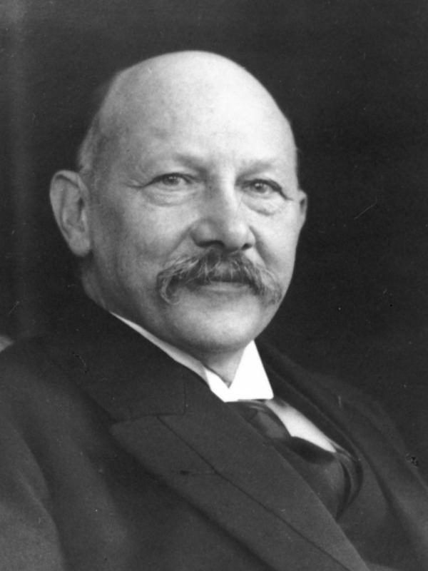
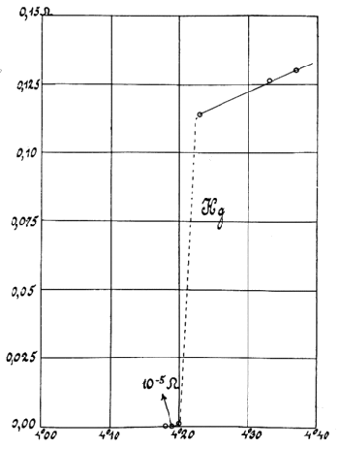
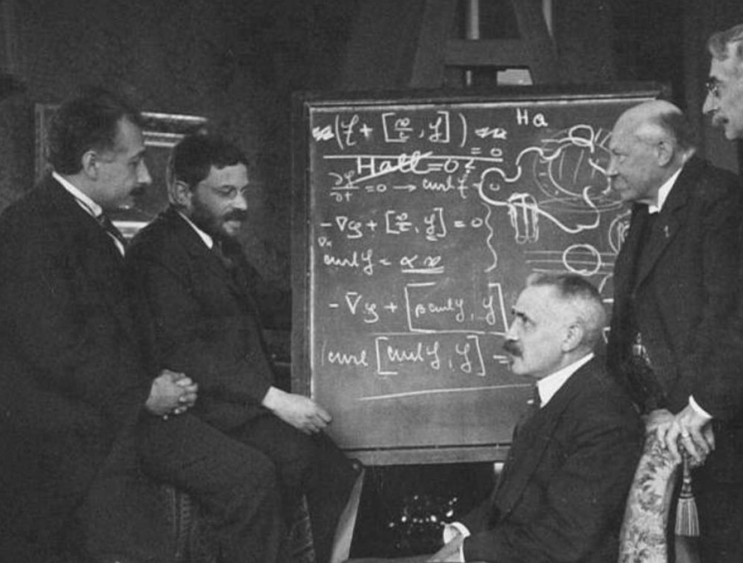
History of superconductivity
Liquefaction of ⁴He
  Heike Kamerlingh Onnes produces liquid ⁴He on 10 July, 1908
  On 8 April, 1911 he discovered superconduct-ivity in a solid Hg wire at 4.2 K
  Quantum origins of superconductivity a mystery until 1957
Einstein, Ehrenfest, Langevin, Kamerlingh Onnes, and Weiss at a workshop in Leiden October 1920. The blackboard discussion, on the Hall effect in superconductors
Notes:
http://upload.wikimedia.org/wikipedia/commons/9/94/Kamerlingh_portret.jpg
http://tikalon.com/blog/2012/Hg_Onnes_1911.gif
C. W. J. Beenakker. “Colloquium: Andreev reflection and Klein tunneling in graphene.” Reviews of Modern Physics 80, no. 4 (2008): 1337.

Slide 2
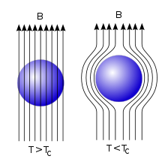
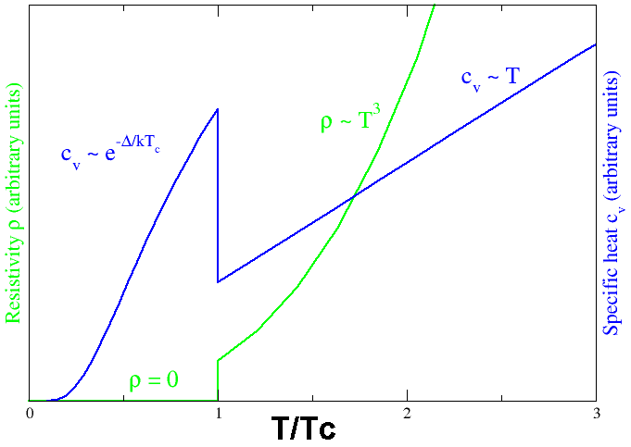
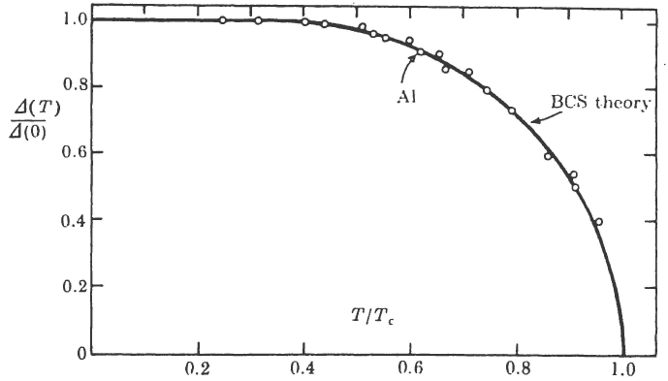
Phenomenology of superconductivity
Experimental facts
  Vanishing resistivity, at T = 0, up to ω = 3.5k_{B}T_{C}/ℏ
  Zero resistivity, at T > 0, only at ω = 0
  Meissner effect (1933) ➔ expulsion of magnetic field in the bulk
  Jump in specific heat ≈ 3 times γT_{C}
  Isotope effect
  Energy gap Δ(T)
  Coherence effects
Notes:
http://upload.wikimedia.org/wikipedia/commons/thumb/b/b5/EfektMeisnera.svg/220px-EfektMeisnera.svg.png
http://upload.wikimedia.org/wikipedia/commons/0/08/Cvandrhovst.png

Slide 3
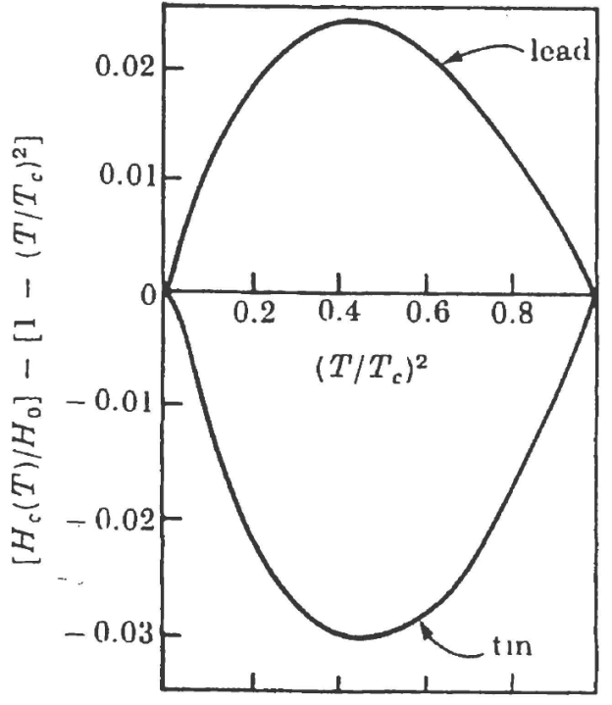
Phenomenology of superconductivity
Phenomenological theories
  Gorter-Casimir Model (1934) ➔ “artificial” two-fluid model
“Superfluid” free energy
“Normal” fluid free energy
  Temperature-dependent critical magnetic field
Notes:
http://upload.wikimedia.org/wikipedia/commons/thumb/b/b5/EfektMeisnera.svg/220px-EfektMeisnera.svg.png
http://upload.wikimedia.org/wikipedia/commons/0/08/Cvandrhovst.png

Slide 4
Phenomenology of superconductivity
Phenomenological theories
  The London Theory (1935) ➔ realistic two-fluid model
  Equations of motion of the two-fluid model
  Londons’ second equation
  Gorter-Casimir + Londons theory
Notes:
http://upload.wikimedia.org/wikipedia/commons/thumb/b/b5/EfektMeisnera.svg/220px-EfektMeisnera.svg.png
http://upload.wikimedia.org/wikipedia/commons/0/08/Cvandrhovst.png

Slide 5
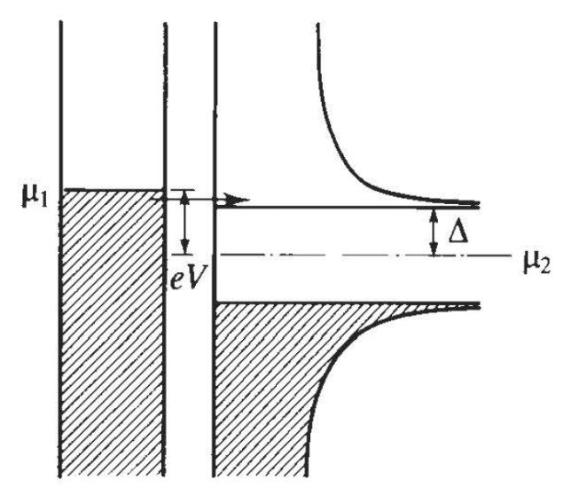
Bardeen-Cooper-Schrieffer (BCS) Theory
Pairing hypothesis
  Hubbard model with attractive interaction
  Composite “boson”
  Assuming mean-field works
  Find eigenvalues and eigenvectors!
Bogoliubov quasiparticles
Notes:
http://upload.wikimedia.org/wikipedia/commons/thumb/b/b5/EfektMeisnera.svg/220px-EfektMeisnera.svg.png
http://upload.wikimedia.org/wikipedia/commons/0/08/Cvandrhovst.png

Slide 6
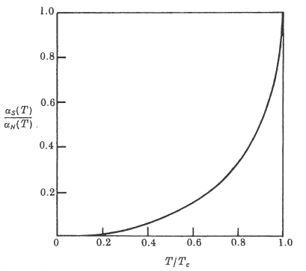
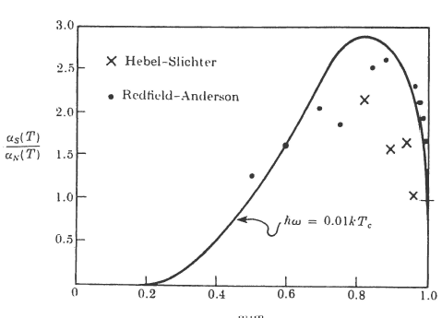
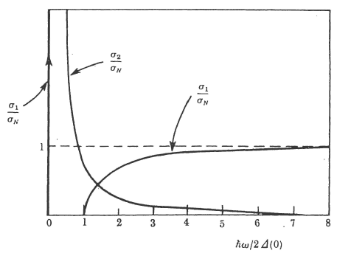
Experimental success of BCS
Acoustic attenuation rate
Nuclear magnetic Resonance (NMR)
Electromagnetic absorption
Notes:
http://upload.wikimedia.org/wikipedia/commons/thumb/b/b5/EfektMeisnera.svg/220px-EfektMeisnera.svg.png
http://upload.wikimedia.org/wikipedia/commons/0/08/Cvandrhovst.png

Slide 7
Part II: Heavy-fermion Superconductivity
History
Local moments and the Kondo lattice
  The Kondo effect
  Poor man’s RG
  Kondo lattice
  Heavy-fermion behavior
Heavy-fermion superconductivity
  Phenomenology
  “BCS-like” theory
  Superconducting phases of UPt₃
  The FFLO phase

Slide 8
Introduction to “Heavy-fermion” systems
History
  Steglich et al. discovered super-conductivity in CeCu₂Si₂ with T_{c} ≈ 0.5 K
  Postulated Cooper pairing of “heavy quasiparticles”
Heavy-fermion systems
  Ingredient 1: lattice of f-electrons
  Ingredient 2: conduction electrons

Slide 9
Local moments and the Kondo lattice
The Anderson Model
  Localized f-electrons hybridize with the itinerant electrons
  Quantum states in the atomic limit
  Cost of inducing a “valence fluc-tuation” by removing or adding an electron to the f¹ state is positive

Slide 10
Local moments and the Kondo lattice
The Anderson Model
  Localized f-electrons hybridize with the itinerant electrons
  Virtual bound-state formation resonance linewidth
  Two approaches to the Anderson model
    “Atomic” picture ➔ tune hybridization strength
    “Adiabatic” picture ➔ tune interaction strength
  Resolution of discrepancy between two pictures ➔ “tunneling” of local moment between spin “up” and “down”

Slide 11
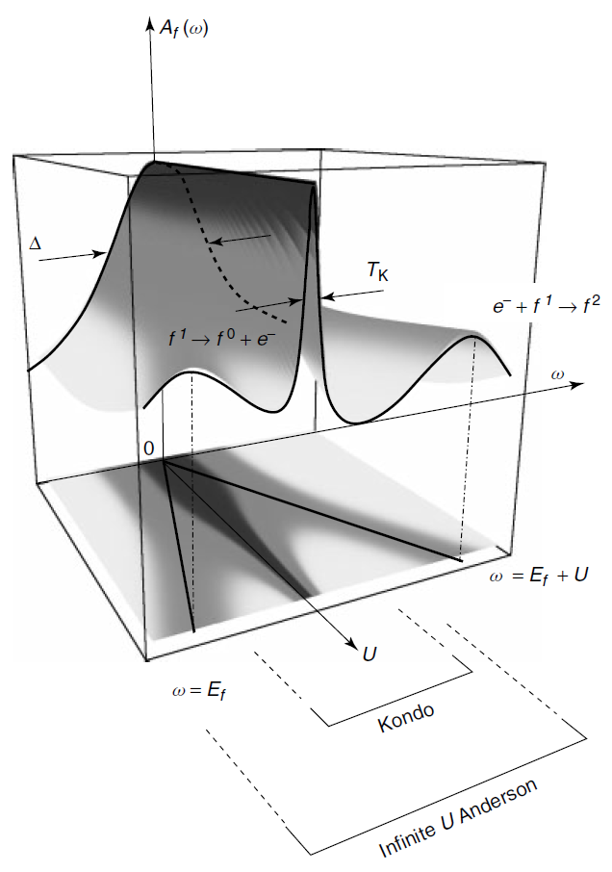
Local moments and the Kondo lattice
Adiabaticity and the Kondo resonance
  f-electron spectral function
  f-charge on the ion
  Phase and amplitude of spectral function at ω = 0
  Friedel sum rule

Slide 12
Local moments and the Kondo lattice
Hierarchies of energy scales
  Renormalization concept
  Renormalized Hamiltonian
  Infinite-U Anderson model
  “Hubbard operators”
  For the symmetric Anderson model we have:

Slide 13
Local moments and the Kondo lattice
Hierarchies of energy scales
  Schrieffer Wolff transformation
  Energy of singlet lowered by –2J
  Matrix elements associated with valence fluctuations
  Effective interaction
  Effective interaction induced by the virtual charge fluctuations
Notes:
Effective interaction induced by the virtual charge fluctuations

Slide 14
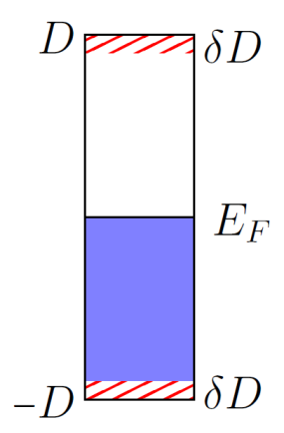
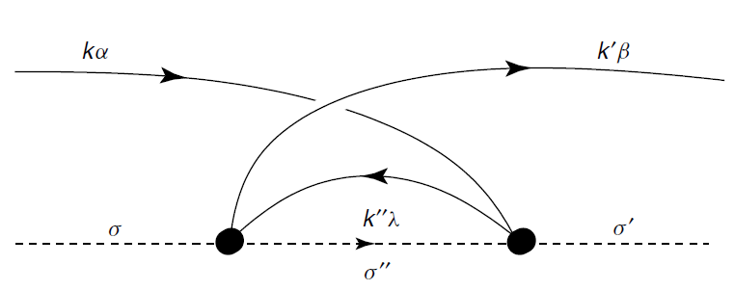
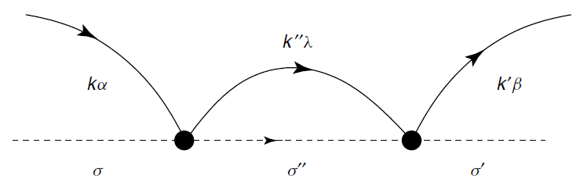
Local moments and the Kondo lattice
Hierarchies of energy scales
  The Kondo Effect
  Process I
  Process II
Notes:
Effective interaction induced by the virtual charge fluctuations

Slide 15
Local moments and the Kondo lattice
Hierarchies of energy scales
  Combining processes I and II
  “Anti-screening” of the Kondo coupling constant
  Introduce coupling constant
  Define
Notes:
Effective interaction induced by the virtual charge fluctuations

Slide 16
Local moments and the Kondo lattice
Hierarchies of energy scales
  Kondo temperature is the only intrinsic scale
  Resistivity
  Universal scattering rate
  To leading order in Born approximation; g₀ is bare coupling
  At finite temperatures g₀ → g(Λ = 2πT)
  Formation of spin-singlet bound state at large coupling
Notes:
Effective interaction induced by the virtual charge fluctuations

Slide 17
Local moments and the Kondo lattice
Hierarchies of energy scales
  Doniach’s Kondo lattice concept
  No Kondo physics ➔ Friedel oscillations
  Ruderman-Kittel-Kasuya-Yosida (RKKY)
  Two possible ordering temperatures
Notes:
Effective interaction induced by the virtual charge fluctuations

Slide 18
Local moments and the Kondo lattice
The Large N Kondo Lattice
  Gauge theories, Large N and strong correlation
  Spin operator representation
  Slave boson approach
  Conservation of gauge charge
  Mobility of f-states
Notes:
Effective interaction induced by the virtual charge fluctuations

Slide 19
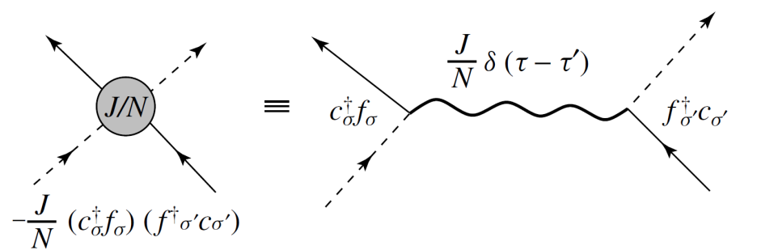
Local moments and the Kondo lattice
The Large N Kondo Lattice
  Mean field theory of the Kondo lattice
  Hubbard-Stratonovich transformation
  Path integral
Notes:
Effective interaction induced by the virtual charge fluctuations

Slide 20
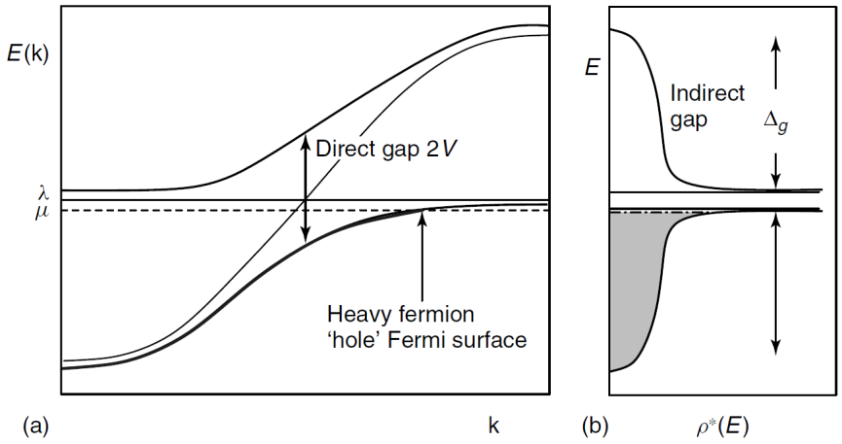
Local moments and the Kondo lattice
The Large N Kondo Lattice
  At the saddle point
  Matrix form of the Hamiltonian
  where
  Diagonalize the Hamiltonian
Notes:
Effective interaction induced by the virtual charge fluctuations

Slide 21
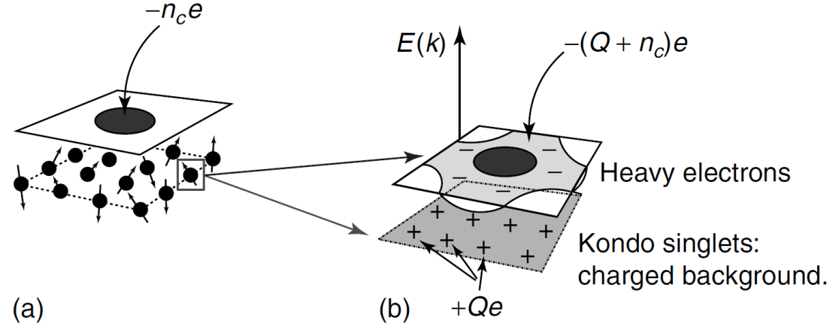
Local moments and the Kondo lattice
The Large N Kondo Lattice
  “Heavy-fermion” dispersion
  How to find V and λ?
  Compute free energy
Notes:
Effective interaction induced by the virtual charge fluctuations

Slide 22
Local moments and the Kondo lattice
The Large N Kondo Lattice
  “Heavy-fermion” dispersion
  Compute free energy
Notes:
Effective interaction induced by the virtual charge fluctuations

Slide 23
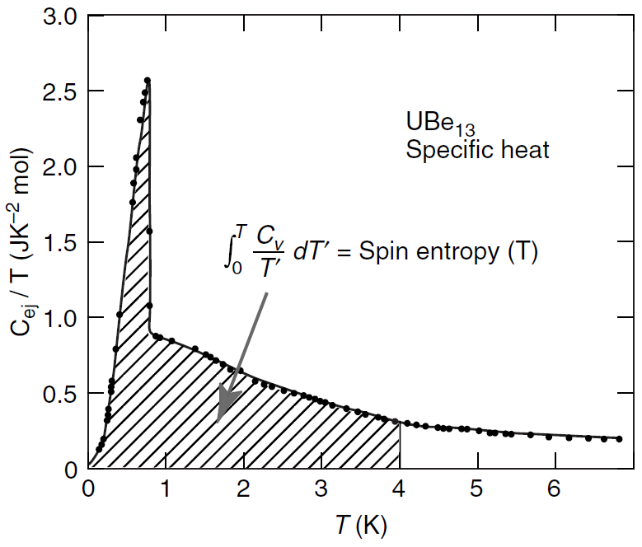
Heavy-fermion superconductivity
Phenomenology
  Spin entropy
  London penetration depth agrees with enhanced mass
  Coherence length reduces
  “BCS-like” theory
  Example: UPt₃
Notes:
Effective interaction induced by the virtual charge fluctuations

Slide 24
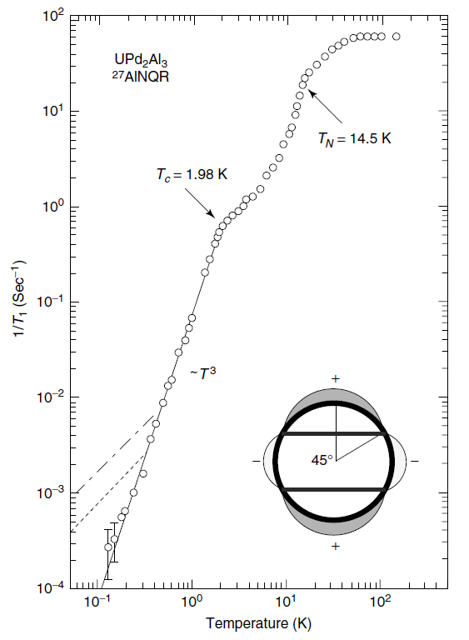
Heavy-fermion superconductivity
Phenomenology
  Density of states near line nodes
  Specific heat
  NMR
  “Volovik effect”
Notes:
Effective interaction induced by the virtual charge fluctuations

Slide 25
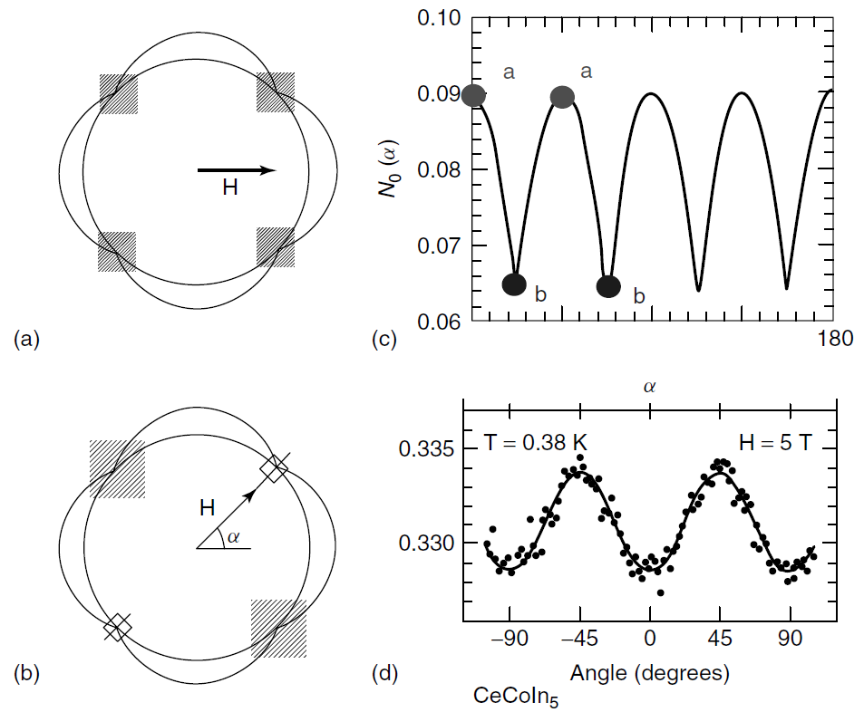
Heavy-fermion superconductivity
Phenomenology
  “Volovik” effect
  Density of quasiparticle states
  DOS depends maximum when magnetic field and node perpendicular
Notes:
Effective interaction induced by the virtual charge fluctuations

Slide 26
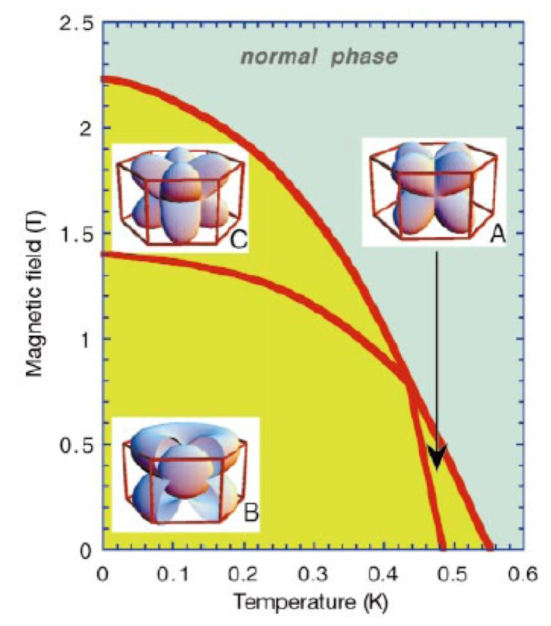
Superconducting “phases” of UPt₃
Symmetry breaking in super-conductor
  Three superconducting phases
  T_{N} = 5 K
  T_{c} = 0.54 K
  Antiferromagnetic order is instrumental for the symmetry breaking between the different superconducting phases

Slide 27
Fulde–Ferrell–Larkin–Ovchinnikov (FFLO) state
FFLO properties
  Superconductor in a large Zeeman field (B)
  Cooper pairs have finite momentum
  Spatially oscillating order parameter
  Proposed candidate: CeCoIn₅
  Unfortunately even the slightest disorder destroys the FFLO state

