Slide 1
Topological Insulators and Superconductors
Tejas Deshpande
Xiao-Liang Qi and Shou-Cheng Zhang. “Topological insulators and superconductors.” Reviews of Modern Physics 83, no. 4 (2011): 1057.

Slide 2
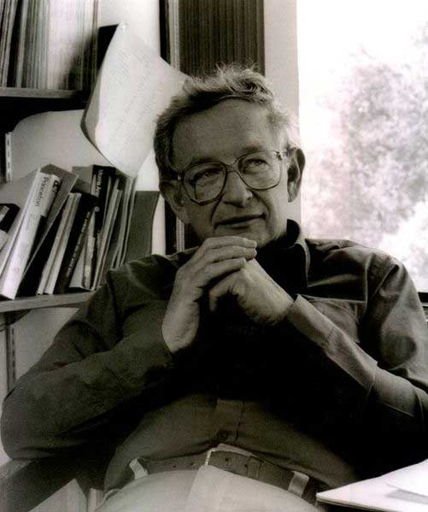

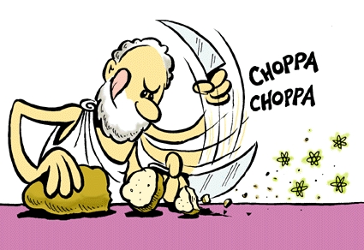
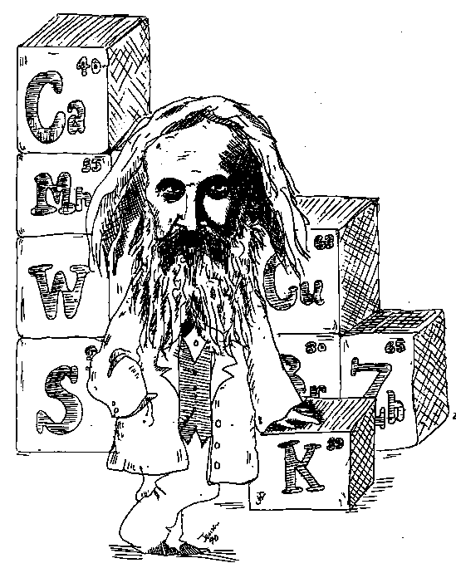
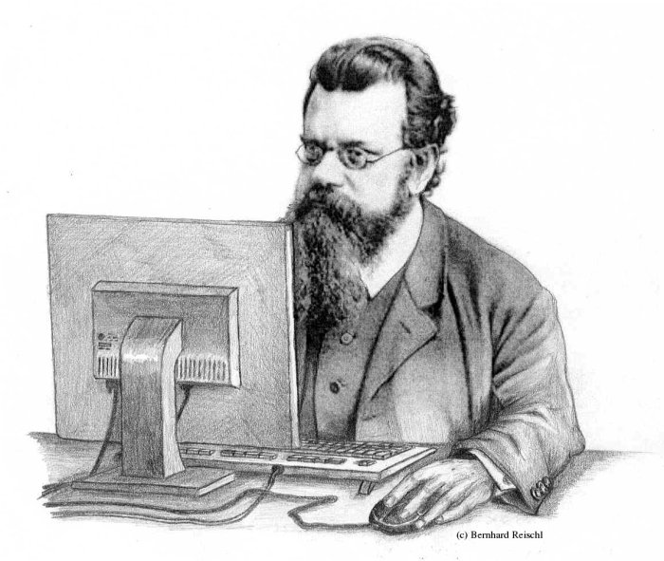
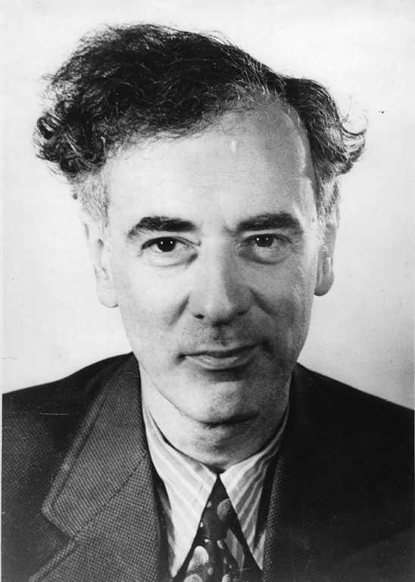
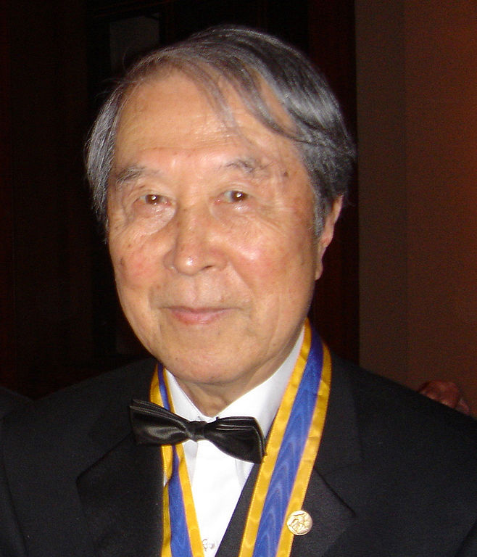
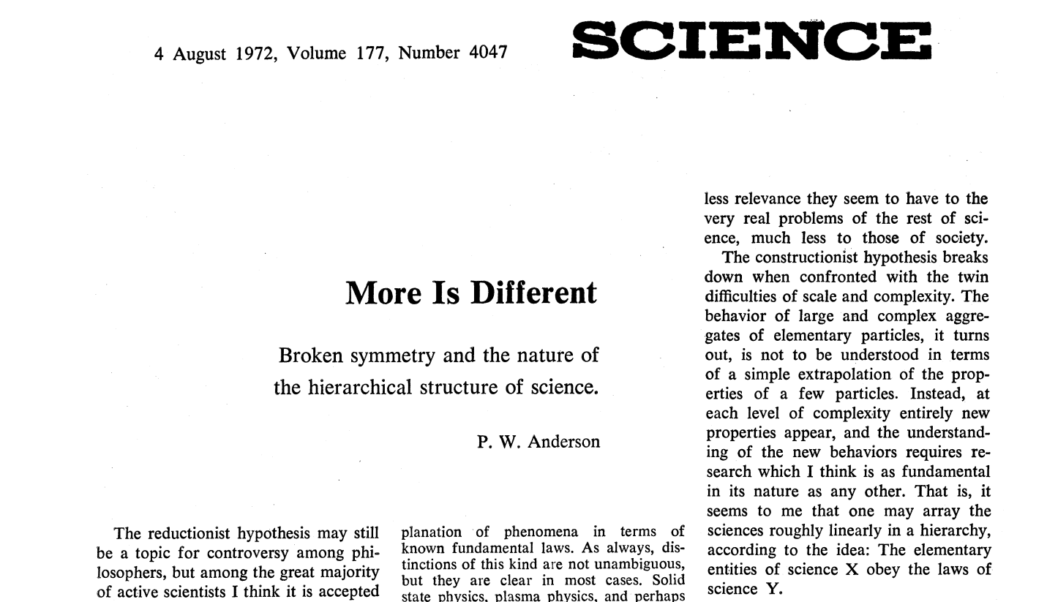
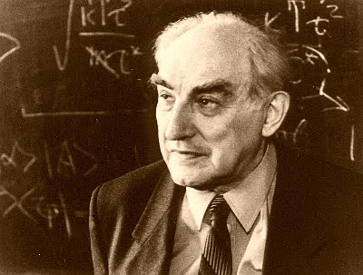
I. Introduction
“Fundamental” science: reductionism
  Greeks: Concept of the atom
  19th century:
    Periodic table of elements
    Statistical mechanics
    Electrodynamics
  20th century:
    Quantum mechanics + Relativity
    Subatomic (elementary) particles
Condensed Matter Physics: emergence
  Anderson: “More is different”
  Spontaneous symmetry breaking in high energy physics: Yoichiro Nambu (inspiration: superconductivity)
  Lev Landau: Classification of phases by symmetry breaking
  Vitaly Ginzburg: Local order parameter
  Success of Landau-Ginzburg: crystalline solids, magnets and superconductors
Notes:
http://www.clab.edc.uoc.gr/materials/pc/img/duck_chopping_atoms.gif
http://www.woodrow.org/teachers/ci/1992/MENDELEEV.GIF
http://homepage.univie.ac.at/bernhard.reischl/images/cp-boltzmann.jpg
http://images.tandf.co.uk/common/jackets/amazon/978075030/9780750307598.jpg
http://upload.wikimedia.org/wikipedia/commons/0/00/Standard_Model_of_Elementary_Particles.svg
http://www.mlahanas.de/Physics/Bios/images/PhilipWarrenAnderson.jpg
http://upload.wikimedia.org/wikipedia/commons/thumb/1/11/YoichiroNambu.jpg/658px-YoichiroNambu.jpg
http://landau100.itp.ac.ru/landau.jpeg
http://4.bp.blogspot.com/_IoU3bEFUwWc/SvgJCWzMIlI/AAAAAAAAGVY/j8ufsXDwxPs/s400/Vitaly+Ginzburg.jpg

Slide 3
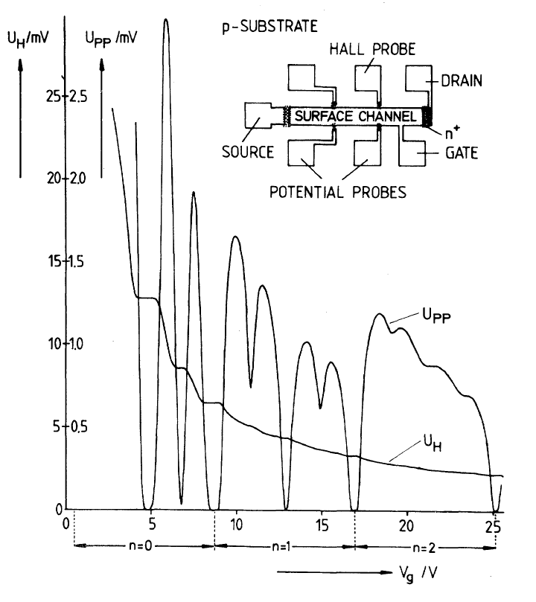
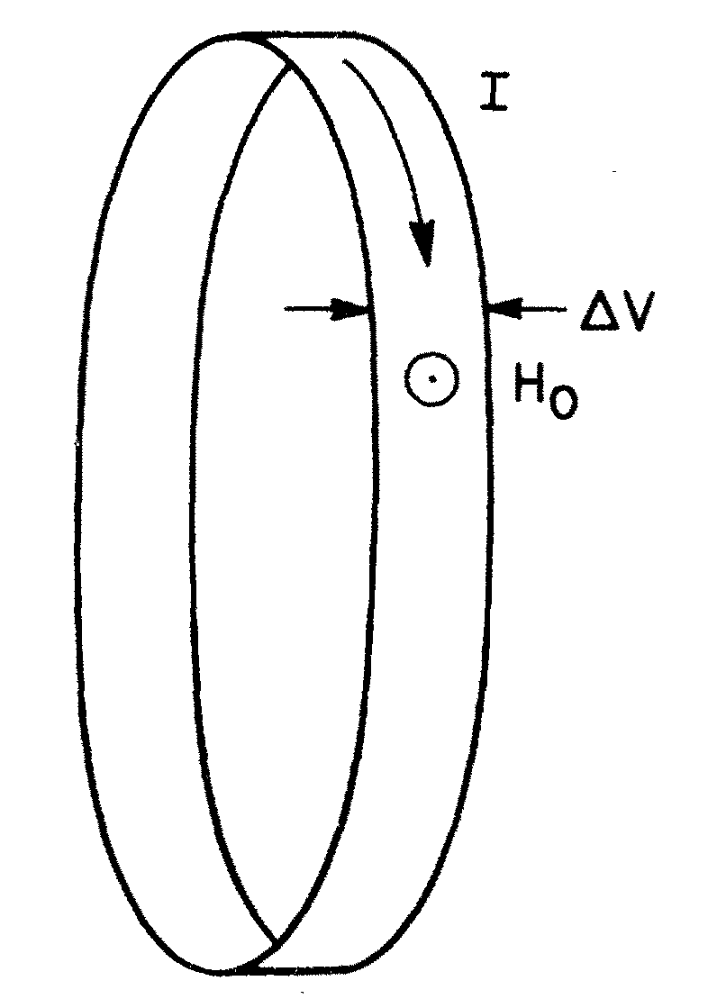
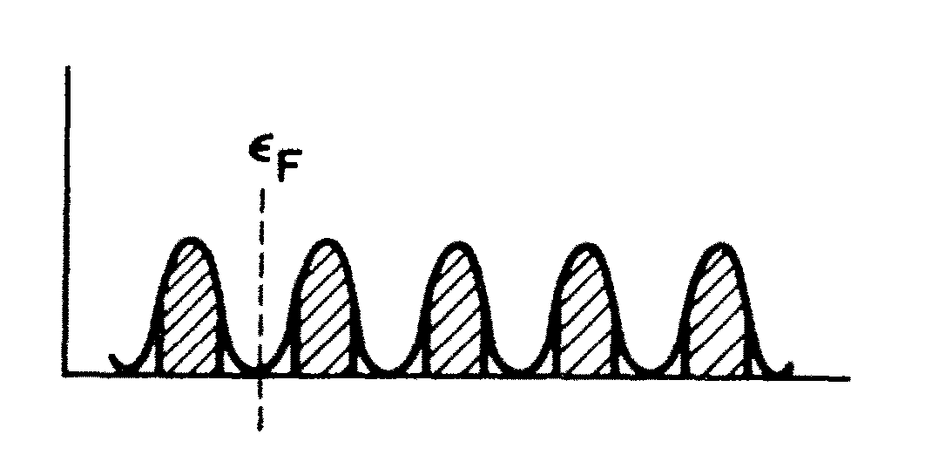
I. Introduction
Topological Phases of Matter
  von Klitzing’s discovery of the Integer Quantum Hall (QH) Effect (IQHE) in 1980
  Topological invariant ➔ Hall conductance quantized in units of e²/h
  Laughlin’s argument of the “quantum pump”
  Thouless, Kohmoto, Nightingale, and den Nijs (TKNN) ➔ Analytically showed quantization of Hall conductance
  Quantization of σ_{xy} was shown by brute force evaluation of Kubo formula
Quantization of σ_{xy} as a consequence of:
  Gauge invariance
  Mobility gap at the quantized plateaus
Current = 1 μA
Magnetic Field = 18 T
Temperature = 1.5 K
Note: the TKNN paper was before Michael Berry’s seminal paper on Berry phase

Slide 4

I. Introduction
Topology in mathematics
  Notion of topological invariance ➔ classification of different geometrical objects into equivalence classes
  Example: classification of 2D surfaces ➔ number of holes (or genus)
Topology in physics
  In physics, consider Hamiltonians of many-particle systems with an energy gap or vacuum of a theory with gapped excitations
  Examples of real systems: Hamiltonians of insulators and superconductors with a full energy gap
  NOT: metals, doped semiconductors, or nodal superconductors
  “Smooth deformation” ➔ Tuning parameters in the Hamiltonian without closing the bulk gap
  Topological invariant ➔ extra label in addition to Landau-Ginzburg order parameter
Notes:
http://i.huffpost.com/gadgets/slideshows/9118/slide_9118_121015_large.jpg?1368697939760

Slide 5
I. Introduction
Overview of important developments in topological materials
  Quantum Hall states belong to a topological class which explicitly breaks time-reversal symmetry (TRS)
  Recently, new topological class of materials theoretically predicted and experimentally observed: Symmetry Protected Topological (SPT) phases preserving TRS in 2D and 3D
Discovery | Theoretical | Experimental
Quantum spin Hall insulator state in HgTe quantum wells | Bernevig et al., Science 314, 5806 (2006), pp. 1757-1761 | König et al., Science 318, 5851 (2007), pp. 766-770.
Topological insulators (TIs) in three dimensions: theory and prediction in Bi_{x}Sb_{1-x} | (Theory) Fu et al., PRL 98, 10 (2007), pp. 106803 | Hsieh et al., Nature 452, 7190 (2008), pp. 970-974
 | (Bi_{x}Sb_{1-x}) Fu et al., PRB 76, 4 (2007), pp. 045302
Second generation of 3D topological insulators: Bi₂Se₃, Bi₂Te₃, and Sb₂Te₃ | Zhang et al., Nature Physics 5, 6 (2009), pp. 438-442 | (Bi₂Se₃) Xia et al., Nature Physics 5, 6 (2009), pp. 398-402
 |  | (Bi₂Te₃,) Chen et al., Science 325, 5937 (2009), pp. 178-181

Slide 6
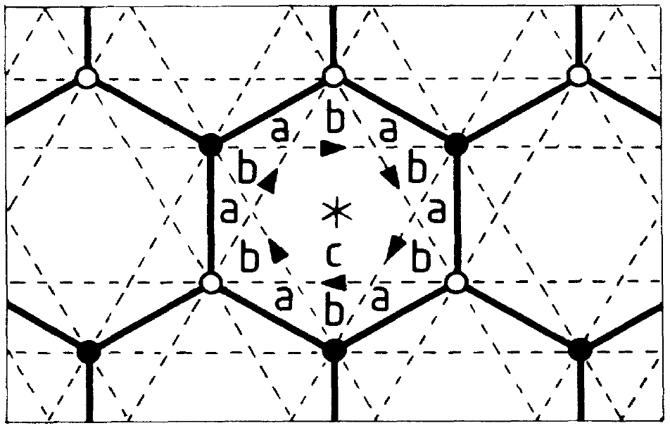
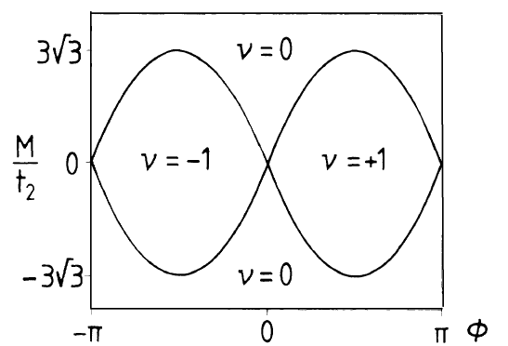
I. “Real” Introduction
The (twisted) Road to Topological Insulators
  IQHE without external gauge field (Haldane, 1988)
  Topological Field Theory (TFT) of the QH effect based on Chern-Simons (CS) term (Zhang et. al, 1992)
  Microscopic model for QH Effect (QHE) in 4D (Zhang et. al, 2001)
  2D and 3D TIs result from dimensional reduction of 4D QHE
  Intrinsic spin Hall effect (Murakami et. al, 2003)
  Dissipationless Spin Hall Insulator (SHI) (Murakami et. al, 2003)
Spin conductance
Occupations of Light-Hole (LH) and Heavy-Hole (HH) bands

Slide 7
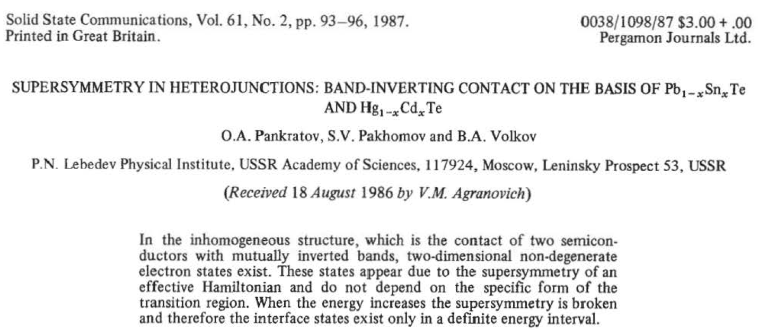
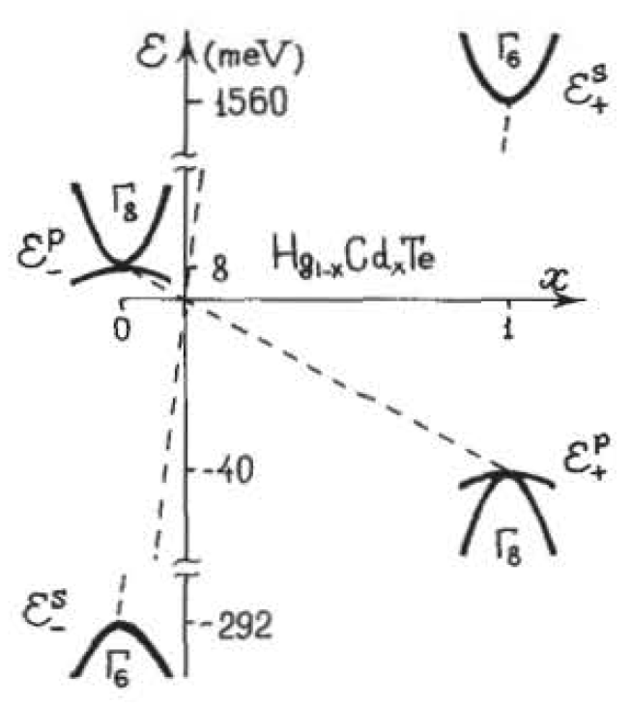
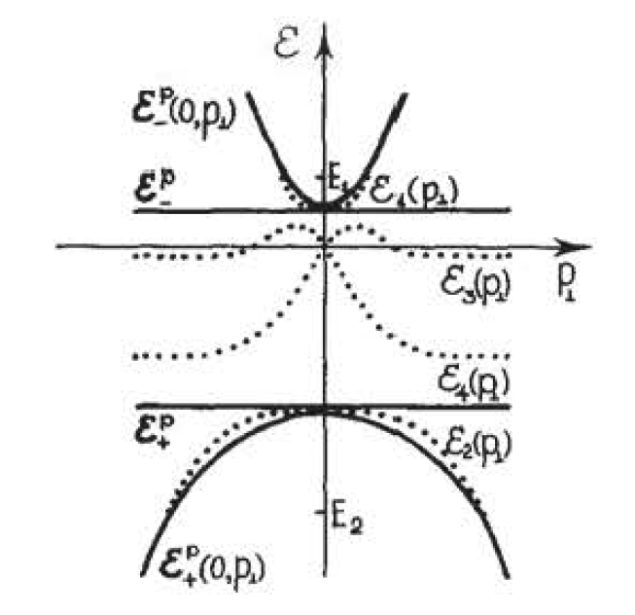
I. “Real” Introduction
The (twisted) Road to Topological Insulators
  Motivation from SHI ➔ Quantum Spin Hall Effect (QSHE) in graphene with intrinsic Spin-Orbit Coupling (SOC) (Kane et. al, 2005a)
  QSHE in strained semiconductors (Bernevig et. al, 2006)
  Important Note: Z₂ classification of TRI insulators ➔ “protected” edge states in QSHE (Kane et. al, 2005b)
  Edge states due to band inversion of HgTe relative to CdTe known back in 1986 by Volkov and Pankratov!
  Volkov and Pankratov did not make the connection to topology or protection of edge states
  TFT for topological insulators using dimensional reduction of 4D QHE (Qi et. al, 2008)

Slide 8
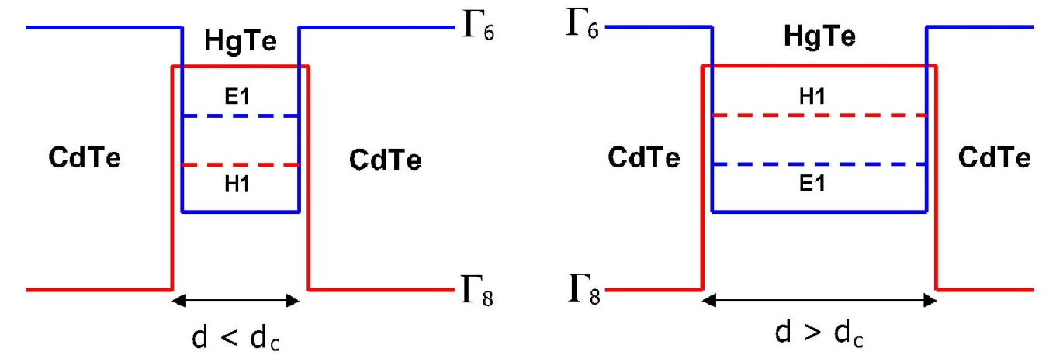
II. Two-Dimensional Topological Insulators
A.
Effective model of the two-dimensional time-reversal invariant topological insulator in HgTe/CdTe quantum wells
HgTe
CdTe
Inversion of the Γ₆ and Γ₈ bands in HgTe relative to CdTe
HgTe can be a 3D topological insulator
HgTe has no gap!
Quantum confinement provides subbands with gaps
For well thickness (d_{QW}) > 6.3 nm phase transtion occurs
Bands get “inverted”

Slide 9
II. Two-Dimensional Topological Insulators
B.
Explicit solution of the helical edge states
Divide the model Hamiltonian into two parts:
The model is defined (say) for the region x > 0. By breaking translational symmetry in this direction we need to replace:
The edge energy spectrum (if it exists) belongs to a family of eigen spectra of the full Hamiltonian with
Above Hamiltonian is block diagonal ➔ solutions take the form
The above eigenstates are related by time-reversal

Slide 10
II. Two-Dimensional Topological Insulators
B.
Explicit solution of the helical edge states
For C = D = 0 (i.e. assuming particle-hole symmetry) and E = 0 we get
With the ansatz:

Slide 11
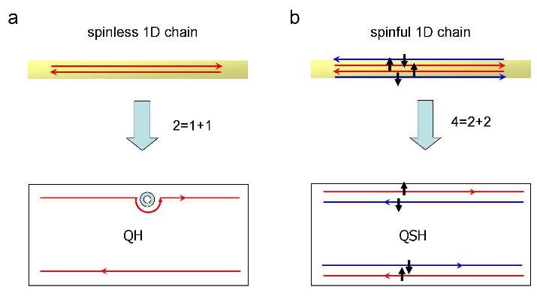
II. Two-Dimensional Topological Insulators
C.
Physical properties of the helical edge states
1.
Topological protection of the helical edge states
Explicit solution of the BHZ model ➔ pair of helical edge states exponentially localized at the edge
The concept of “helical” edge state ➔ states with opposite spin counter-propagate at a given edge
QH protected by “chiral” edge states; QSH edge states protected due to destructive interference between all possible backscattering paths
SOC provides spin-momentum locking
Clockwise and anticlockwise rotation of spin pick up ±π phase leading to destructive interference

Slide 12
II. Two-Dimensional Topological Insulators
C.
Physical properties of the helical edge states
1.
Topological protection of the helical edge states
The physical description of edge state protection works only for single pair of edge states
With (say) two forward-movers and two backward-movers backscattering is possible without spin flip
In other words, TRS perturbations can destroy edge states in pairs
Robust or non-dissipative edge transport requires odd number of edge states
If TR symmetry is not present
Electron operators:
Define the “chirality” operator
Any operator that changes C by 2(2n-1) is odd under TR

Slide 13
II. Two-Dimensional Topological Insulators
C.
Physical properties of the helical edge states
2.
Interactions and quenched disorder
Only two TR invariant non-chiral interactions can be added
Two-particle backscattering or “Umklapp” term
forward scattering term
We can “bosonize” the Hamiltonian
Boson to fermion field operators
The forward scattering term simply renormalizes the parameters K and v_{F}
Combined with Umklapp term we get (opens a gap at k_{F} = π/2)

Slide 14
II. Two-Dimensional Topological Insulators
C.
Physical properties of the helical edge states
2.
Interactions and quenched disorder
Total Hamiltonian
Umklapp term
Interactions can spontaneously break time-reversal symmetry
TR odd single-particle backscattering:
RG analysis ➔ Umklapp term relevant for K < 1/2 with a gap:
Bosonize N_{x} and N_{y} . For g_{u} < 0 fixed points at
For g_{u} < 0, N_{y} is the (Ising-like) ordered quantity at T = 0
Due to thermal fluctuations TRS is restored for T > 0
For
mass order parameter N_{y} is disordered + TR is preserved with a gap

Slide 15
II. Two-Dimensional Topological Insulators
C.
Physical properties of the helical edge states
2.
Interactions and quenched disorder
Total Hamiltonian
Umklapp term
Two-particle backscattering due to quenched disorder
Gaussian random variables
The “replica trick” in disordered systems shows disorder relevant for K < 3/8
N_{x} and N_{y} show glassy behavior at T = 0 with TRS breaking; TRS again restored at T > 0
Where would all these interactions come from? locally doped regions? Band bending?
But edge states are immune to electrostatic potential scattering
Potential inhomogeneities can trap bulk electrons which may then interact with the edge electrons
K < 1

Slide 16
II. Two-Dimensional Topological Insulators
C.
Physical properties of the helical edge states
2.
Interactions and quenched disorder
Static magnetic impurity breaks local TRS and opens a gap
Quantum impurity ➔ Kondo effect:
Doing the “standard” RG procedure we get flow equations

Slide 17
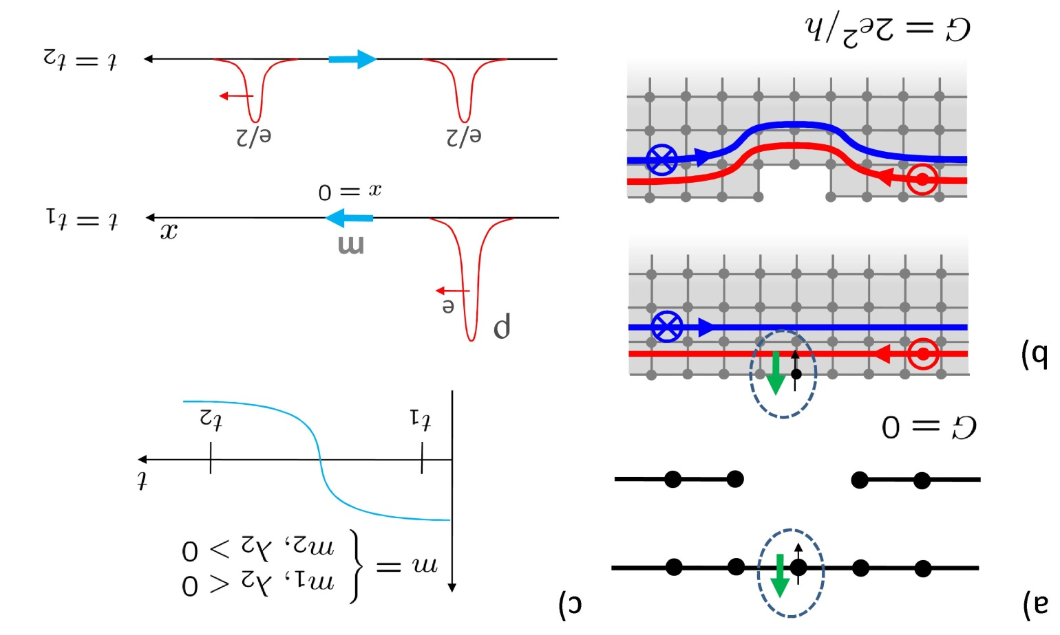

II. Two-Dimensional Topological Insulators
C.
Physical properties of the helical edge states
2.
Interactions and quenched disorder
Static magnetic impurity breaks local TRS and opens a gap
Quantum impurity ➔ Kondo effect
  At high temperature (T) conductance (G) is log
  For weak Coulomb interaction (K > 1/4) conductance back to 2e²/h. At intermediate T the G ~ T^{2(4K-1)} due to Umklapp term
  For strong Coulomb interaction (K < 1/4) G = 0 at T = 0 due to Umklapp. At intermediate T the G ~ T^{2(1/4K–1)} due to tunneling of e/2 charge

Slide 18
II. Two-Dimensional Topological Insulators
C.
Physical properties of the helical edge states
3.
Helical edge states and the holographic principle
The physical description of edge state protection works only for single pair of edge states
With (say) two forward-movers and two backward-movers backscattering is possible without spin flip
In other words, TRS perturbations can destroy edge states in pairs
Robust or non-dissipative edge transport requires odd number of edge states
Fermion doubling theorem

Slide 19
II. Two-Dimensional Topological Insulators
C.
Physical properties of the helical edge states
4.
Transport theory of the helical edge states
Using Landauer-Büttiker formalism for an n-terminal device
For the helical edge channels we expect
For a 2-point transport measurement between terminals 1 and 4

Slide 20
II. Two-Dimensional Topological Insulators
C.
Physical properties of the helical edge states
4.
Transport theory of the helical edge states
If the transport is dissipationless where is the resistance coming from?
In QSHE don’t we have spin currents of e²/h + e²/h = 2e²/h and charge currents of e²/h – e²/h = 0?
Answer 1: dissipation comes from the contacts. Note that transport is dissipationless only inside the HgTe QW
Answer 2: We do measure charge conductance! The existence of helical edge channels is inferred from charge transport measurements

Slide 21
II. Two-Dimensional Topological Insulators
D.
Topological excitations
1.
Fractional charge on the edge
Quantized charge at the edge of domain wall
    Jackiw-Rebbi (1976)
    Su-Schrieffer-Heeger (1979)
Helical liquid has half DOF as normal liquid ➔ e/2 charge at domain walls
Mass term ∝ Pauli matrices ➔ external TRS breaking field
Mass term to leading order
Current due to the mass field
For m₁ = m cos(θ), m₂ = m sin(θ), and m₃ = 0
Topological response ➔ net charge Q in a region [x₁,x₂] at time t = difference in θ(x,t) at the boundaries
Charge pumped in the time interval [t₁, t₂]

Slide 22
II. Two-Dimensional Topological Insulators
D.
Topological excitations
1.
Fractional charge on the edge
Two magnetic islands trap the electrons between them like a quantum wire between potential barriers
Conductance oscillations can be observed as in usual Coulomb blockade measurements
Background charge in the confined region Q (total charge) = Q_{c} (nuclei, etc.) + Q_{e} (lowest subband)
Flip relative magnetization ➔ pump e/2 charge
Continuous shift of peaks with θ(B)
AC magnetic field drives current

Slide 23
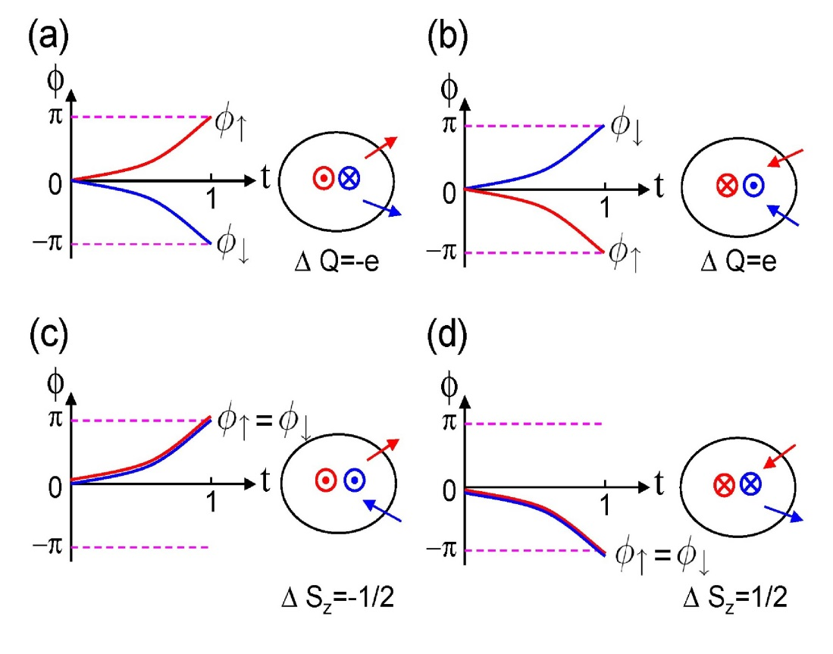
II. Two-Dimensional Topological Insulators
D.
Topological excitations
2.
Spin-charge separation in the bulk
Simplified analysis:
  Assume S_{z} is preserved
  QSHE as two copies of QHE
Thread a π (units of ℏ = c = e = 1) flux ϕ
TRS preserved at ϕ = 0 and π; also, π = –π
Four possible paths for ϕ↑ and ϕ↓:
Current density from E||:
Net charge flow:

Slide 24
II. Two-Dimensional Topological Insulators
E.
Quantum anomalous Hall insulator
The trio is finally complete!
Ordinary Hall Effect with external magnetic field (H) | Pure Spin Hall Effect | Anomalous Hall Effect with magnetization (M)
Hall voltage but no spin accumulation | Spin accumulation but no Hall voltage | Hall voltage and spin accumulation

Slide 25
II. Two-Dimensional Topological Insulators
E.
Quantum anomalous Hall insulator
Quantum Anomalous Hall Effect (QAHE) described by upper 2×2 block of the QSHE, i.e. 2-band model with explicit TRS breaking
The quantized Hall conductance is determined by
With TRS breaking charge Hall conductance of counter propagating states do not cancel perfectly
For system doped with magnetic impurities, splitting term added:
Upper and lower blocks have masses M + (G_{E} – G_{H})/2 and M + (G_{E} + G_{H})/2
QAHE is given by G_{E}G_{H} < 0
Mn-doped HgTe QWs or Cr- or Fe-doped Bi₂Se₃ and Bi₂Te₃ thin films satisfy above condition for different physical reasons
In HgTe the 2 bands have opposite signed exchange coupling, i.e. s-d and p-d
In Bi₂Se₃ and Bi₂Te₃ sign of the spin different in the two blocks

Slide 26
II. Two-Dimensional Topological Insulators
F.
Experimental Results
1.
Quantum well growth and the band inversion transition
HgTe width (d_{QW}) in the range from 4.5 nm to 12.0 nm were grown with phase transition at 6.3 nm
Ranges: V_{g} ≥ –1.0 V (n-doped), –1.9 V < V_{g} < –1.4 V (insulating), and V_{g} < –2.0 V (p-doped)
Hall resistance R_{xy} for L = 600 μm and W = 200 μm

Slide 27
II. Two-Dimensional Topological Insulators
F.
Experimental Results
1.
Quantum well growth and the band inversion transition
For normal ordering of bands the Landau levels will get further apart as B increases
For inverted bandstructures Landau levels will cross at a certain B
Only inverted bandstructures will reeneter the quantum Hall states when B field increases

Slide 28
II. Two-Dimensional Topological Insulators
F.
Experimental Results
2.
Longitudinal conductance in the quantum spin Hall state
For d_{QW} < 6.3 nm resistance is in the MΩ, i.e. insulating
For d_{QW} > 6.3 nm resistance is 100 kΩ
100 kΩ ≫ h/2e² (12.8 kΩ)
The extra resistance may come from inelastic scattering
Estimate inelastic mean free path ~ 1 μm
Experiments on device with L = 1 μm
4-point measurements give R_{xx} = h/2e² as expected
Changing width between W = 1 μm and 0.5 μm gives same result ➔ there is no parasitic bulk conduction

Slide 29
II. Two-Dimensional Topological Insulators
F.
Experimental Results
3.
Magnetoconductance in the quantum spin Hall state
There is a large anisotropy in magnetoconductance for magnetic fields pointing in-plane or perpendicular to the plane

Slide 30
II. Two-Dimensional Topological Insulators
F.
Experimental Results
4.
Nonlocal conductance
Using the Landauer-Buttiker formulas we can compute resistance among different terminals
This type of “nonlocal” conductance was measured and found to match with theory
This was unambiguous proof that these are helical edge states

Slide 31
III. Three-Dimensional Topological Insulators
Simple model Hamiltonian for Bi₂Se₃, Bi₂Te₃, Sb₂Te₃ a natural extension of HgTe
SOC drives band inversion at the Γ point
Full bulk gap with 2D massless “helical” and “holographic” Dirac surface spectrum
TR breaking perturbation opens a gap in the surface spectrum ➔ Topological Magnetoelectric Effect
A.
Effective model of the three-dimensional topological insulator
Rhombohedral crystal structure with space group:
Each “quintuple layer” consists of five atoms per unit cell
Each quintuple layer is ~ 1 nm thick
The primitive lattice vectors are t₁, t₂, t₃
Under inversion the primed atoms transform into the unprimed atoms

Slide 32
III. Three-Dimensional Topological Insulators
A.
Effective model of the three-dimensional topological insulator
Consider the example Bi (6s²6p³) and Se (4s²4p⁴)
Recombine the orbitals in a single unit cell according to their parity
In step I we have 3 states (2 odd, 1 even) from each Se p-orbital and 2 states (1 odd, 1 even) from each Bi p-orbital
In step II crsytal field splits p_{z} into p_{x} and p_{y}
In step III we turn on the L.S spin-orbit splitting term
|P1_{z}⁺⟩ and |P2_{z}–⟩ as a function of spin-orbit strength λ
λ(Bi/Se) = xλ₀(Bi/Se) with λ₀(Bi) = 1.25 eV and λ₀(Se) = 0.22 eV
Phase transition occurs before the real values of spin-orbit strength
Band inversion of opposite parity states at odd TRIM ➔ topologically nontrivial
Hybridized states

Slide 33
III. Three-Dimensional Topological Insulators
A.
Effective model of the three-dimensional topological insulator
Similar to HgTe we can define a model Hamiltonian respecting symmetries
The 4 closest states can be chosen as our basis
The model Hamiltonian in the above basis can be written as
Parameters determined by comparison to ab initio calculations
Hamiltonian is like a 3D anisotropic Dirac model but with k-dependent mass
Extra cubic terms ➔ reduce rotational symmetry about z-axis from SO(2) to C₃

Slide 34
III. Three-Dimensional Topological Insulators
B.
Surface states with a single Dirac cone
Similar to the HgTe case split the Hamiltonian into portions with and without k_{z} since we break translational symmetry along the z-axis
The form of the first Hamiltonian is similar to the one in QSHE
Surface state at k_{x} = k_{y} = 0 is determined by the same equation as the QSHE
Surface state exists for M/B₁ > 0. In the examples below B₁B₂ > 0, A₁A₂ > 0
Note: surface helicity is determined by sign of A₁/B₁; here spins have more than 2 polarization states
Once again projection of bulk Hamiltonian on to surface states we get
For A₂ = 4.1 eV, v_{F} = A₂/ℏ = 6.2 × 10⁵ m/s vs. ab initio result of v_{F} = 5 × 10⁵ m/s

Slide 35
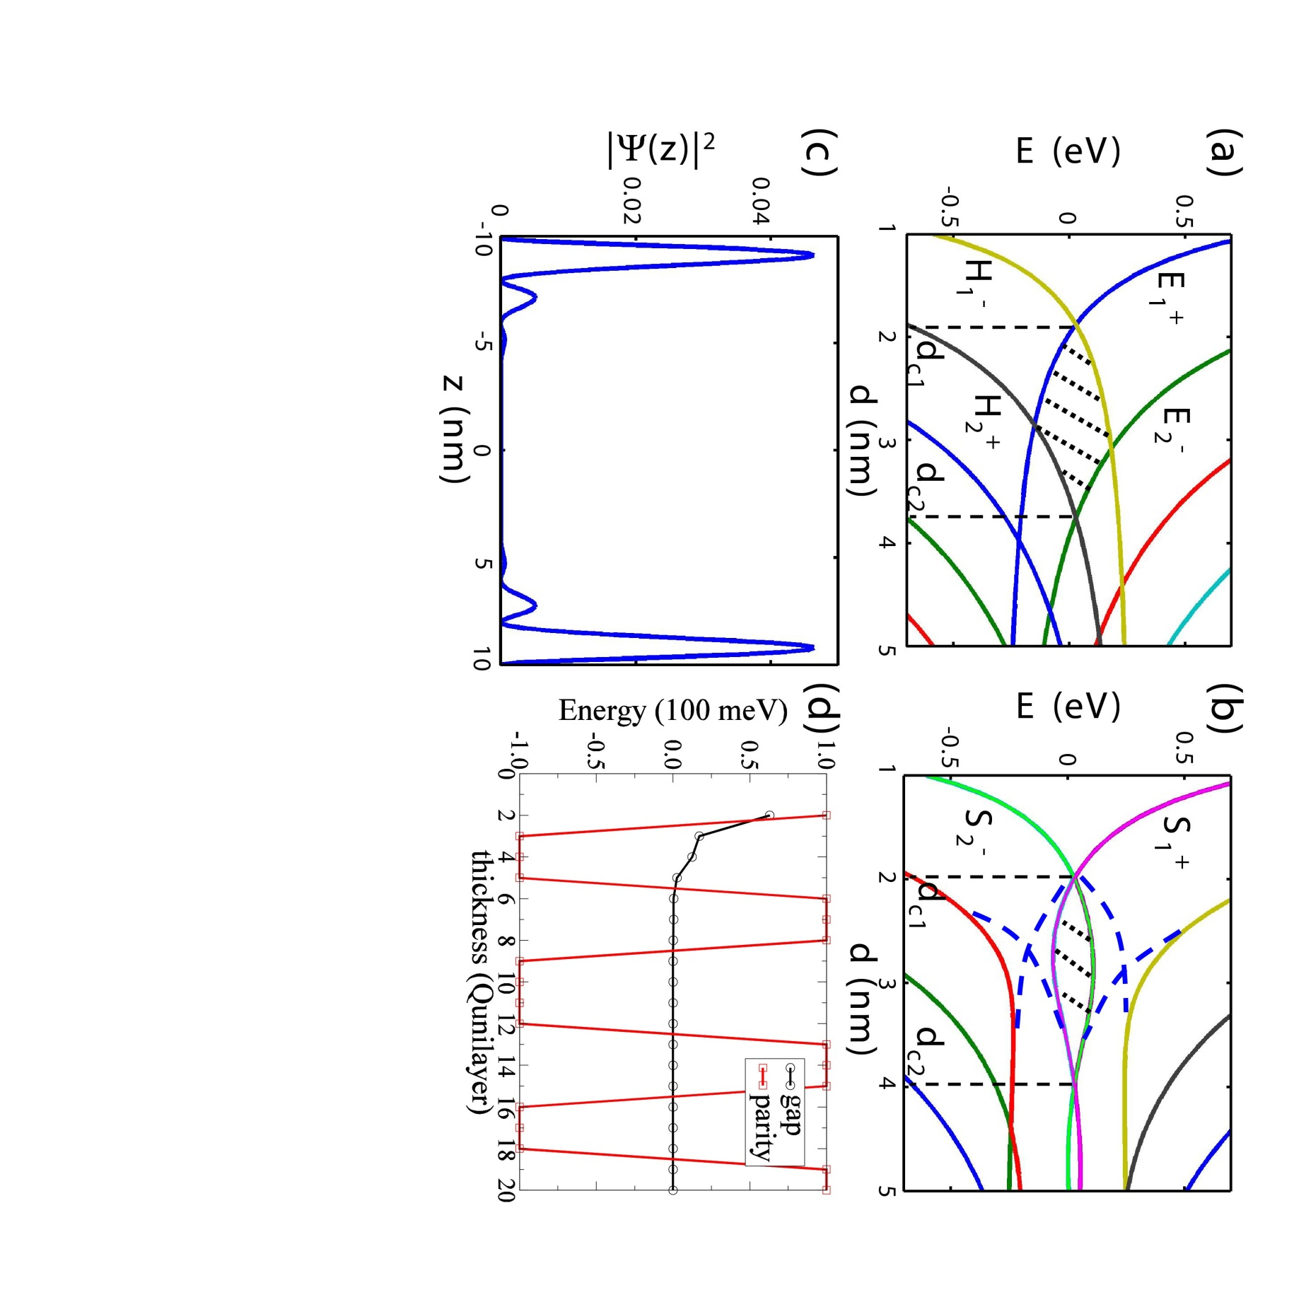
III. Three-Dimensional Topological Insulators
C.
Crossover from three dimensions to two dimensions
The models describing 2D and 3D topological insulators are quite similar
But is a thin 3D film a trivial or nontrivial insulator?
Consider a 3D TI with finite thickness d in the z-direction
For k_{x} = k_{y} = 0 we have
For A₁ = 0 the Hamiltonian is diagonal and we can compute the eigenstates as
For M < 0 and a small enough d the subbands are normally ordered
As d increases there must be an electron-hole subband crossing at some d = d_{c}
For A₁ = 0 the subband energies as a function of distance look similar to the HgTe QW
Note: multiple crossings

Slide 36
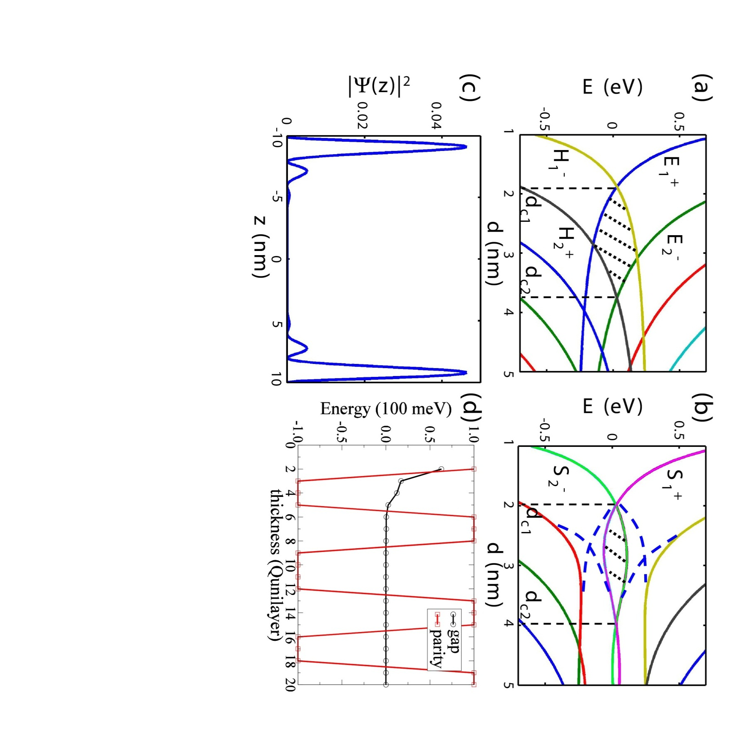
III. Three-Dimensional Topological Insulators
C.
Crossover from three dimensions to two dimensions
For k_{x} = k_{y} = 0 we have
For A₁ = 0 the subband energies as a function of distance look similar to the HgTe QW
Note: multiple crossings
For A₁ ≠ 0 the subbands on the right (for A₁ = 0) hybridize
Hybridization gives special states |S₁⁺⟩, which is superposition of |E_{2n–1}⟩ and |H_{2n}⟩ (for n = 1, 2, …), and |S₂–⟩ (superposition of |H_{2n–1}⟩ and |E_{2n}⟩)
Crossing is permitted only with the next closest subband and they intersect multiple times
Thin film oscillates between trivial and nontrivial with transition points given by (A₁ → 0)

Slide 37



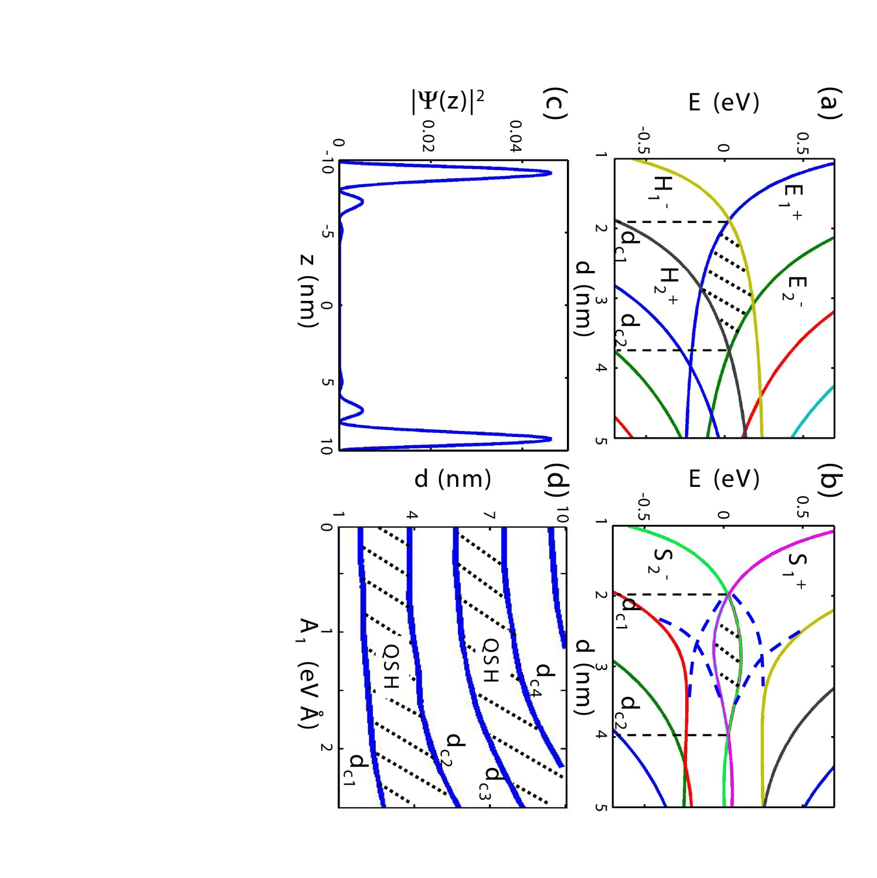
III. Three-Dimensional Topological Insulators
C.
Crossover from three dimensions to two dimensions
For k_{x} = k_{y} = 0
Hybridization gives special states |S₁⁺⟩, which is superposition of |E_{2n–1}⟩ and |H_{2n}⟩ (for n = 1, 2, …), and |S₂–⟩ (superposition of |H_{2n–1}⟩ and |E_{2n}⟩)
Multiple crossings give relative parity oscillations with thickness
|S₁⁺⟩ and |S₂–⟩ are localized at the opposite surfaces of the 3D TI slab; oscillations in wave function also go as ~ π(B₁/|M|)^{1/2}
Dependence of critical thickness on A₁ is shown in the figure to the right
As d → ∞, |S₁⁺⟩ and |S₂–⟩ decouple and become surface state of the 3D TI

Slide 38
III. Three-Dimensional Topological Insulators
C.
Crossover from three dimensions to two dimensions
Relation between electron and hole subbands in the d → ∞ limit suggests another way to describe 3D to 2D crossover
The surface is described by
The upper and lower block diagonal elements correspond to the two surfaces
For slabs of finite thickness a coupling term M_{2D}(k) can be added
Changes in sign of M_{2D} tell if phase is trivial or not. M_{2D} oscillates with d since the surface wave functions oscillate
In other words, both top-down and bottom-up approaches agree
In real materials, like Bi₂Se₃ we can expect the nontrivial phase to first occur at a thickness of ~ 3 nm or three quintuple layers

Slide 39
III. Three-Dimensional Topological Insulators
D.
Electromagnetic properties
1.
Half quantum Hall effect on the surface
The only momentum independent term one can add is
The perturbed Hamiltonian has the spectrum
Only parameter m_{z} can open a gap and destabilize the surface states
The term m_{z}σ^{z} breaks TRS; but (say) with 2 identical Dirac cones, with imaginary coupling, we have gapped system with TRS
But with term m_{z}σ^{z} the surface will be
With the generic two-band model we consider the winding of:
A “meron” configuration d(k) covers half the unit sphere
With winding number ±1/2 we have Hall conductance (valid for m_{z} → 0)
Parity anomaly in high energy physics
Above analyis only applies in continuum, i.e. |m_{z}|/A₂ ≪ 2π/a
Unlike QAHE, where M → 0, Hall conductance = 0 or 1 instead of ±1/2

Slide 40
III. Three-Dimensional Topological Insulators
D.
Electromagnetic properties
1.
Half quantum Hall effect on the surface
Deviations from the Dirac effective model at large momenta ➔ corrections to the Hall conductance
is independent of large momentum contributions
The effect of the mass term m_{z}σ^{z} on the large-momentum sector of the theory is negligible for m_{z} → 0
Contributions to σ_{H} from large momenta ➔ continuous functions of m_{z}; therefore Δ σ_{H} should not be affected
TR transforms the system with mass m_{z} to that with mass –m_{z}
Note: unlike QAHE upper and lower 2 × 2 blocks are not TR conjugate
Disorder: Nomura, Koshino, and Ryu showed that the surface state is metallic even for an arbitrary impurity strength
TR breaking disorder ➔ unitary class
For infinitesimal TR breaking σ_{xx} = 0 and σ_{xy} = ±e²/2h
Exchange interaction with impurity given by

Slide 41
III. Three-Dimensional Topological Insulators
D.
Electromagnetic properties
1.
Half quantum Hall effect on the surface
In a usual Fermi liquid, if the surface state has a finite k_{F}, an RKKY interaction between the impurity spins is introduced
The sign of RKKY oscillates with wave length ∝ 1/2k_{F}
For k_{F} → 0 the sign of the RKKY interaction does not oscillate but is uniform
The resulting uniform spin-spin interaction (ferromagnetic) is determined by the coupling to the surface electrons
A uniform spin polarization can maximize the gap opened on the surface ➔ energetically favorable
Therefore, the system can order ferromagnetically when the chemical potential is near the Dirac point
This mechanism provides a way to generate a surface TR symmetry breaking field by
  Coating the surface with magnetic impurities
  Tuning the chemical potential near the Dirac point

Slide 42
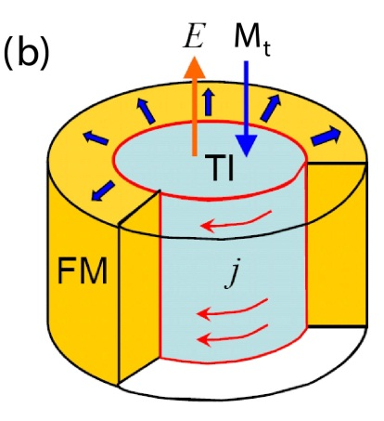
III. Three-Dimensional Topological Insulators
D.
Electromagnetic properties
2.
Topological magnetoelectric effect
Unlike QHE in the pure 2D system surface quantum Hall cannot be measured using DC transport for the reasons:
  Surface of a 3D TI is a closed manifold (i.e. no edges)
  If TRS is broken only on a partial patch of the surface chiral states on the domain wall give σ_{H} = e²/h and not e²/2h
The TRS broken patch (right) is like the boundary between n and n+1 level QHE
A new probe is needed ➔ Topological Magnetoelectric Effect (TME)
The complete EM response of the system is described by the modified constituent equations (P₃ = ±1/2)

Slide 43
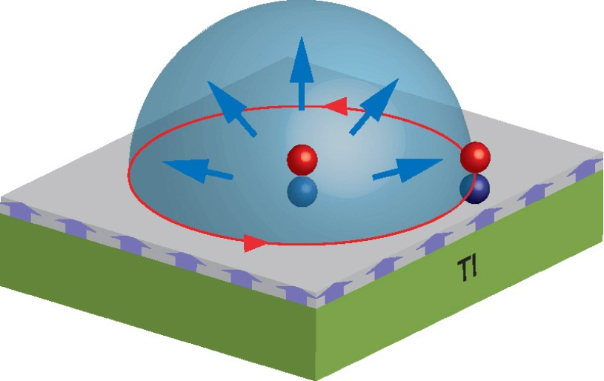
III. Three-Dimensional Topological Insulators
D.
Electromagnetic properties
3.
Image magnetic monopole effect
Direct consequences of the TME effect is the image magnetic monopole effect
Interesting phenomena appear when we consider the dynamics of the external charge
For 2DEG at a distance d above the surface of the 3D TI and if the motion of the 2DEG electrons is slow enough compared to ℏ/m the image monopoles will follow the electrons adiabatically
The electron forms an electron-monopole composite, i.e. a “dyon”
When 2 electrons wind around each other, each electron perceives the magnetic flux of the image monopole attached to the other electron

Slide 44
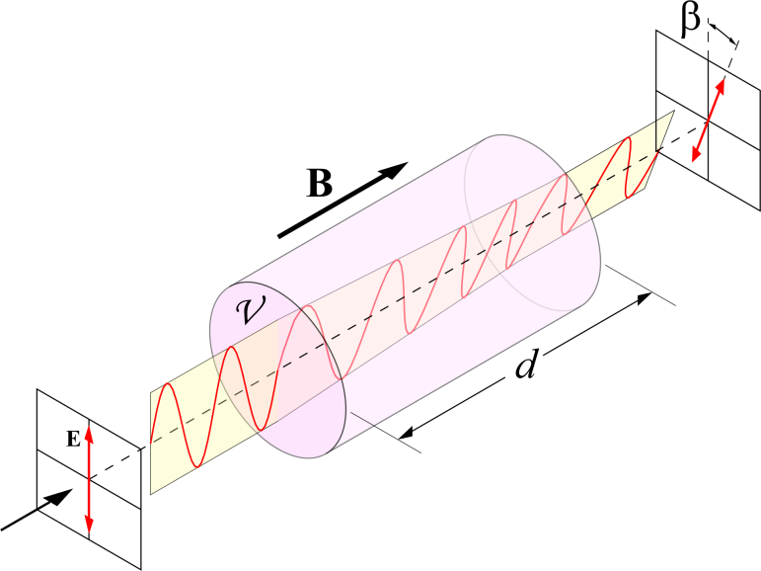
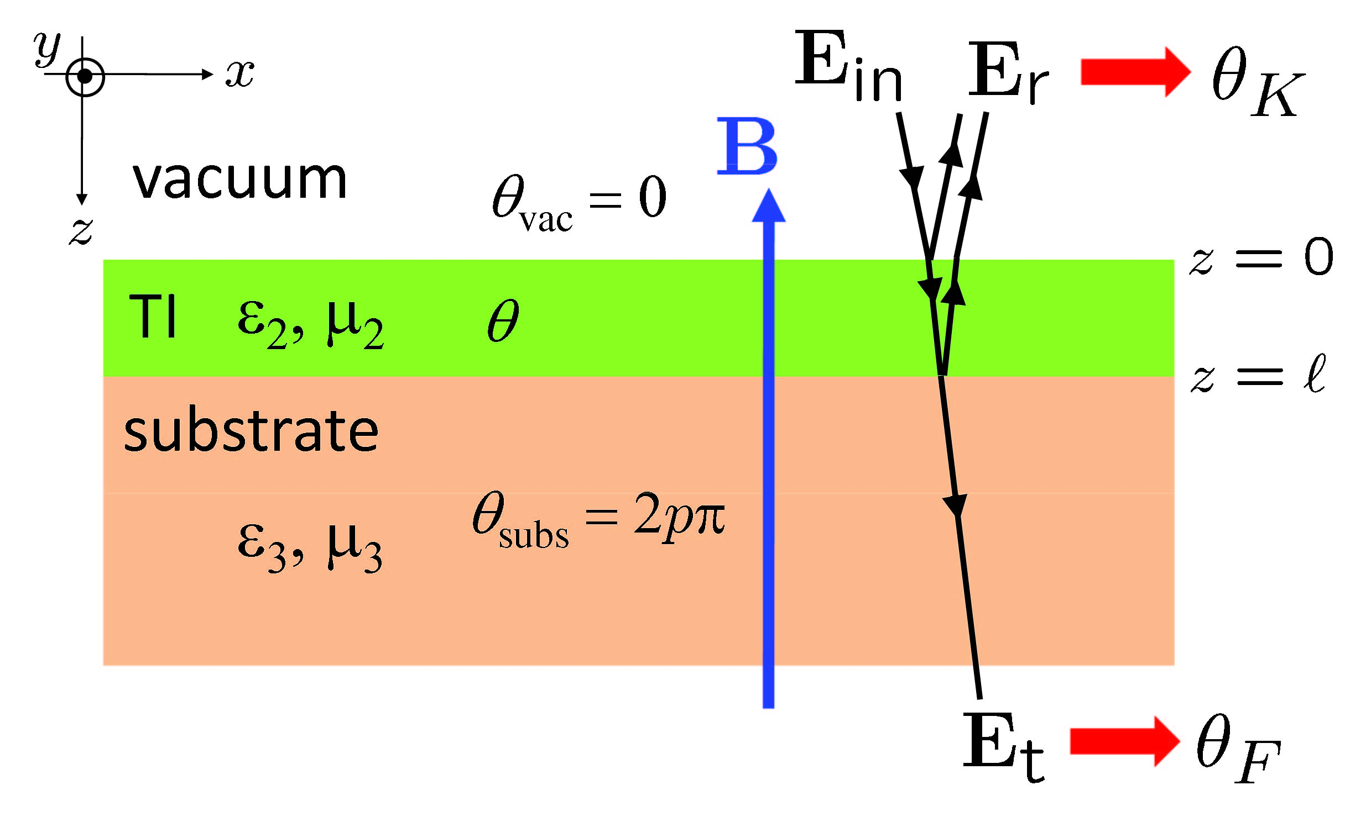
III. Three-Dimensional Topological Insulators
D.
Electromagnetic properties
4.
Topological Kerr and Faraday rotation
Another TME effect is through the transmission and reflection of polarized light
Standard Faraday effect requires an external B field
For TME we Faraday rotation occurs due to unusual boundary conditions at the interface of the TI and ferromagnetic insulator (FMI)
The rotation angles for the Kerr and Faraday effect are
Problems:
  Dependence on material parameters
  Detection obscured by standard EM response
New scheme: combine Faraday and Kerr

Slide 45
III. Three-Dimensional Topological Insulators
D.
Electromagnetic properties
5.
Related Effects
The magnetic monopole carries a charge, i.e. monopole with unit flux carries e/2 charge
There is a charge pumping effect when monopole motion ➔ couples to electric charge
When electron-electron interaction is considered interesting new effects can occur
We can get a so-called axion from fluctuations of P₃ due coupling between spin-waves and the electromagnetic field
Polariton can be formed by the hybridization of the spin-wave and photon
The polariton gap is controlled by the magnetic field, which may realize a tunable optical modulator
Inter-surface exciton condensate can be formed
Charge current on the surface can flip the magnetic moment of the magnetic layer
In other words, charge density is coupled to magnetic textures such as domain walls and vortices
Potential applications in spintronics

Slide 46
III. Three-Dimensional Topological Insulators
E.
Experimental results
1.
Material growth
Cava group (Princeton): Bulk materials were first grown for experiments on topological insulators (Bi_{1-x}Sb_{x}, Bi₂Se₃, Bi₂Te₃, and Sb₂Te₃)
Fisher group (Stanford): Bi₂Te₃
Cui group (Stanford): Bi₂Se₃ nanoribbons
Xue group (Tsinghua): MBE grown thin films of Bi₂Se₃, Bi₂Te₃
Due to layered structure thin films can also be obtained by exfoliation from bulk samples
Stoichiometric compounds relatively easy to grow
Due to intrinsic doping from vacancy and anti-site defects Bi₂Se₃, Bi₂Te₃, are n-type and Sb₂Te₃ are p-type in the bulk
Controlled doping of Bi₂Se₃ with Sb and Ca and Bi₂Te₃ with Sn gives control over the chemical potential
Cu doping causes Bi₂Se₃ to become superconducting (nontrivial?)
Fe and Mn dopants may yield ferromagnetism

Slide 47
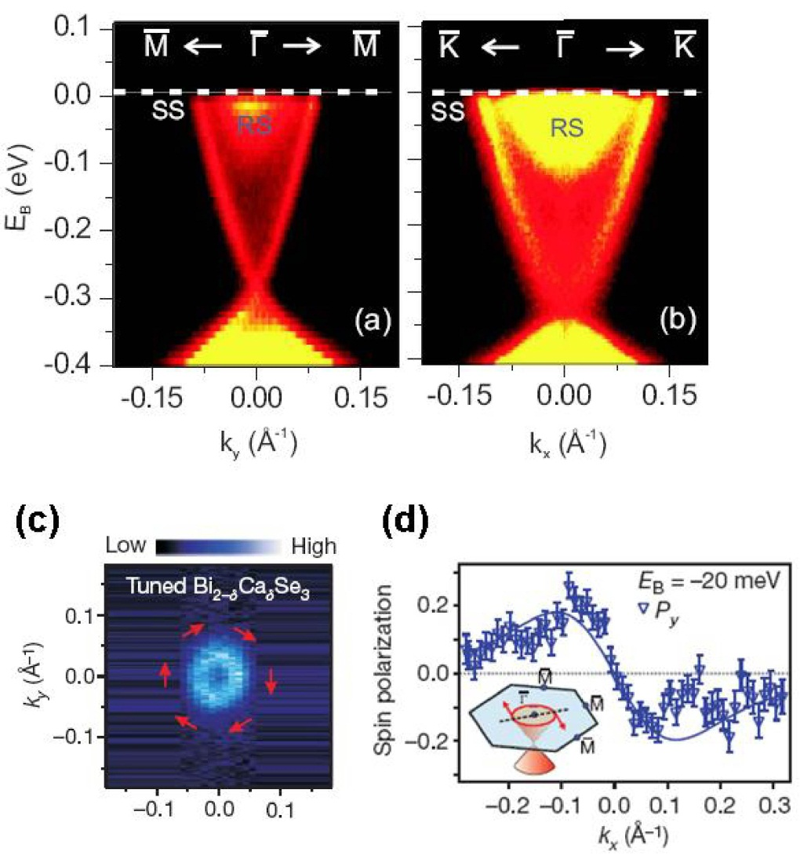
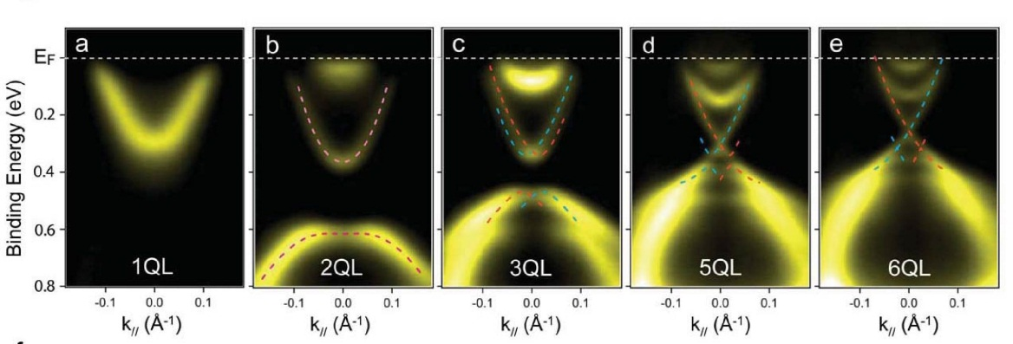
III. Three-Dimensional Topological Insulators
E.
Experimental results
2.
ARPES
Unlike Bi_{1-x}Sb_{x} second generation TIs have only one Dirac cone
Spin-resolved ARPES can show spin polarization of surface states
However, “hexagonal warping” effects appear in the data away from the Dirac point
ARPES spectra are shown for several thicknesses of a Bi₂Se₃ thin film, which show the evolution of the surface states.

Slide 48
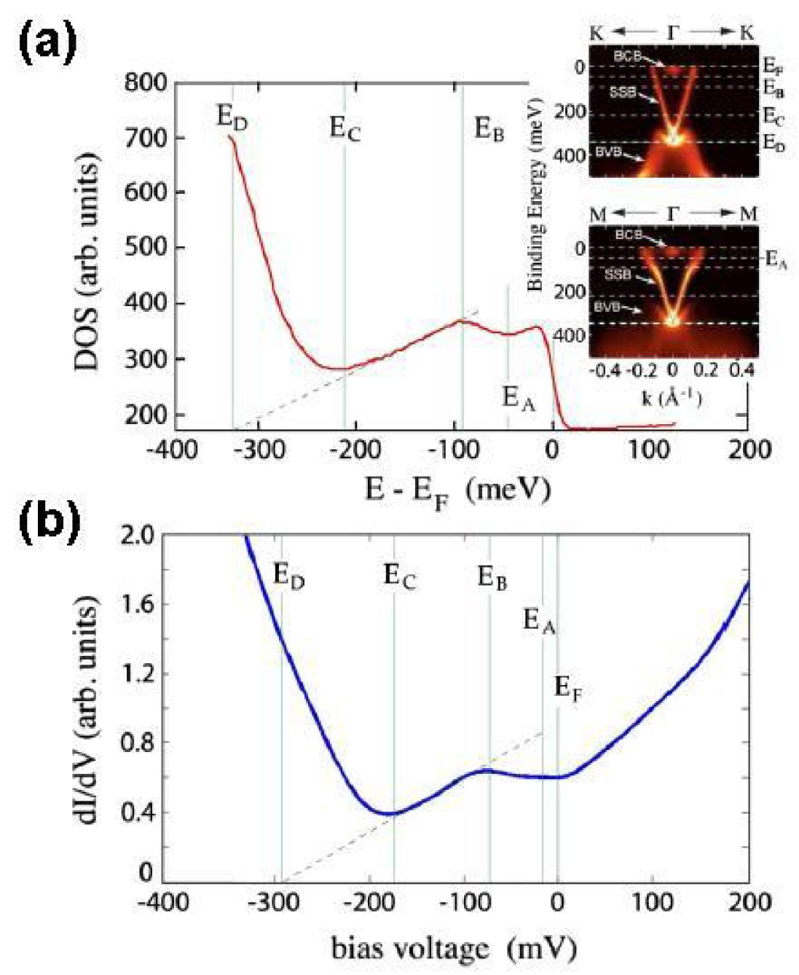
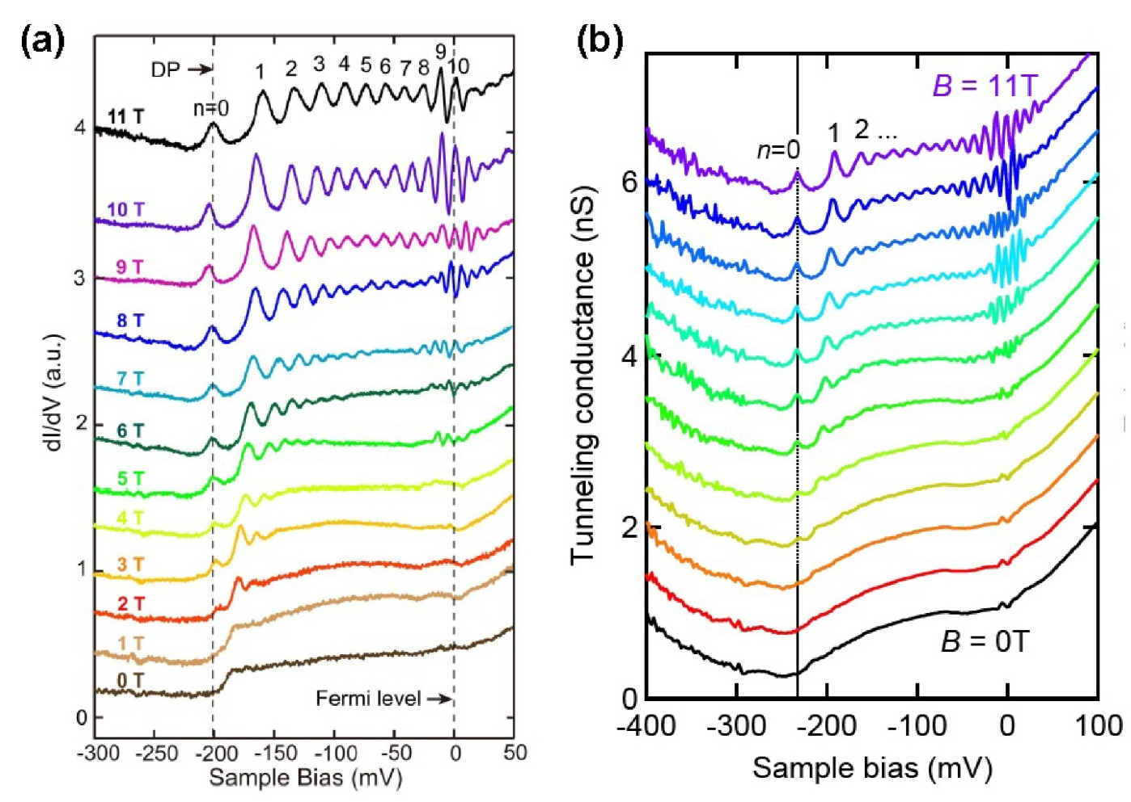
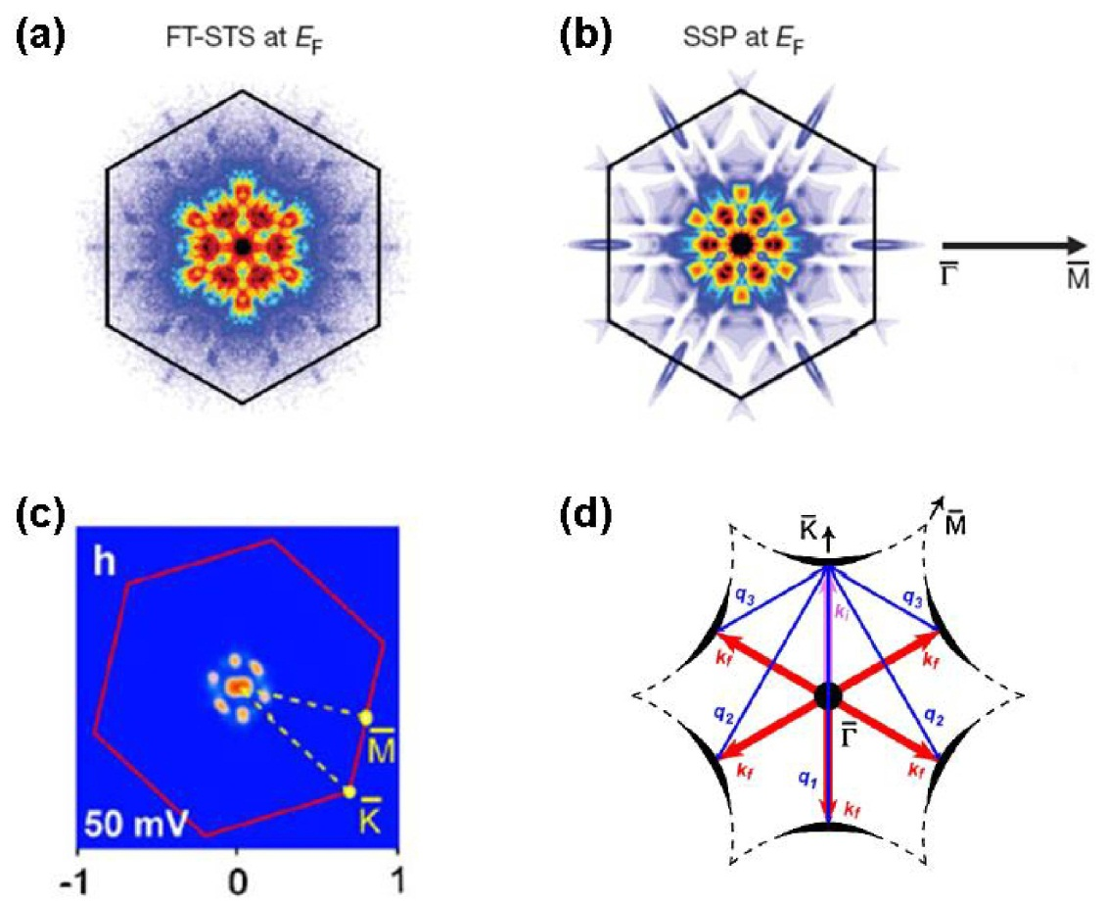
III. Three-Dimensional Topological Insulators
E.
Experimental results
3.
STM
Good agreement is found between the integrated density of states from ARPES and STM
STM also shows protection against backscattering
Like graphene surface states would have a relativistic (Dirac-like) Landau level spectrum
We can also observe Landau levels in a magnetic field

Slide 49
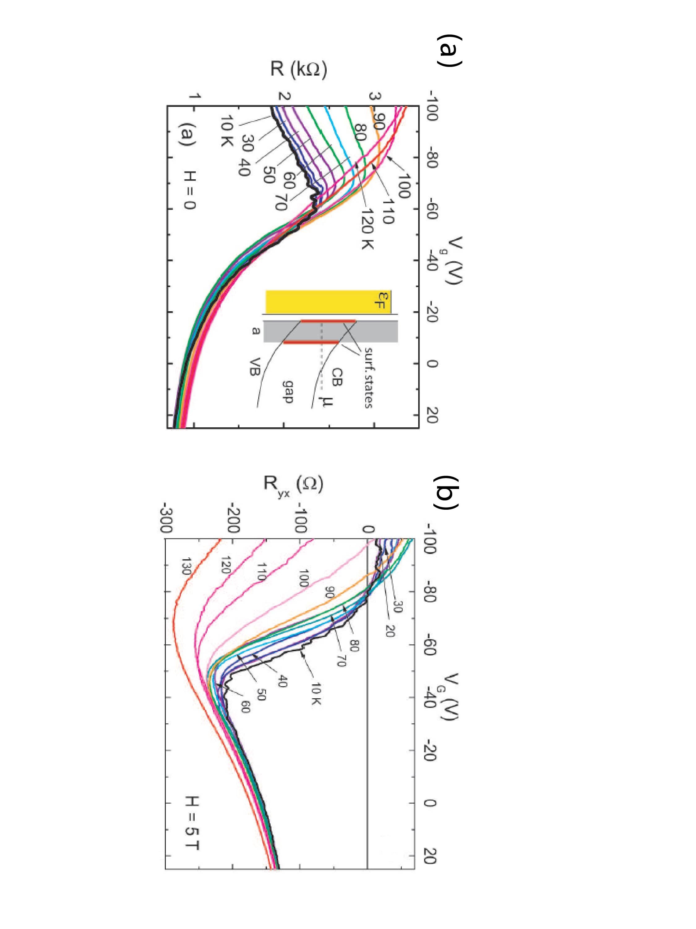
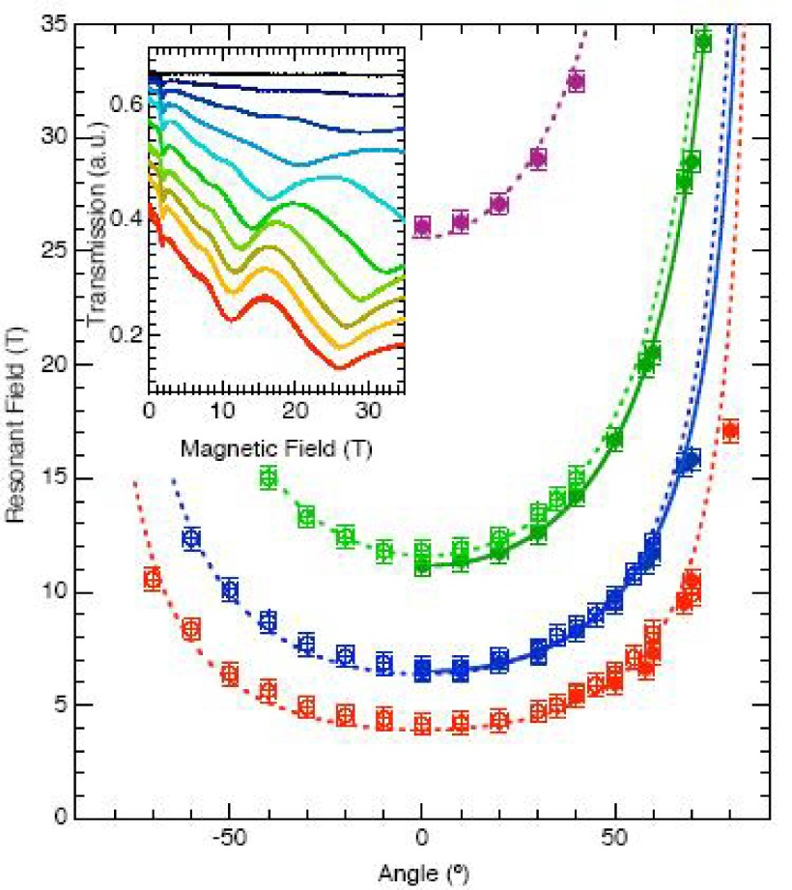
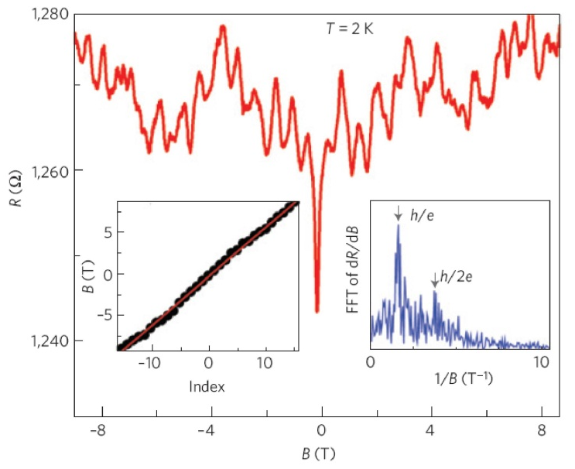
III. Three-Dimensional Topological Insulators
E.
Experimental results
2.
Transport
The fact that cyclotron resonance frequency only scales with perpendicular magnetic field shows 2D nature of surface states
One way to reduce bulk doping is using thin films obtained by mechanically exfoliation or epitaxial growth
An important advantage of a sample of mesoscopic size is the possibility of tuning the carrier density by an external gate voltage
Magnetoresistance of a nanoribbon exhibits a primary hc/e oscillation, which corresponds to Aharonov-Bohm oscillations of the surface state around the surface of the nanoribbon

Slide 50
III. Three-Dimensional Topological Insulators
F.
Other topological insulator materials
Topological materials HgTe, Bi₂Se₃, Bi₂Te₃, and Sb₂Te₃ provided us with a prototype material for 2D and 3D TIs
Other 3D TIs: tetradymite semiconductors like Thallium-based III-V-VI₂ ternary chalcogenides
Strained bulk HgTe is a topological insulator; distortion along [111] opens a gap between LH and HH bands
A similar band structure also exists in ternary Heusler compounds; fifty of them are found to exhibit band inversion; other interesting properties
  Superconductivity
  Magnetism
  Heavy-fermion behavior
QSHE has been proposed in Na₂IrO₃
Topolgical Mott insulator phases have been proposed in Ir-based pyrochlore oxides Ln₂Ir₂O₇ with Ln = Nd, Pr
SmB₆ was recently verified as a Kondo topological insulator

Slide 51
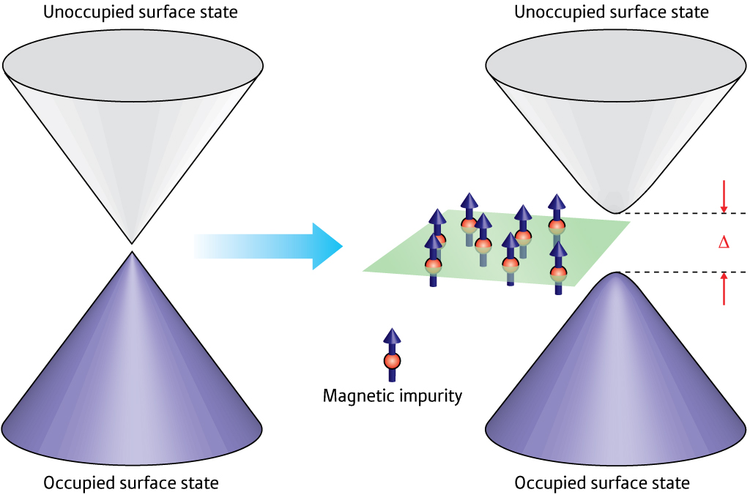
IV. General Theory of Topological Insulators
A.
Topological field theory
Interested in long-wavelength and low-energy properties of a condensed matter system
In this limit details of the microscopic Hamiltonian are not important
Broken symmetry states ➔ order parameter, symmetry and dimensionality
SPT states ➔ coefficient of the topological term identified as the topological order parameter
Topological Field Theory (TFT) can be developed for topological insulators
Unlike Topological Band Theory (TBT), TFT can accommodate interactions and disorder
In the limit of no interactions and disorder TFT reduces to TBT
Notes:
http://www.rikenresearch.riken.jp/images/figures/hi_4817.jpg

Slide 52
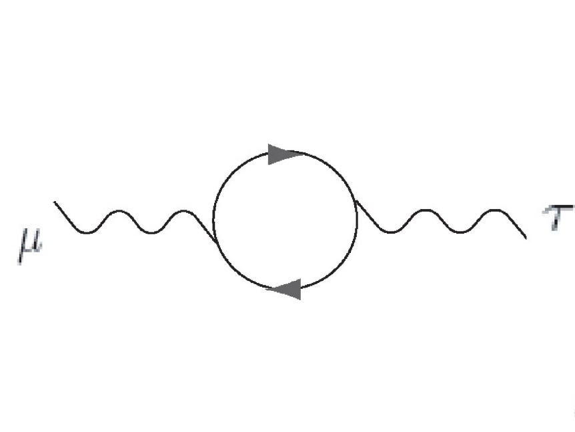
IV. General Theory of Topological Insulators
A.
Topological field theory
1.
Chern-Simons insulator in 2+1 dimensions
TFT for the QH system in 2+1 D
TFT for the QH system in 2+1 D
where G(k,ω) is imaginary-time single-particle Green's function μ, ν, ρ = 0, 1, 2 ≡ t, x, y
For an interacting system we can have a map from k-space to space of nonsingular Green functions in the group GL(n, ℂ); 3rd homotopy group labeled by an integer
The winding number for this homotopy class is exactly measured by C₁, where n ≥ 3 is the number of bands
For G → G₀, integral over ω gives

Slide 53
IV. General Theory of Topological Insulators
A.
Topological field theory
1.
Chern-Simons insulator in 2+1 dimensions
Under TR, since A₀ → A₀ and A → –A, Chern-Simons theory breaks TRS in 2+1 D
Taking a functional derivative with respective to A_{μ} we get:
Splitting into temporal component we get charge accumulated:
Charge accumulated due to magnetic field; i.e. magnetic flux pumps charge
The spatial component of the space-time current gives
Electric field gives transverse current with σ_{xy} = (C₁/2π) e²/h
At least in the non-interacting case it’s easy to see that C₁ = 2πn since the Berry phase is quantized
This is the usual quantum Hall response, i.e. σ_{xy} = ne²/h (with n ∈ ℤ)

Slide 54

IV. General Theory of Topological Insulators
A.
Topological field theory
2.
Chern-Simons insulator in 4+1 dimensions
Advantage of TFT of QHE ➔ Generalization to all odd space-time dimensions
The action is explicitly invariant under TR
C₂ is written in terms of full Green’s functions
This labels the homotopy group
For a non-interacting system, C₂ can be obtained by explicit integration over ω to give a Berry-like integration in k-space for i, j, k, ℓ = 1, 2, 3, 4
The physical response of 4+1 D Chern-Simons insulators is given by
which is the nonlinear response to the external field A_{μ}

Slide 55
IV. General Theory of Topological Insulators
A.
Topological field theory
2.
Chern-Simons insulator in 4+1 dimensions
Advantage of TFT of QHE ➔ Generalization to all odd space-time dimensions
The physical response of 4+1 D Chern-Simons insulators is given by
which is the nonlinear response to the external field A_{μ}
To understand this response better, consider a special field configuration
Non-zero components ➔ F_{xy} = B_{z} and F_{zt} = –E_{z}
Integrating in the x, y dimensions we get

Slide 56
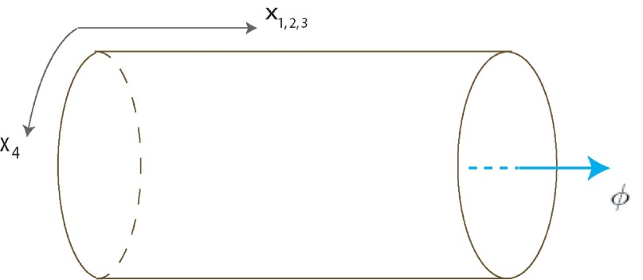
IV. General Theory of Topological Insulators
A.
Topological field theory
3.
Dimensional reduction to the three-dimensional ℤ₂ topological insulator
3D and 2D TIs can be obtained by dimensional reduction on the 4D QHE
Only consider A_{μ} ≡ A(x₀, x₁, x₂, x₃)
Consider a geometry where x₄ forms a small circle
For fixed k₄ we obtain an effective TFT in 3+1 D
The flux due to A₄(x, t, x₄) through the compact extra dimension is
TRS constrains the value of the flux to two values: 0 and π (for C₂ = 1)
Using a model 3D Hamiltonian (general interacting) is more practical; need to define an order parameter
where G(k, u = 0) ≡ G(k₀, k, u = 0) ≡ G(k₀, k) is the imaginary-time single-particle Green's function of the fully interacting many-body system; u = 1 is topologically trivial

Slide 57
IV. General Theory of Topological Insulators
A.
Topological field theory
3.
Dimensional reduction to the three-dimensional ℤ₂ topological insulator
Topological order parameter
The following identity is essential for the definition of P₃
Unlike the Chern-Simons insulator P₃ is not strictly quantized; it can vary continuously between 1/2 and 0 when TRS is broken
For a non-interacting system, integrating out ω, we get the elegant formula
For the model of 2nd generation 3D TIs the above formula can be evaluated explicitly as
The θ-term for 3D TI vs. 2+1 D QH
  θ-term dominates Maxwell term at low energies in 2+1 D by dimensional analysis
  In 3D TI θ- and Maxwell terms have same scaling dimension
The full set of modified Maxwell's equations + θ-term:

Slide 58
IV. General Theory of Topological Insulators
A.
Topological field theory
3.
Dimensional reduction to the three-dimensional ℤ₂ topological insulator
The full set of modified Maxwell's equations + θ-term:
In component form
where D = E + 4πP and H = B - 4πM
Alternatively one could absorb the topological terms while defining D and H (previous section)
The topological response can be determined by taking a functional derivative of the topological action with respect to A_{μ}

Slide 59
IV. General Theory of Topological Insulators
A.
Topological field theory
3.
Dimensional reduction to the three-dimensional ℤ₂ topological insulator
1. Half-QH effect on the surface of a 3D topological insulator
When P₃ = P₃(z) the topological response equation becomes
Integration along the z-direction gives the total Hall current
with total 2D Hall conductance
For a interface between a topologically nontrivial insulator with P₃=1/2 and a topologically trivial insulator with P₃=0 (say vacuum) the Hall conductance is σ = ΔP₃ = ±1/2
Aside from an integer ambiguity, the QH conductance is exactly quantized, independent of the details of the interface

Slide 60
IV. General Theory of Topological Insulators
A.
Topological field theory
3.
Dimensional reduction to the three-dimensional ℤ₂ topological insulator
2. Topological magnetoelectric effect induced by a temporal gradient of P₃
When P₃ = P₃(t) the topological response equation:
which can be compactly written as
Since j = ∂_{t}P, for a constant static magnetic field, we can write
This can also be viewed as the higher dimensional charge pumping
Witten Effect: assume we have magnetic charge distribution, i.e. ∇.B ≠ 0
The monopole density is given by
When P₃ is changed adiabatically from 0 to Θ/2π the monopole acquires an electric charge

Slide 61
IV. General Theory of Topological Insulators
A.
Topological field theory
4.
Further dimensional reduction to the two-dimensional ℤ₂ topological insulator
Similar to 3D TIs, topological order parameter can be defined for 2D TIs
We need two Wess-Zumino-Witten extension parameters (u, v) since dimensional reduction needs to be performed twice on the 4D QH state
For a general interacting insulator, the 2+1 D topological order parameter is expressed as
where ϵ^{μνρστ} is the totally antisymmetric tensor in five dimensions, taking value 1 when the variables are an even permutation of (k₀, k₁, k₂, u, v)
This topological order parameter is valid for interacting QSH systems in 2+1 D, including states in the Mott regime
Note: This is not true for all Mott insulators; P₃ might not be a good topological order parameter for some 3D Mott insulators

Slide 62
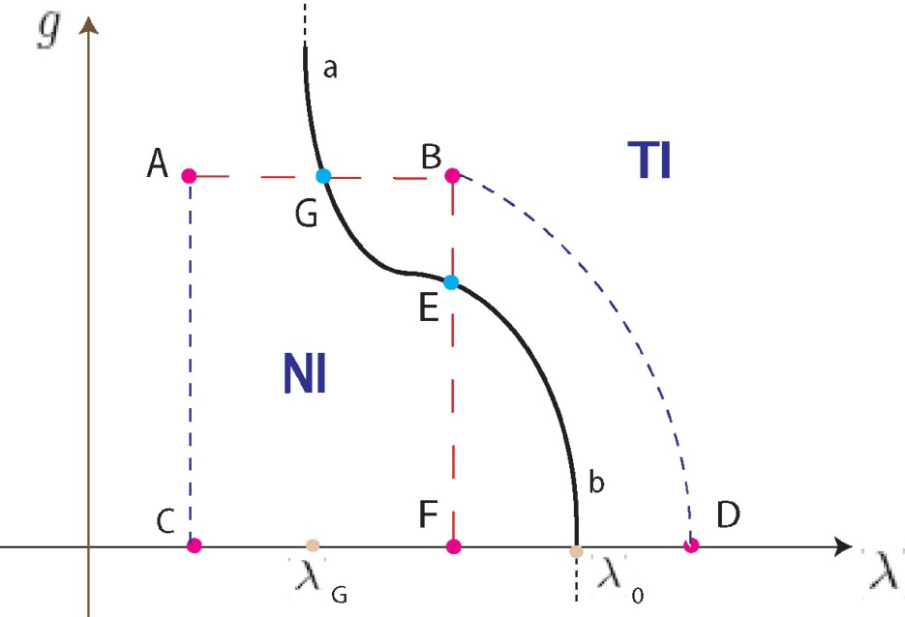
IV. General Theory of Topological Insulators
A.
Topological field theory
5.
General phase diagram of topological Mott insulator and topological Anderson insulator
Topological order parameter defined earlier not applicable to all interacting systems
For example, Topological order parameter difficult to compute when we have ground state degeneracy or intrinsic topological order; TFT is still possible
In 3D, Fractional TIs (FTIs) have P₃ = rational multiple of 1/2
Breaking TRS on the surface of FTI ➔ half of Fractional QHE (FQHE)
In general, consider H = H₀(λ₁, λ₂, …) + H₁(g₁, g₂, …)
For F → B we have dynamically generated SOC
Several proposals
  Topological Mott insulators (TMI)
  Topological Kondo insulators (TKI)
  …
For example, consider the Kane-Mele-Hubbard model

Slide 63
IV. General Theory of Topological Insulators
A.
Topological field theory
5.
General phase diagram of topological Mott insulator and topological Anderson insulator
For example, consider the Kane-Mele-Hubbard model
Interactions can be dealt with TFT be solving for full Green’s function
Useful simplification: when there is an adiabatic connection to non-interacting system we can define a “topological Hamiltonian”
Remarkably, the topological Hamiltonian captures the topological invariant of the full interacting problem
Other simplifications: Self-energy is local like in Dynamical Mean Field Theory (DMFT), i.e. Σ(ω, k) ≈ Σ(ω)
Expression for topological order parameter

Slide 64
IV. General Theory of Topological Insulators
A.
Topological field theory
5.
General phase diagram of topological Mott insulator and topological Anderson insulator
Other simplifications: Self-energy is local like in Dynamical Mean Field Theory (DMFT), i.e. Σ(ω, k) ≈ Σ(ω)
Expression for topological order parameter
Integrate out frequency part
Winding number becomes
When Σ(ω) is diagonal in orbital space:
Chern number = Frequency-Domain Winding Number × Chern number of a mean-field Hamiltonian

Slide 65
IV. General Theory of Topological Insulators
A.
Topological field theory
5.
General phase diagram of topological Mott insulator and topological Anderson insulator
For disordered systems, we can use TFT be replacing Green’s functions by the disorder-averaged Green's functions
Interpret g as the disorder strength in the phase diagram
Effect of disorder on QSHE

Slide 66
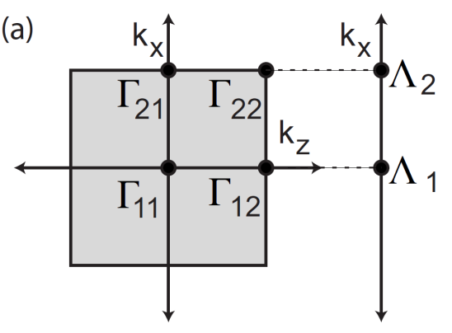
IV. General Theory of Topological Insulators
B.
Topological band theory
Only works for non-interacting system
Important tool in the discovery of new topological materials
Difficult to evaluate ℤ₂ invariants for a generic band structure
Three approaches
  Spin Chern numbers
  Topological invariants constructed from Bloch wave functions
  Discrete indices calculated from single-particle states at Time-Reversal Invariant Momentum (TRIM) in the Brillouin zone
Consider the matrix
At the TRIM B(Γ_{i}) is antisymmetric; we can define
In 1D, there are only two TRIM, and a “TR polarization” can be defined as the product of δ_{i}:
Similarly for 2D we can define
Trivial: (–1)^{ν2D} = +1 and Non-trivial: (–1)^{ν2D} = –1

Slide 67
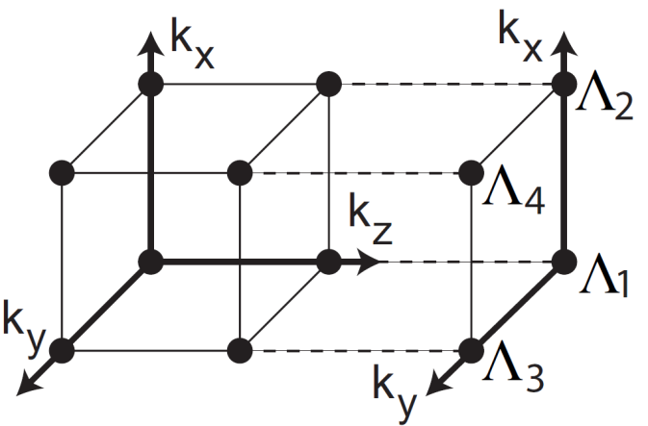
IV. General Theory of Topological Insulators
B.
Topological band theory
“Dimensional increase” to 3D
Weak TI: (–1)^{ν3D} = +1 and Strong TI: (–1)^{ν3D} = –1
Product of any four δ_{i} for which Γ_{i} lie in the same plane are gauge invariant
Therefore we get 3 more invariants defined by
It is useful to view these invariants as components of a mod 2 reciprocal lattice vector
For a dislocation with Burgers vector b it was shown that there will be gapless modes on the dislocation if G_{ν}⋅b=(2n+1) π for integer n

Slide 68
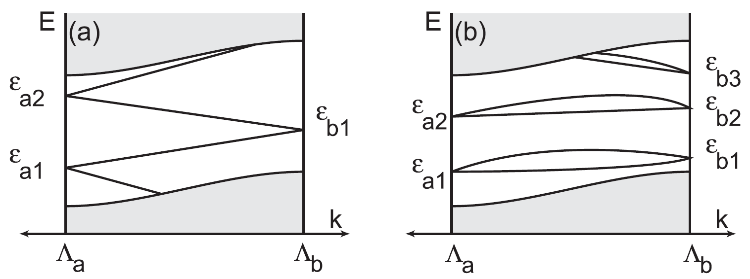
IV. General Theory of Topological Insulators
B.
Topological band theory
The surface band structure (bottom figures) will resemble
  (a): paths connecting a filled circle to an empty circle
  (b): paths connecting two filled circles or two empty circles
With inversion symmetry rewrite δ_{i} as
where ξ_{2m}(Γ_{i}) = ±1 is the parity eigenvalue of the 2m^{th} band at Γ_{i}) and ξ_{2m} = ξ_{2m–1} are Kramers pairs
This algorithm also applies to non-inversion symmetric materials which can adiabatically deformed into inversion symmetric ones without closing the energy gap

Slide 69
IV. General Theory of Topological Insulators
C.
Reduction from topological field theory to topological band theory
It’s intuitive that there’s a connection between TBT and TFT in the non-interacting limit
TFT requires knowledge of the band structure over the entire Brillouin zone
Recall the matrix
The TFT formula for P₃ then reduces to
The TFT formula for P₃ gives deg(f), where f: T³ → SU(2)
Due to TR symmetry, if we choose the image point as one of the two antisymmetric matrices in SU(2) (e.g. iσ_{y}) we have an interesting “pair annihilation” of those points other than the eight TRIM
In other words, Brillouin zone has redundancy in the non-interacting limit
The explicit relation between TFT and TBT is

Slide 70
V. Topological Superconductors and Superfluids
Superconducting gap, in Bogoliubov-de Gennes (BdG) Hamiltonian, is analogous to band gap of insulators
³He-B is a topological superfluid state; BdG Hamiltonian identical to 3D TI
Classification similar for Topological Superconductors (TSCs) and TIs in 2D
TRS breaking 2D TSCs are classified by ℤ like IQHE
TRS preserving 2D TSCs and 2D TIs are both ℤ₂
TSCs in 1D are always ℤ₂ with or without TRS
Subtlety: 3D TSC is ℤ while 3D TI is ℤ₂
Aside from striking similarities between time-reversal symmetric TSCs and TIs, TRS breaking TSCs are interesting due to non-Abelian statistics and their potential application to Topological Quantum Computation (TQC)
p_{x}+ip_{y} TSC with 𝒩 vortices has that many Majorana Zero Modes (MZMs)
Braiding vortices gives non-Abelian statistics
Simplest 𝒩 = 1 spinless chiral TSC first proposed by Read and Green in 2000
Spinful version predicted in Sr₂RuO₄; very little experimental progress
New proposals based on conventional superconductors proposed by including elements with high Spin-Orbit Coupling (SOC)

Slide 71
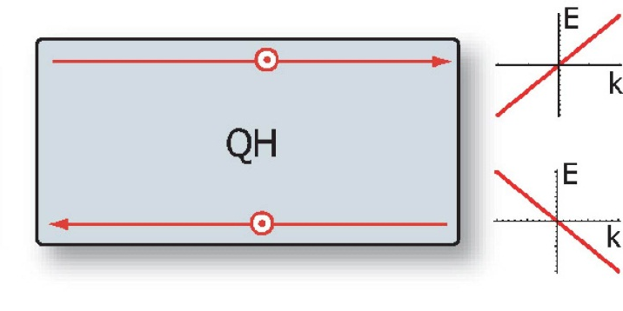
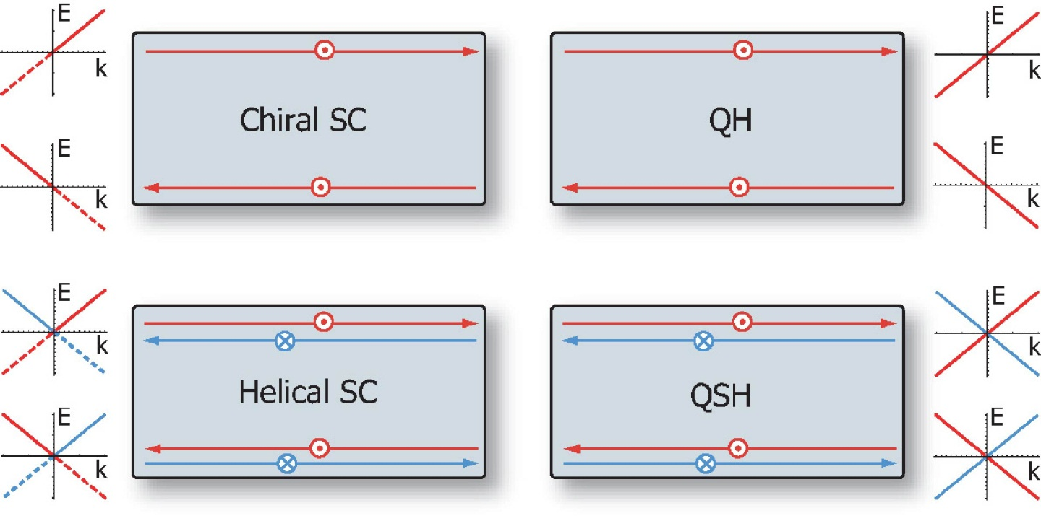
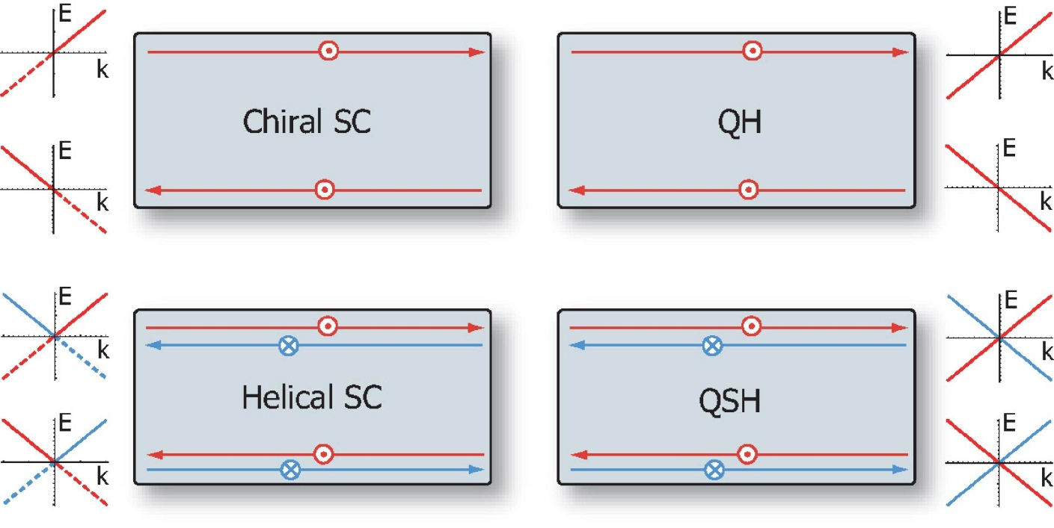
V. Topological Superconductors and Superfluids
A.
Effective models of time-reversal invariant superconductors
The simplest way to understand TRI TSCs is through their analogy with TIs
Similar to TRS breaking example: just as a QH state with Chern number N has N chiral edge states, a chiral TSC with topological invariant 𝒩 has 𝒩 chiral Majorana edge states
However, unlike IQHE, chiral Majoranas have half the Degrees of Freedom (DOF) as chiral electron edge states
Therefore, the chiral superconductor is the “minimal” topological state in 2D
Superconducting analogue of QSH state: a “helical” superconductor
Spin up: p_{x}+ip_{y}; spin down: p_{x}–ip_{y}
Counter-propagating Majorana Kramer’s pairs
These “Majorana modes,” and not “Majorana fermions,” superficially have the same Dirac-like dispersion as Majorana fermions in high energy

Slide 72
V. Topological Superconductors and Superfluids
A.
Effective models of time-reversal invariant superconductors
Hamiltonian of the simplest nontrivial TRS breaking superconductor, the p+ip superconductor for spinless fermions
where and
In the weak pairing phase with the chiral superconductor is known to have chiral Majorana edge states propagating on each boundary, described by the Hamiltonian
where
Simplest model for the topologically nontrivial TRI superconductor in 2D:
with
Note that upper (lower) block, with ( ) pairing, is analogous to spin up (down) Kramer partner
Hamiltonian has same form as BHZ model with PHS and k-dependent mass term replaced by

Slide 73
V. Topological Superconductors and Superfluids
A.
Effective models of time-reversal invariant superconductors
Simplest model for the topologically nontrivial TRI superconductor in 2D:
with
The form of this model is similar to 2D TIs; i.e. Bogoliubov quasiparticles behave like electrons in a TI
Although free electron edge states protected by TRS in TIs, is it also true for Bogoliubov quasiparticles?
Consider the edge state Hamiltonian
The Bogoliubov quasiparticles in terms of electron operators
Eigenstates of BdG Hamiltonian
Time-reversal transformation of electron states implies and

Slide 74
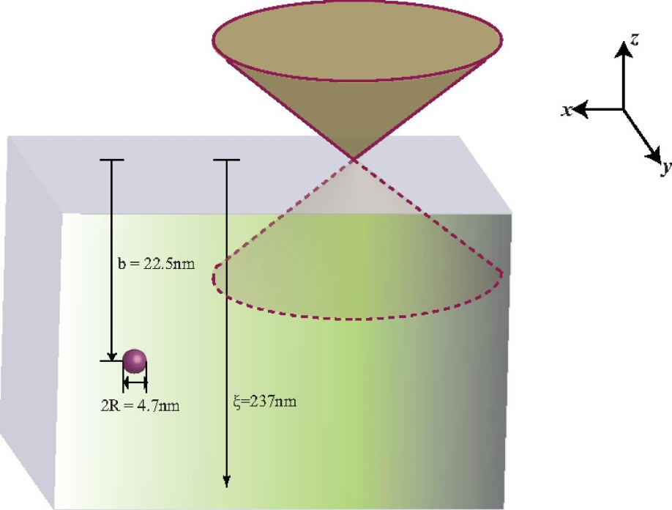
V. Topological Superconductors and Superfluids
A.
Effective models of time-reversal invariant superconductors
Similar to 2D, the 3D TSC Hamiltonian can be written as
with
where is a 3 × 3 matrix with
Ignoring dipole-dipole interaction term, and performing a spin rotation, can be diagonalized to
where and
For μ > 0 the surface states are Majorana mode described by
with the Majorana condition
Particle-hole symmetry enforces
  Chemical potential at the Dirac point (μ = 0)
  Spin lies in the surface plane
Spin winding around the momentum is well-defined and gives invariant ℤ

Slide 75
V. Topological Superconductors and Superfluids
B.
Topological invariants
TSCs with and without TRS in 1, 2, or 3 dimensions is either ℤ₂ or ℤ
Generic mean-field BdG Hamiltonian for a 3D TR invariant superconductor
In a different basis we have
where is an N-component vector and and are N × N matrices
The time-reversal matrix satisfies: , , and
The above off-diagonal form is only possible with TRS + PHS
These two conditions also require hermiticity of ; this means generic non-hermiticity of
Using singular value decomposition we can write ; we can deform (diagonal) matrix into the identity without closing the bulk gap
Then defining integer-valued topological invariant can be defined as
1D and 2D invariants can be obtained by dimensional reduction

Slide 76
V. Topological Superconductors and Superfluids
B.
Topological invariants
Consider in the weak pairing limit
When the Fermi Surfaces (FSs) are non-degenerate, and is only turned on around the FSs, the matrix elements of between different bands are negligible; to leading order we have
are simply matrix elements of between and its Kramers partner
where are eigenvectors of
In this approximation are given by
Plugging the above expression for into the general formula for we get

Slide 77
V. Topological Superconductors and Superfluids
B.
Topological invariants
Formulas from the last slide
Restrict the pairing to an energy shell ; means only is non-zero
This means outside this energy range is an integer multiple of π
Standard (but not simple!) trigonometry gives
in the limit we have the remaining two terms vanish
Therefore, the entire 2nd term of vanishes
First term?

Slide 78
V. Topological Superconductors and Superfluids
B.
Topological invariants
Main formulas
To the leading order, near the Fermi surface we have
In the limit we have ; more precisely we have
On differentiating we get
which, in the vector form, looks like
The term does indeed blow up at the Fermi surface

Slide 79
V. Topological Superconductors and Superfluids
B.
Topological invariants
Main formulas
Plugging in all the formulas
Labeling the single band crossing the Fermi surface with n = 0

Slide 80
V. Topological Superconductors and Superfluids
B.
Topological invariants
Main formulas
Labeling the single band crossing the Fermi surface with n = 0
Formal expression for the Chern number:

Slide 81
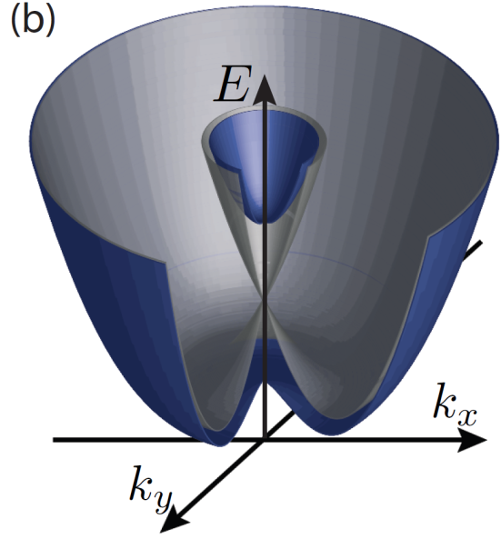
V. Topological Superconductors and Superfluids
B.
Topological invariants
Topological invariant or winding number:
Chern number:
Consider an example:
Rashba spin-orbit coupling gives two spin-polarized Fermi surfaces with opposite Chern numbers of ±1
Consider a pairing function
The pairing function cannot be constant; it must change sign between different Fermi surfaces
Now, consider unconventional, i.e. momentum dependent pairing
Consider analogy to TRS breaking counterpart

Slide 82
V. Topological Superconductors and Superfluids
B.
Topological invariants
Topological invariant of 2D and 1D TSCs obtained by dimensional reduction
Consider 3D Hamiltonian with k_{z} replaced by θ
Topological invariant in 2D:
The Chern number obeys the properties:
  For m_{s} TRIMs enclosed in the s^{th} Fermi surface we have
  As a consequence of the Nielsen-Ninomiya theorem we have
Topological invariant for 2D TSCs:
In 1D each Fermi “surface” encloses 1 TRIM; invariant for 1D TSCs is

Slide 83
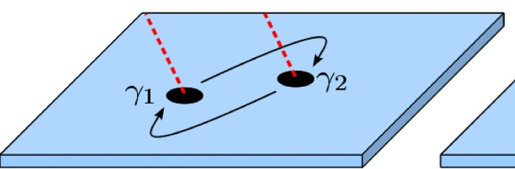
V. Topological Superconductors and Superfluids
C.
Majorana zero modes in topological superconductors
1.
Majorana zero modes in p+ip superconductors
The core of a p+ip superconducting vortex contains a localized quasiparticle with exactly zero energy: the Majorana Zero Mode (MZM)
The quasiparticle operator γ is the Majorana mode obeying [γ, H] = 0 and γ† = γ
When two vortices are exchanged, since the phase of charge-2e order parameter winds by 2π, electron picks up a phase π
Since Majoranas are superposition of electron creation and annihilation operators, we get γ₁ → –γ₂ and γ₂ → γ₁
Two vortices actually share two internal states labeled by iγ₁γ₂ = ±1
With 2N vortices the core states span a 2^{N}-dimensional Hilbert space
The braiding of vortices leads to non-Abelian unitary transformations in this Hilbert space
Non-locality of the internal states of vortices ensures their coupling to the environment to be exponentially small ⇒ fault-tolerant quantum computation at the hardware level
Natural p+ip ➔ Sr₂RuO₄; many properties of this system remain unclear
Artificial p+ip: proximity effect on (i) surface of 3D TI (ii) TRS breaking 2D TI (iii) semiconductors with strong Rashba SOC

Slide 84
V. Topological Superconductors and Superfluids
C.
Majorana zero modes in topological superconductors
2.
Majorana fermions in surface states of the topological insulator
Fu and Kane proposed MZM in superconducting vortex using surface states of a 3D topological insulator
Consider (say) the surface of Bi₂Se₃
with
Considering proximity to an s-wave superconductor we add
The BdG Hamiltonian is given by
where
With a finite μ and a TRS breaking mass term we can write
with
“nonrelativistic approximation” to the massive Dirac Hamiltonian
where is the positive energy branch of the surface states; in momentum space
with
and

Slide 85
V. Topological Superconductors and Superfluids
C.
Majorana zero modes in topological superconductors
2.
Majorana fermions in surface states of the topological insulator
Nonrelativistic approximation
with
where is the positive energy branch of the surface states; in momentum space
with
and
The projection of the pairing term onto the band we get
Precisely the Hamiltonian for a p+ip superconductor
As we tune m → 0, we can still tune μ → 0 while satisfying
and keeping superconducting gap finite; i.e. MZM still exists with TRS and μ = 0
Lower dimensional analogue of this system ➔ pairing on the edges of QSHE
MZM appears on the domain wall between s-wave superconductor and ferromagnetic insulator on the QSHE edge

Slide 86
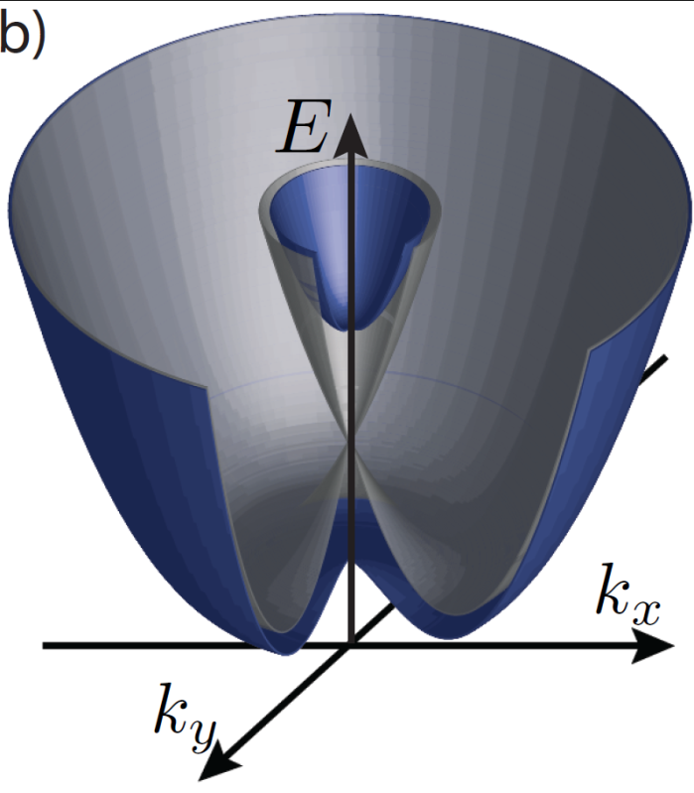
V. Topological Superconductors and Superfluids
C.
Majorana zero modes in topological superconductors
3.
Majorana fermions in semiconductors with Rashba spin-orbit coupling
2D electron gas with Rashba SOC: system which is described by a Hamiltonian very similar to the surface of a 3D TI
When s-wave pairing is introduced, each of the two spin-split Fermi surfaces forms a nontrivial superconductor
The Majoranas from these two Fermi surfaces annihilate each other so that the s-wave superconductor in the Rashba system is trivial
Breaking TRS opens a gap at k = 0; if chemical potential lies in the gap only one Fermi surface exists
Alternative to Ferromagnetic (FM) insulator: in-plane magnetic field + Dresselhaus SOC
Similar scheme possible in 1D: semiconductor nanowires with Rashba SOC
Non-Abelian statistics still possible in 1D nanowire “T junctions”

Slide 87
V. Topological Superconductors and Superfluids
C.
Majorana zero modes in topological superconductors
4.
Majorana fermions in quantum Hall and quantum anomalous Hall insulators
A proposal based on proximity effect to a 2D QH or QAH insulator
Consider a QH insulator with Hall conductance Ne²/h in close proximity to a superconductor
For infinitesimally small pairing we get chiral TSC with invariant 𝒩 = 2N
The edge state Hamiltonian, in terms of creation/annihilation operators for a complex spinless fermion, of a QH state with Chern number N = 1 is described by
where
and
Split into Majorana operators and
QH plateau transition from N = 1 to N = 0 will generically split into two transitions when superconducting pairing is introduced
However, large external magnetic field suppresses superconductivity
Can induce superconductivity in QAHE in Mn-doped HgTe QWs, and Cr- or Fe-doped Bi₂Se₃ thin films

Slide 88
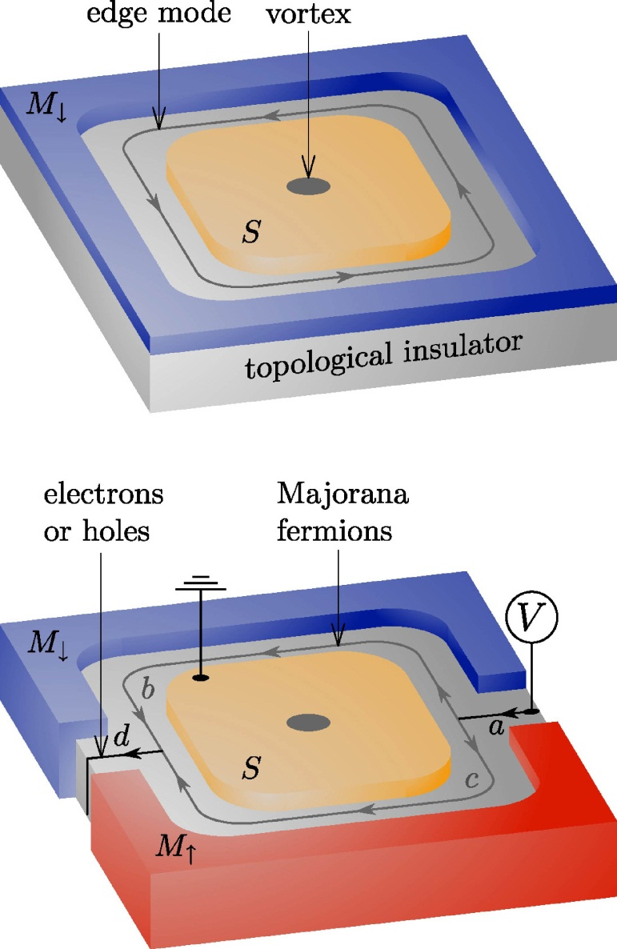
V. Topological Superconductors and Superfluids
C.
Majorana zero modes in topological superconductors
5.
Detection of Majorana fermions
Consider the geometry shown in the figure to the right
An incident electron, with E = 0, splits into two chiral Majoranas at point “a,” with each Majorana following a path “b” and “c,” and recombining at point “d”
Say the ring encloses a flux Φ = nhc/2e
For odd (even) n we get a (an) hole (electron) at point “d”
Other proposals
  Charging energy effects in mesoscopic superconductors
  Doubled period of the Josephson tunneling current as a function of flux (i.e. Fraunhofer patten) in 1D and 2D junctions

