Slide 1
3. Second Chern number and its physical consequences
B. TRI topological insulators based on lattice Dirac models
The continuum Dirac model in (4+1)-d dimensions is expressed as
Note: the above model bears superficial resemblance to (3+1)-d relativistic Dirac model. Here we don’t need a “5-vector” since we don’t require Lorentz invariance. The gamma matrices satisfy the Clifford algebra
The lattice (tight-binding) version of this model is written as
To get the k-space we do the same old Wannier to Bloch transformation defined by

Slide 2
3. Second Chern number and its physical consequences
B. TRI topological insulators based on lattice Dirac models
To get the k-space we do the same old Wannier to Bloch transformation defined by
The sum over i can be evaluated as
Diagonalized Hamiltonian in k-space

Slide 3
3. Second Chern number and its physical consequences
B. TRI topological insulators based on lattice Dirac models
Diagonalized Hamiltonian in k-space
This Hamiltonian can be written in the compact form
The second Chern number can be written as
In terms of the compact Hamiltonian we get
The critical values of m can be found as solutions to
The function P[k] is a set of all the wavevectors obtained from index permutations of wavevector k. For example:
The second Chern number C₂ for the different regions in parameter space, separated by critical values of m, can be evaluated approximately near the critical points to give:

Slide 4
4. Dimensional reduction to (3+1)-d TRI insulators
A. Effective action of (3+1)-d insulators
Hamiltonian of Dirac model coupled to an external U(1) gauge field
Consider a special “Landau”-gauge configuration satisfying:
We have translational invariance in the w-direction; k_{w} is a good quantum number. Hamiltonian can be rewritten as:
On a hyper-cylinder we can define:
Since different k_{w} are decoupled we obtain the (3+1)-d model:
To study the response properties of the (3+1)-d system, the effective action can be defined as:
We can Taylor expand around the field configuration:
The coefficient G₃(θ₀) is determined by the below Feynman diagram

Slide 5

4. Dimensional reduction to (3+1)-d TRI insulators
A. Effective action of (3+1)-d insulators
Copying coefficient G₃(θ₀) from last slide
If we define the 4-D Berry connection can be defined as:
Then we can show that the above expression for G₃(θ₀), in terms of Green functions, reduces to:
The equivalence of these two forms can be proved in three steps:
  Derive an expression h(k, t) showing adiabatic connection between the expression for arbitrary h(k) and maximally degenerate h₀(k)
  Explicit evaluation of G₃(θ₀) using Green functions for h₀(k)
  Topological invariance of G₃(θ₀) under adiabatic deformations of h(k)
Step I: Adiabatic connection of h(k) to h₀(k)
  Any single particle Hamiltonian h(k) can be diagonalized as
  where and
  With zero chemical potential, for an insulator with M full bands, the eigenvalues satisfy
  For t $ε$ [0,1] we can define the interpolation
  and
  Then we get
  We obtain an adiabatic interpolation between

Slide 6
4. Dimensional reduction to (3+1)-d TRI insulators
A. Effective action of (3+1)-d insulators
Step II: Explicit evaluation of G₃(θ₀) using Green’s function for h₀(k)
  The expression for h₀(k) from step I:
  Properties of “projection” operators P_{G}(k) and P_{E}(k):
  The Green’s function for h₀(k):
Consider the maximally degenerate or flat-band Hamiltonian
Using the Green’s function we can write

Slide 7
4. Dimensional reduction to (3+1)-d TRI insulators
A. Effective action of (3+1)-d insulators
Step II: Explicit evaluation of G₃(θ₀) using Green’s function for h₀(k)
  Properties of “projection” operators P_{G}(k) and P_{E}(k):
  The Green’s function for h₀(k):
  Recall the expression for G₃(θ₀)
  Recall C₂ as well
  Plugging in the above expressions for the Green’s functions we get
  where P_{1/2}(k) = P_{G/E}(k)
  Now, introduce the non-Abelian Chern-Simons term
  Analogy to the charge polarization defined as the integral of the adiabatic connection 1-form over a path in momentum space

Slide 8
4. Dimensional reduction to (3+1)-d TRI insulators
B. Physical Consequences of the Effective Action S_{3D}
Extremizing the action S_{3D} we get response equation
Two cases: spatial and temporal variation of P₃
Case 1: Spatial variation, i.e. P₃ = P₃(z)
For a uniform electric field E_{x}
The integration over z in a finite range gives the 2D current density in the xy plane
The net Hall conductance of the region z₁ ≤ z ≤ z₂ is:
Case 2: Temporal variation, i.e. P₃ = P₃(t)
Using continuity j = ∂_{t}P and the fact that B is constant and uniform we get:
Such an equation describes the charge polarization induced by a magnetic field, which is a magneto-electric effect
This can also be viewed as the higher dimensional charge pumping analog of the 1D case where the charge is pumped from one boundary to the other (see figure)

Slide 9
4. Dimensional reduction to (3+1)-d TRI insulators
C. Z₂ topological classification of time-reversal invariant insulators
Consider the second quantized Hamiltonian:
Define a time-reversal matrix:
Properties of the Hamiltonian in k-space:
We can define an interpolation for any two TRI band insulators as:
where
We can define an two different interpolations shown in the figure
We want to show Chern number difference of these two paths is an even number
To show this define two new interpolations defined as
By their definition we can write
To show C₂[g₁] = C₂[g₂] consider the eigenvalue equation
Consider the action of g₂ on the eigenstate of g₁
Since g₁ and g₂ are Hermitian we can write
Plugging this in the above equation we get
Taking the complex conjugate of both sides we get
Using this we can write
where

Slide 10
4. Dimensional reduction to (3+1)-d TRI insulators
C. Z₂ topological classification of time-reversal invariant insulators
Expression from last slide:
Now, we can write the Berry phase gauge vector of the g₁ and g₂ systems as
In other words, they are equivalent up to a gauge transformation, i.e.
Therefore, we can say that
Then we have effectively shown that
Consequences of this topological quantum number
For 4+1 D Dirac model, there are |C₂[h]| nodal points (of the spectrum) in the 3D Brillouin zone
If there exist a nodal point (k, θ) which is not time-reversal symmetric then it has a nodal partner (-k, -θ)
For topologically nontrivial insulator |C₂[h]| is odd
Then number of nodes at the 8 time-reversal symmetric points (in 3D) must have odd number of spectral nodes

Slide 11
4. Dimensional reduction to (3+1)-d TRI insulators
D. Physical properties of Z₂-nontrivial insulators
The non-trivial insulator has a magnetoelectric polarization P₃ = 1/2 mod 1; the effective action of the bulk system should be
where n = P₃ – 1/2 ϵ ℤ. S_{3D} is quantized (and independent of P₃) for compact space-time; hence P₃ is unphysical
For open boundaries consider semi-infinite nontrivial insulator occupying the space z ≤ 0; the rest (z > 0) is vacuum
Effective action for all of ℝ³ as
Since P₃ = 1/2 mod 1 for z < 0 and P₃ = 0 mod 1 for z > 0, we have
The domain wall of P₃ carries a quantum Hall effect
The Hall conductance carried by a Dirac fermion is well-defined only when the fermion mass is non-vanishing, so that a gap is opened
If the surface (initially) has 2n+1 Dirac cones. Breaking time-reversal symmetry on the surface gives the following Hall conductance from each Dirac cone
We can explicitly see this in the model:
Then the Dirac Hamiltonian looks like:

Slide 12
4. Dimensional reduction to (3+1)-d TRI insulators
D. Physical properties of Z₂-nontrivial insulators
Recall Dirac Hamiltonian from last slide
Under a time-reversal transformation, Γ⁰ is even and Γ^{1,2,3,4} are odd; in other words only H₀ respects time-reversal symmetry
Recall second Chern number for this model
For θ = π and -4c < m < -2c we have C₂ = 1. It can be shown that for θ = 0, the region -4c < m < -2c is adiabatically connected to m → -∞ such that C₂ = 0.
It can be noted that {Γ⁴,H₀} = 0 in the bulk and on the surface
The surface Hamiltonian of H₀ can be written as
Since the only thing that anticommutes with this above surface Hamiltonian, the surface Hamiltonian for H = H₀ + H₁ is
In summary, the effect of a time-reversal symmetry breaking term on the surface is to assign a mass to the Dirac fermions which determines the winding direction of P₃ through the domain wall
An analogous Chern number, that can evaluate the winding, can be defined as g[M(x)], where M(x) is the T-breaking field. The surface action, in terms of g[M(x)], can be written as

Slide 13
4. Dimensional reduction to (3+1)-d TRI insulators
D. Physical properties of Z₂-nontrivial insulators
1. Magnetization-induced QH effect
Consider a ferromagnet-topological insulator heterostructure
The pointing of the magnetization is given by
For the first (parallel) case
For the second (antiparallel) case
Then for
Using this expression the currents on the top and bottom surfaces can be determined and are indicated for the two cases by (horizontal) blue arrows
The antiparallel magnetization leads to a vanishing net Hall conductance, while the parallel magnetization leads to σ_{H} = e²/h
A top-down view of the device, to measure this quantum Hall effect, can be seen in the bottom left figure
For the case of parallel magnetization, the trapping of the chiral edge states on the side surfaces of the topological insulator can be seen in the 3D view in the bottom right figure; these carry the quantized Hall current.
Recall, in a T-breaking field M(x), the surface Chern-Simons action:
Note: Although the Hall conductance of the two surfaces are the same in the global x, y, z basis, they are opposite in the local basis defined with respect to the normal vector
This corresponds to g[M(x)] + 1/2 = ±1/2 for the top and bottom surfaces respectively.
Drawing closer analogy to the integer quantum Hall effect (IQHE), we could alternatively say g[M(x)] = 0 (-1) for the top (bottom) surface; i.e. there exists a domain wall between two adjacent plateaux of IQHE
Such a domain wall will trap a chiral Fermi liquid which is responsible for the net Hall effect
Note: in general there will also be other non-chiral states on this side surface; they are irrelevant since only one chiral edge state is protected
Conditions for observing this type of quantum Hall: (i) k_{B}T ≪ E_{M} (magnetization-induced bulk gap), (ii) chemical potential lies in the bulk gap
Question: is this special type of quantum Hall a topological phase or symmetry-protected topological phase?

Slide 14
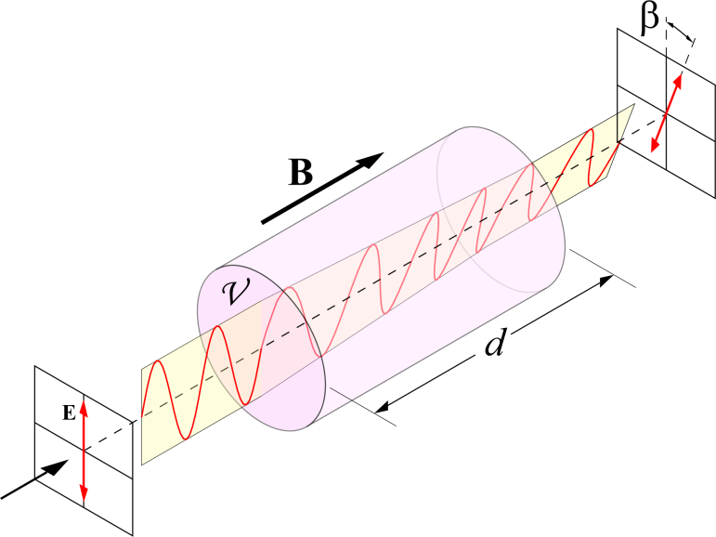
4. Dimensional reduction to (3+1)-d TRI insulators
D. Physical properties of Z₂-nontrivial insulators
3. Low-frequency Faraday rotation
It is the rotation of polarization of light by a certain angle β = B𝒱d
We can tune polarization by tuning the applied magnetic field
Perhaps the same can be accomplished with external electric fields by exploiting TME in a medium with nonzero θ
Electric fields are, in general, easier to generate than magnetic fields
Recall that the total action of the electromagnetic field including the topological term is given by
However, the effective theory only applies in the low-energy limit E ≪ E_{g}, where E_{g} is the gap of the surface state
Assuming a FM-TI interface at z = 0, normally incident, linearly-polarized light in either region can be written as (primed variables belong to the TI):
The ΔP₃ terms in the action contribute unconventional boundary conditions at z = 0 given by (a = a_{x} + ia_{y}, etc.)
Solving the above equations simultaneously we get:
By simple algebra the polarization plane rotated by an angle is given by
For typical values of E_{g} = 10 meV (and ϵ, μ ~ 1 and Δ = 1/2) we get EM frequency ≪ 2.4 THz, which is in the far infrared or microwave region
In principle, it is possible to find a topological insulator with a larger gap which can support an accurate measurement of Faraday rotation

