Slide 1
Introduction to topological superconductivity and Majorana fermions
Tejas Deshpande
(17 February 2013)

Slide 2
Outline
Introduction
Majorana fermions in p-wave superconductors
  Representation in terms of fermionic operators
  Non-abelian statistics
  Majorana qubits and topological quantum computation
Proximity-induced superconductivity in spin-orbit semiconductors
Induced p-wave-like gap in semiconductors
Conclusions and outlook

Slide 3
Kitaev 1-D Chain
Spinless p-wave superconductor
  Tight-Binding Hamiltonian
  Defining Majorana Operators
Anticommutation relations for Majorana Operators
  Special case: “left” Majoranas on different sites
  Majoranas on same site:

Slide 4
Kitaev 1-D Chain
Hamiltonian in terms of Majorana Operators
  Simple case
  Recall anticommutation

Slide 5
Kitaev 1-D Chain
Alternative pairing of Majorana fermions
  Recall 1-D Majorana Hamiltonian
  Define
  Diagonalized Hamiltonian

Slide 6
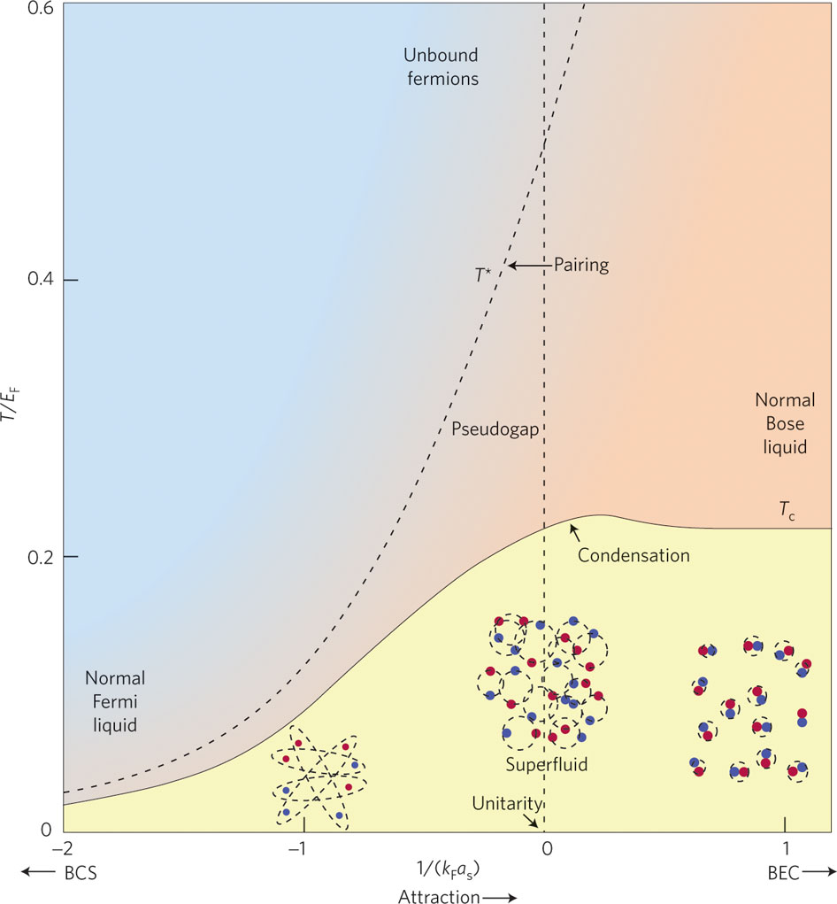
Role of pairing in Kitaev 1-D Chain
What is the nature of pairing?
  Recall the tight-Binding Hamiltonian
  Why is this a p-wave superconductor?
  For the so-called s-, p-, d- or f-wave
  superconductor
Pairing in real space
  How to visualize cooper pairs?
  Lattice model for (conventional) s-wave
  On-site particle number operator
  This “bosonic blob” still at the same site

Slide 7
Role of pairing in Kitaev 1-D Chain
Pairing in “conventional” superconductivity
  Recall lattice model for conventional superconductor
  Applying Wick’s theorem
  The mean field Hamiltonian
Pairing in “unconventional” superconductivity
On-site pairing
Nearest-neighbor pairing

Slide 8
Role of pairing in Kitaev 1-D Chain
Pairing in “unconventional” superconductivity
  2-D lattice model mean field Hamiltonian (lattice constant = 1)
  Diagonalize

Slide 9
Properties of Majorana Fermions
Are Majoranas “hard-core balls”?
  Majorana “mode” is a superposition of electron and hole states
  Is this like a bound state? e.g. exciton, hydrogen atom, positronium?
  Can “count” them by putting them in bins?
  Sure, define a number operator
  Garbage! Okay, counting doesn’t make sense!
Regular fermion basis
  We can count regular fermions
  We can pair Majoranas into regular fermions and measure them
  How to chose? Number of pairings:
  Overlap between states
  To observe the state of the system we need to “fuse” two Majoranas

Slide 10
Properties of Majorana Fermions
Non-abelian statistics
  A system of 2N well separated Majoranas has a 2^{N} degenerate ground state. Think of N independent of 1-D Kitaev chains
  Exchanging or “braiding” connects two different ground states
  What is nonabelian about them?
  “if one performs sequential exchanges, the final state depends on the order in which they are carried out”
  Consider the exchange of two Majoranas

Slide 11
Properties of Majorana Fermions
Non-abelian statistics
  Exchange of two Majoranas
  Define “braiding” operator

Slide 12
Properties of Majorana Fermions
Non-abelian statistics
  Exchange of two Majoranas
  Effect on number states

Slide 13
Properties of Majorana Fermions
Non-abelian statistics
  Exchange of four Majoranas
  Effect on number states
Define Pauli matrices for rotations on the Bloch sphere
Braiding as rotations

Slide 14
Ingredients for observing Majoranas?
Key ingredients
  Mechanism for pairing of regular fermions
  Spin degree of freedom must be suppressed
  Additionally we need
    p-wave pairing symmetry
    Spin-triplet state
Tools that provide these ingredients
  Pairing ➔ in superconductors or proximity effect
  Suppress spin ➔ break time-reversal symmetry or polarize a band
Few important approaches/proposals
  Engineer systems with strong spin-orbit coupling and superconductors
  Induced triplet p-wave pairing in non-centrosymmetric superconductors
  Discover Time Reversal Invariant topological superconductors!

Slide 15
“Artificial” topological superconductors
“Spinless” p-wave superconductors
  2nd quantized Hamiltonian
  Pairing Hamiltonian:
  Nambu spinor
  s-wave singlet pairing inherited from superconductor:

Slide 16
“Artificial” topological superconductors
“Spinless” p-wave superconductors
  Recall 1st and 2nd quantized Hamiltonians
  Define
  Then total Hamiltonian is given by
where

Slide 17
“Artificial” topological superconductors
Obtaining Bogoliubov-de Gennes (BdG) equation
  Compare

Slide 18
“Artificial” topological superconductors
Artifacts of the BdG formalism?
  Particle-hole symmetry
  Action on operators
  Relation between particle and hole eigenstates
  Therefore, Majorana fermions
  Structure of the Nambu spinor

Slide 19
“Artificial” topological superconductors
“Spinless” p-wave superconductors
  2nd quantized Hamiltonian
  Assume on-site pairing
  First consider
  Block diagonal 2 × 2 Hamiltonians
where

Slide 20
“Artificial” topological superconductors
“Spinless” p-wave superconductors
  Diagonalizing 2 × 2 matrices
Eigenvalues

Slide 21
“Artificial” topological superconductors
“Spinless” p-wave superconductors
  Recall eigenvalues
  For no Zeeman field

Slide 22
“Artificial” topological superconductors
“Spinless” p-wave superconductors
  Now, slowly turn on the pairing
  Total Hamiltonian becomes
  Brute force diagonalization
  The gap vanishes at

Slide 23
“Artificial” topological superconductors
“Spinless” p-wave superconductors
  The gap vanishes at
and
Consider the limit
where

Slide 24
Conclusions and Outlook
Overview
  How to obtain Majorana fermions
  Non-abelian statistics
  Engineering/finding systems that host Majorana zero modes
Experimental progress
  Kouwenhoven group first to see “zero bias conductance peak” (ZBCP) in InSb nanowires
  Other groups confirmed existence of ZBCP with different experimental parameters
Experimental to-do’s
  Verify non-abelian statistics
  Test more platforms for hosting Majorana fermions
  Accomplish reliable quantum computation

Slide 25
References
Martin Leijnse and Karsten Flensberg, “Introduction to topological superconductivity and Majorana fermions,” Semiconductor Science and Technology, vol. 27, no. 12, p. 124003, 2012
Jason Alicea, “New directions in the pursuit of Majorana fermions in solid state systems,” Reports on Progress in Physics, vol. 75, no. 7, p. 076501, 2012

Slide 26
Thanks for listening!
Questions?

